Slide 1
ATLAS Capabilities Today May 15, 2014
Richard Pardo

Slide 2
Outline
Overview of ATLAS Intensity Upgrade
Phase I: RFQ installation and PII reconfiguration
Phase II: New Booster cryostat and reconfiguration
Main goals:
Improved transmission
Excellent high current performance
Current
Un-irradiated samples used to test laser/ECR performance
Yield check
Background check
Test accelerator system scaling improvements
Test overall ‘clock’ program
Test FMA/detector system
Explore operating mode options

Slide 3
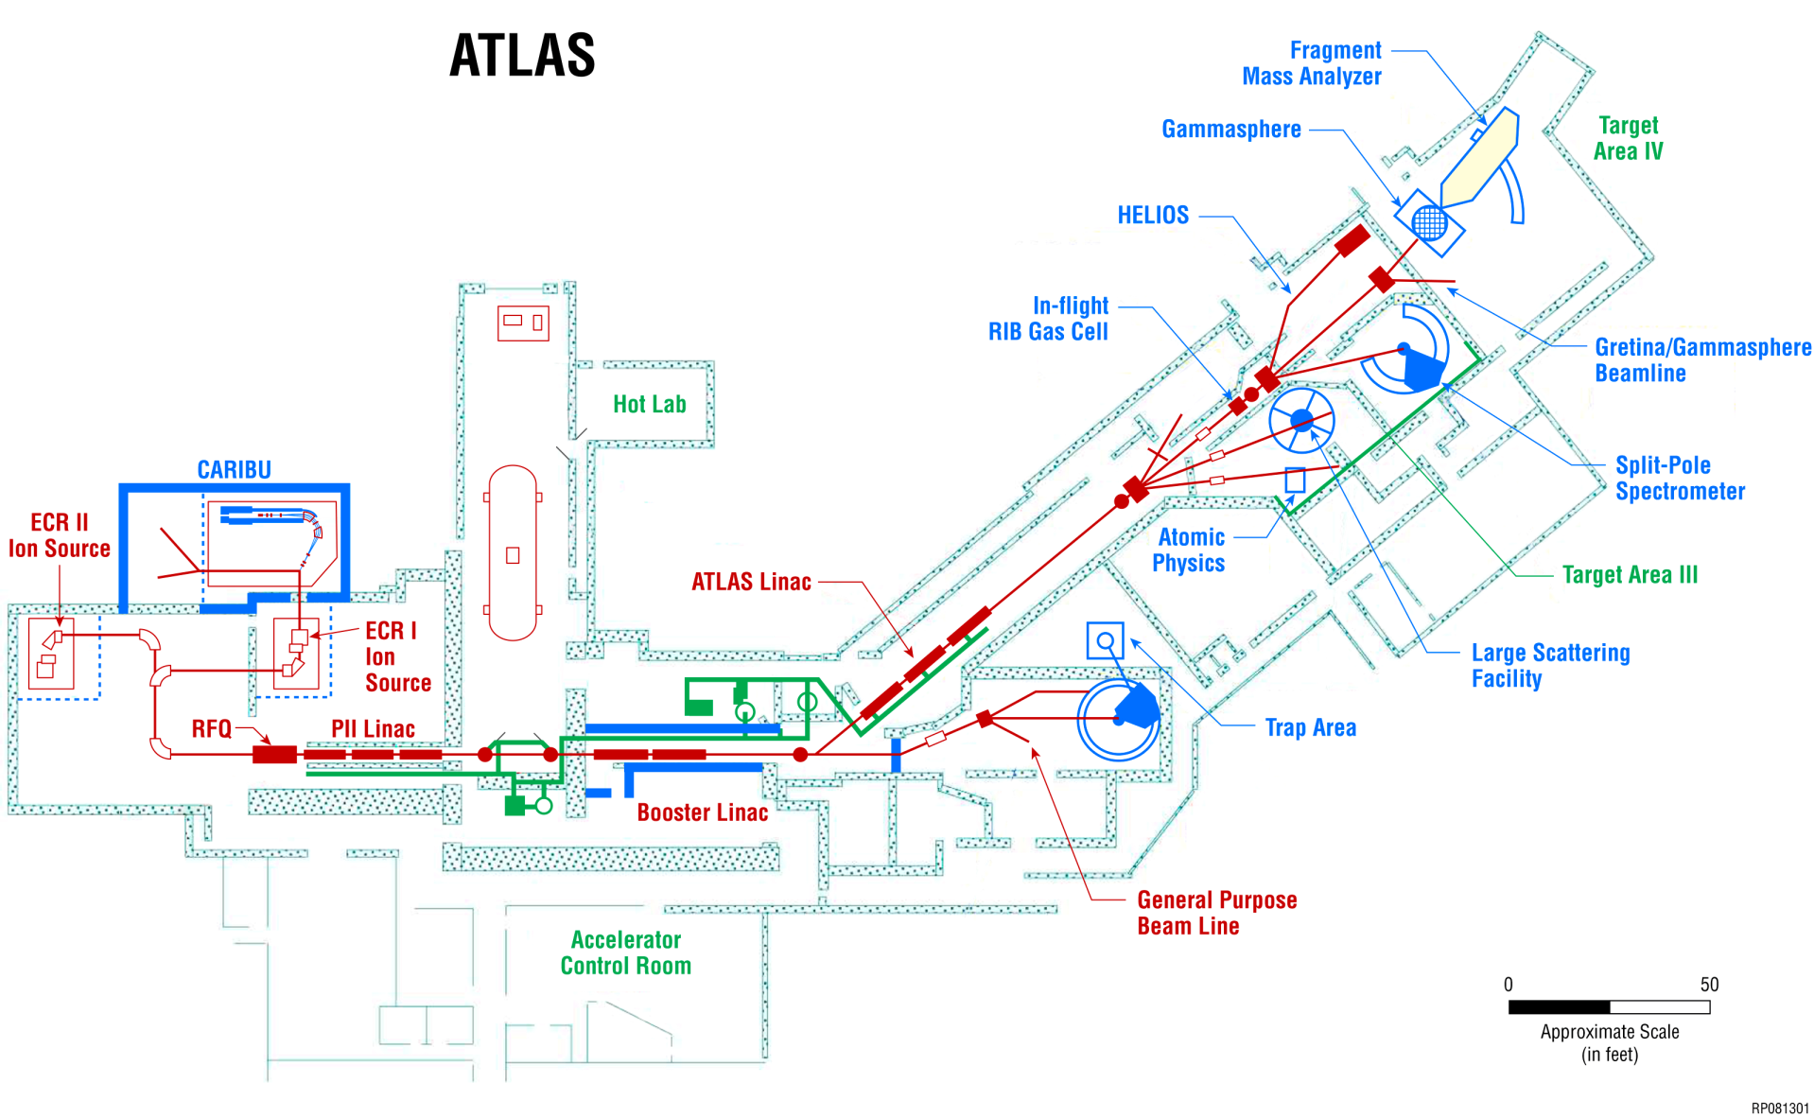
ATLAS Upgrade Activities: Two Phases
Improved transmission
Good high current performance
Phase I
January 2013
Phase II
March 2014

Slide 4
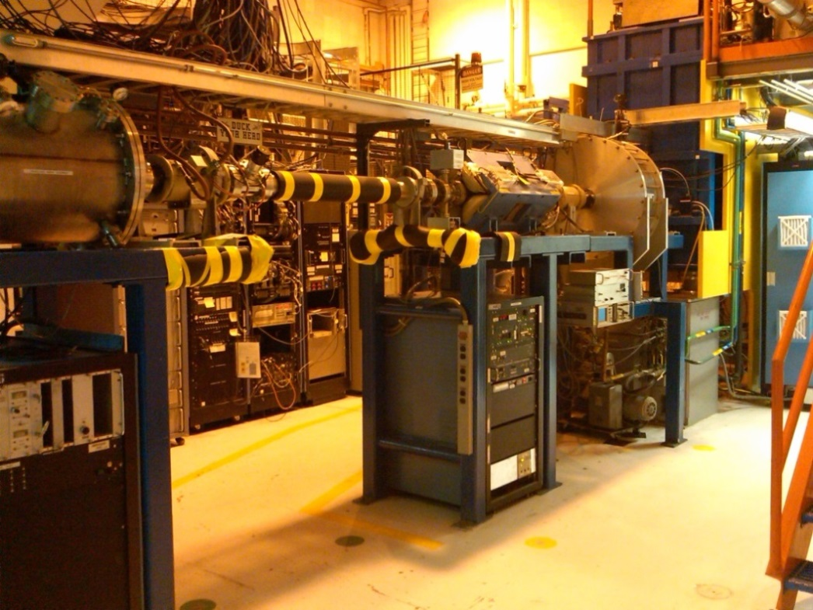
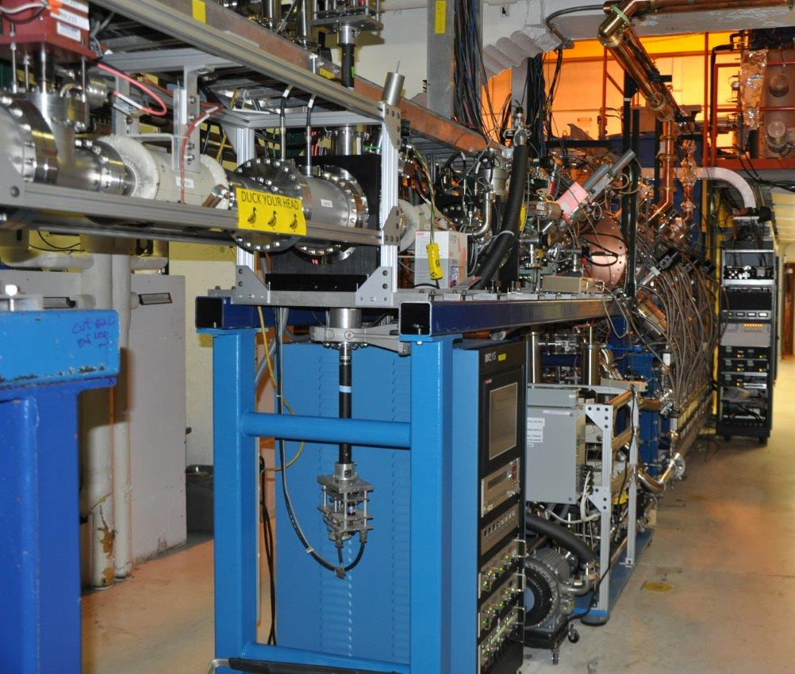
ATLAS Upgrade Project – Two Major Phases
Phase I: Replace first three linac resonators with new RFQ linac section
Completed in January 2013
Ran accelerator from January to May 2013
Included March 2013 MANTRA test run
Excellent overall performance
Planned improvements
Circulators to protect RF Amplifiers at high power
Full computer control and monitoring
Before After

Slide 5
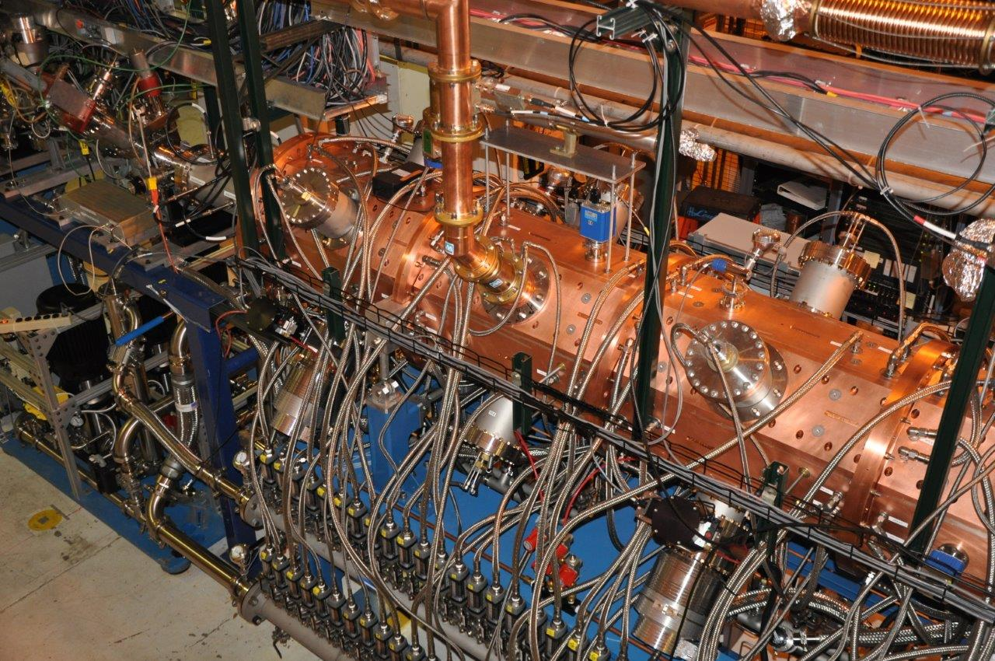
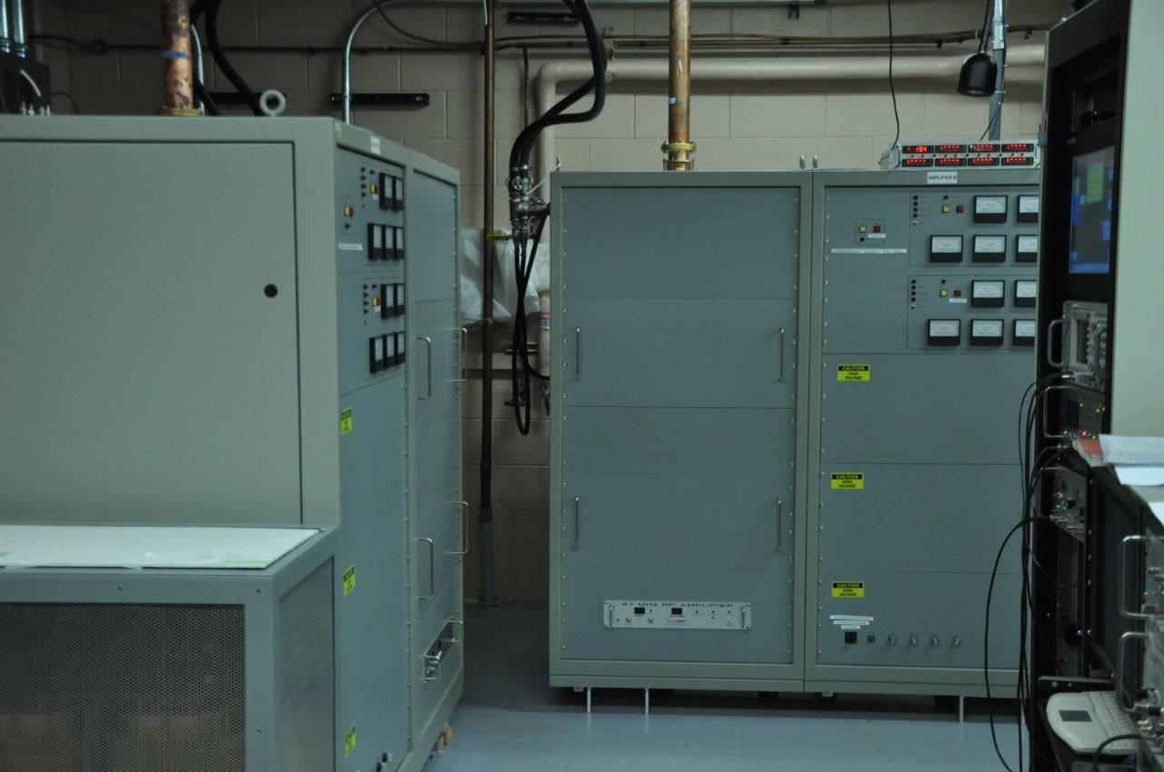
Top view of new RFQ Linac

Slide 6
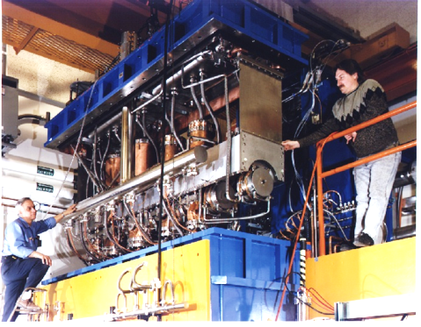
PII cryostat reconfiguration
RFQ output energy is 293 keV/u
First three PII resonators have bad effect on beam optics
Therefore these resonators were retired from use in PII
Beam

Slide 7
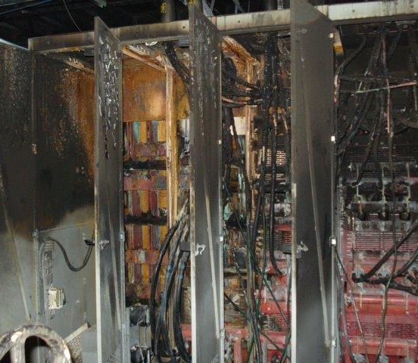
Phase II: Center (“Booster”) Section Rebuild
Accelerator shutdown began in last days of May 2013
Early start due to complete failure of major ATLAS Power Substation
Relatively new substation
Loose high-current connectors (???)
Full power restored in October 2013
Complete disassembly and rebuild of the center of the accelerator
New cryostat of seven resonators (7 new resonators replaced 16 old resonators)
World-record accelerating field performance
Restart of facility began in January 2014
PII beam acceleration and low-energy irradiation.
“Full” operation restored March 2014
Over $1M total cost to Laboratory

Slide 8
ATLAS Upgrade Activities: Second Phase New Booster Cryostat and complete Booster Rebuild
Phase I
Phase II

Slide 9
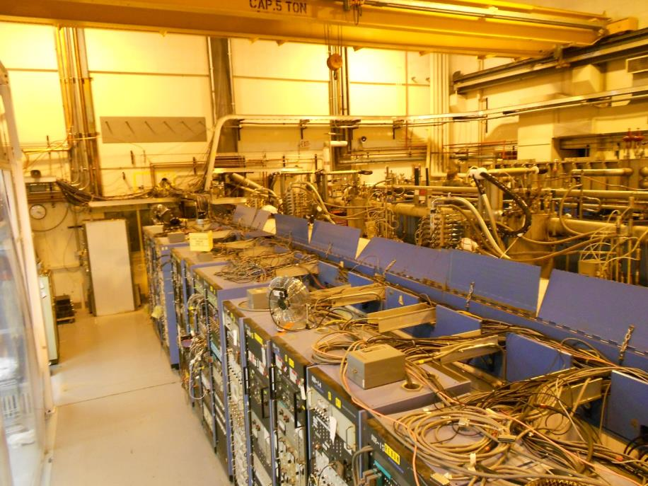
Before Project “Booster” Room
Booster Room June 10, 2013

Slide 10
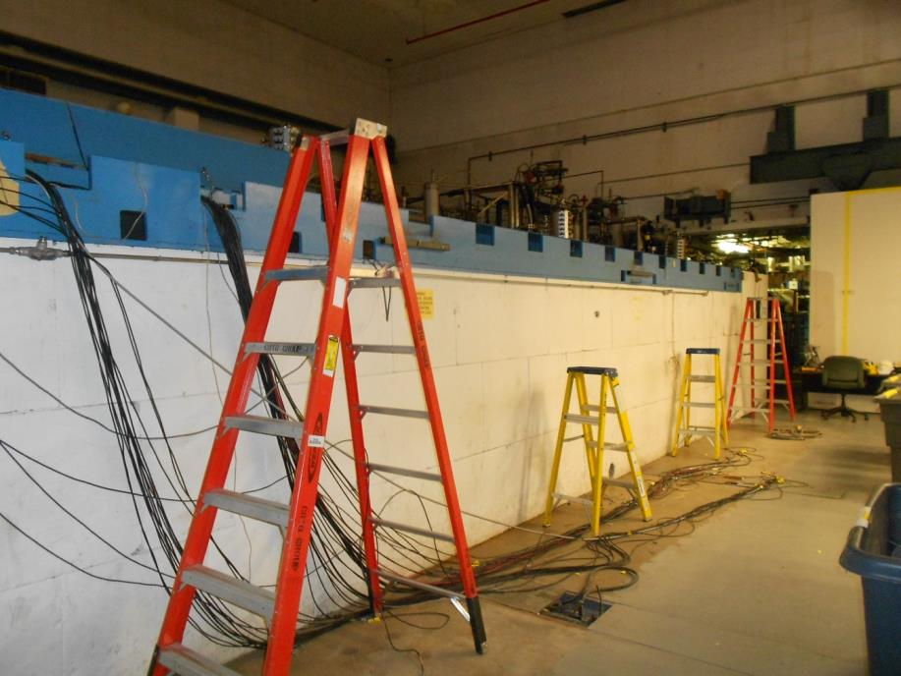
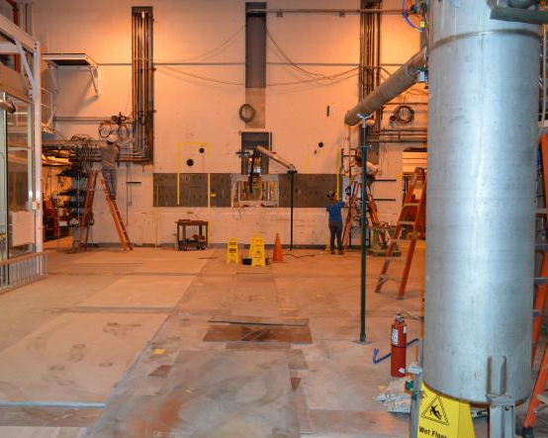
Booster Upgrade Progress
June 12, 2013 August 8, 2013

Slide 11
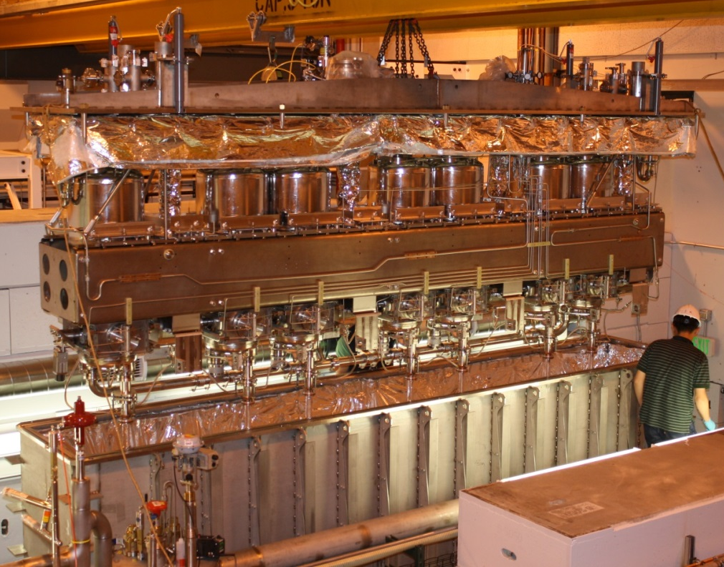
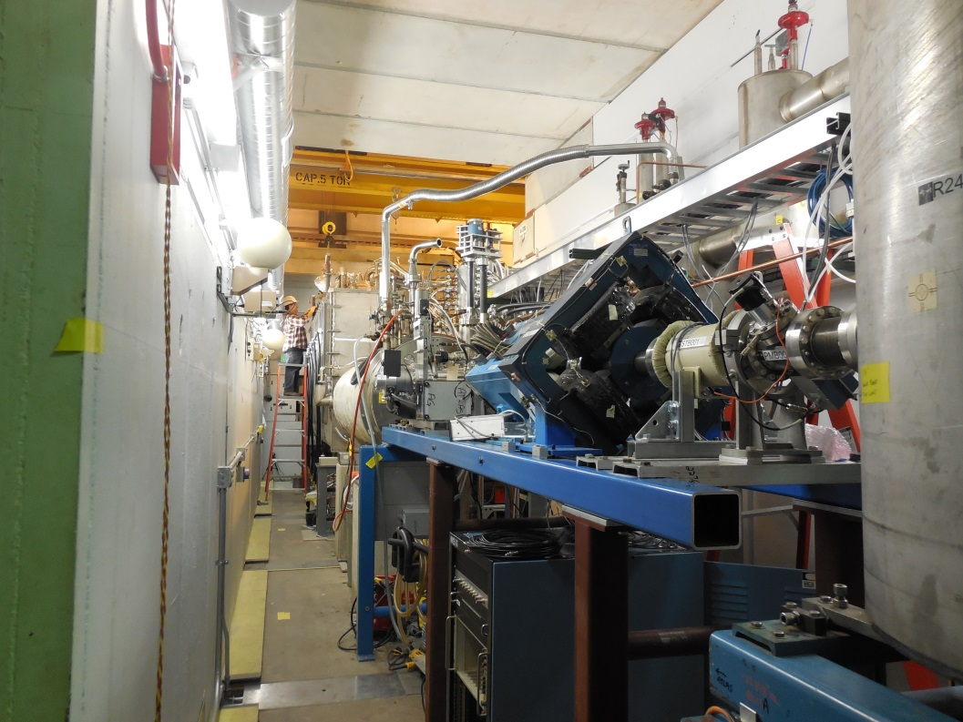
Phase II: Center (“Booster”) Section Rebuild
November 2013 January 2014

Slide 12
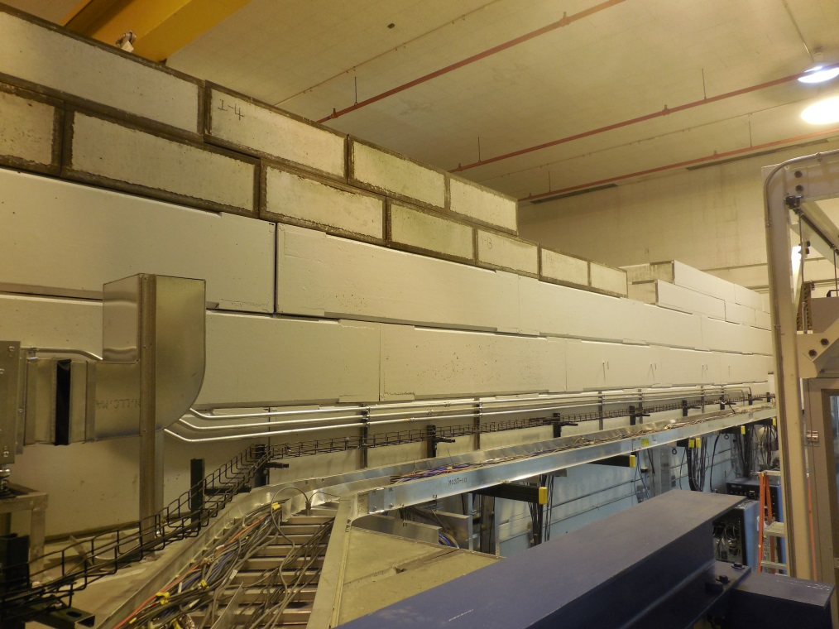
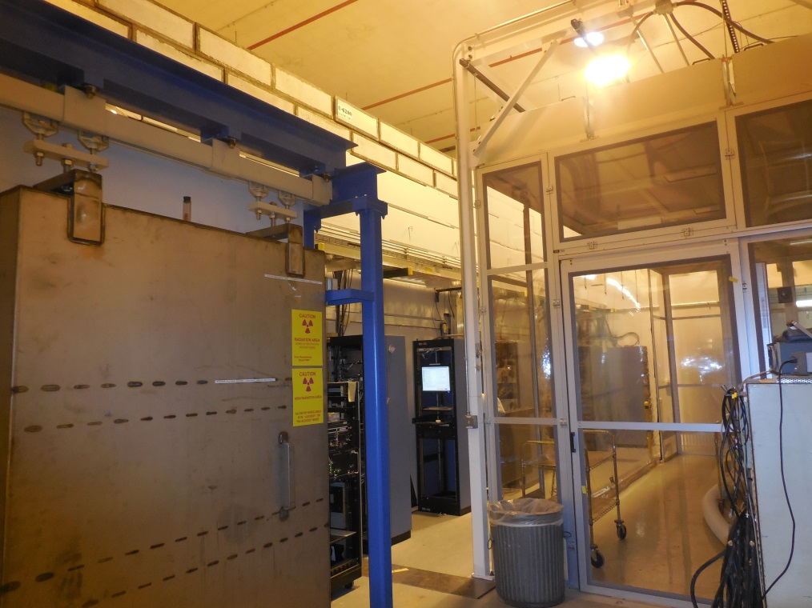
Phase II: Center (“Booster”) Section Rebuild
March 2014 April 2014

Slide 13
Facility Configuration Changes
Tandem now retired
All beam lines disconnected
Beginning the process of SF₆ disposal
One lab interested in entire tandem system
Tandem vault plans
South section for ATLAS operation
North section for ion source and Accelerator R&D Development
Central section for expanded stopped beam research area
Ion Source and Accelerator Dev.
New low-energy experimental area
ATLAS Operations
EBIS

Slide 14
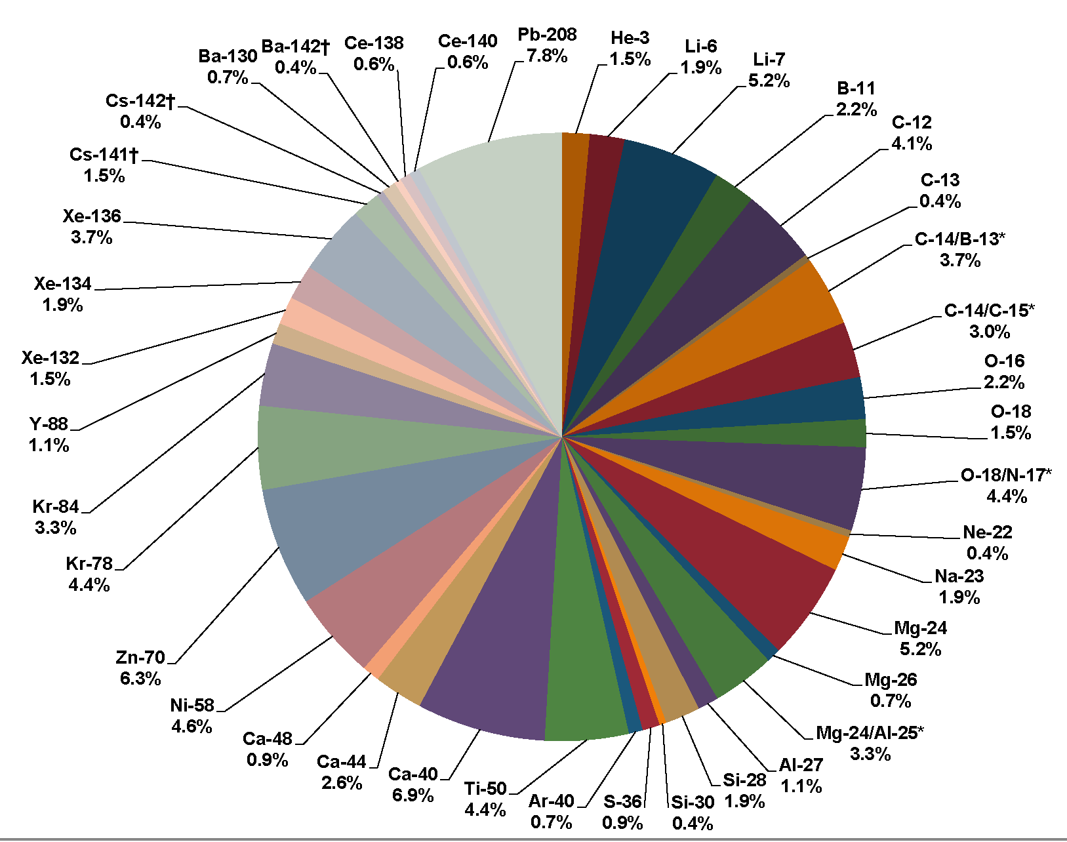
ATLAS Present Beam Properties
ATLAS Beams for FY2012
Beam Types
Any stable isotope beam available
In principle.
See ATLAS website for current ‘normal’ list.
In-flight Radioactive Beams
Charge exchange, 1-2 nucleon transfer.
20 isotopes produced so far.
Poorer beam quality than stable ions
Purity
Energy spread
Emittance and beam size
CARIBU Fission Fragment Beams
Goal of routine operation by end of 2014.
Beam properties same as stable ions
See later talk on overall status.
High Current performance
Long term goal measured in pμA at target (eventually ~10 pμA )
Recently demonstrated up to 7 pμA through PII

Slide 15
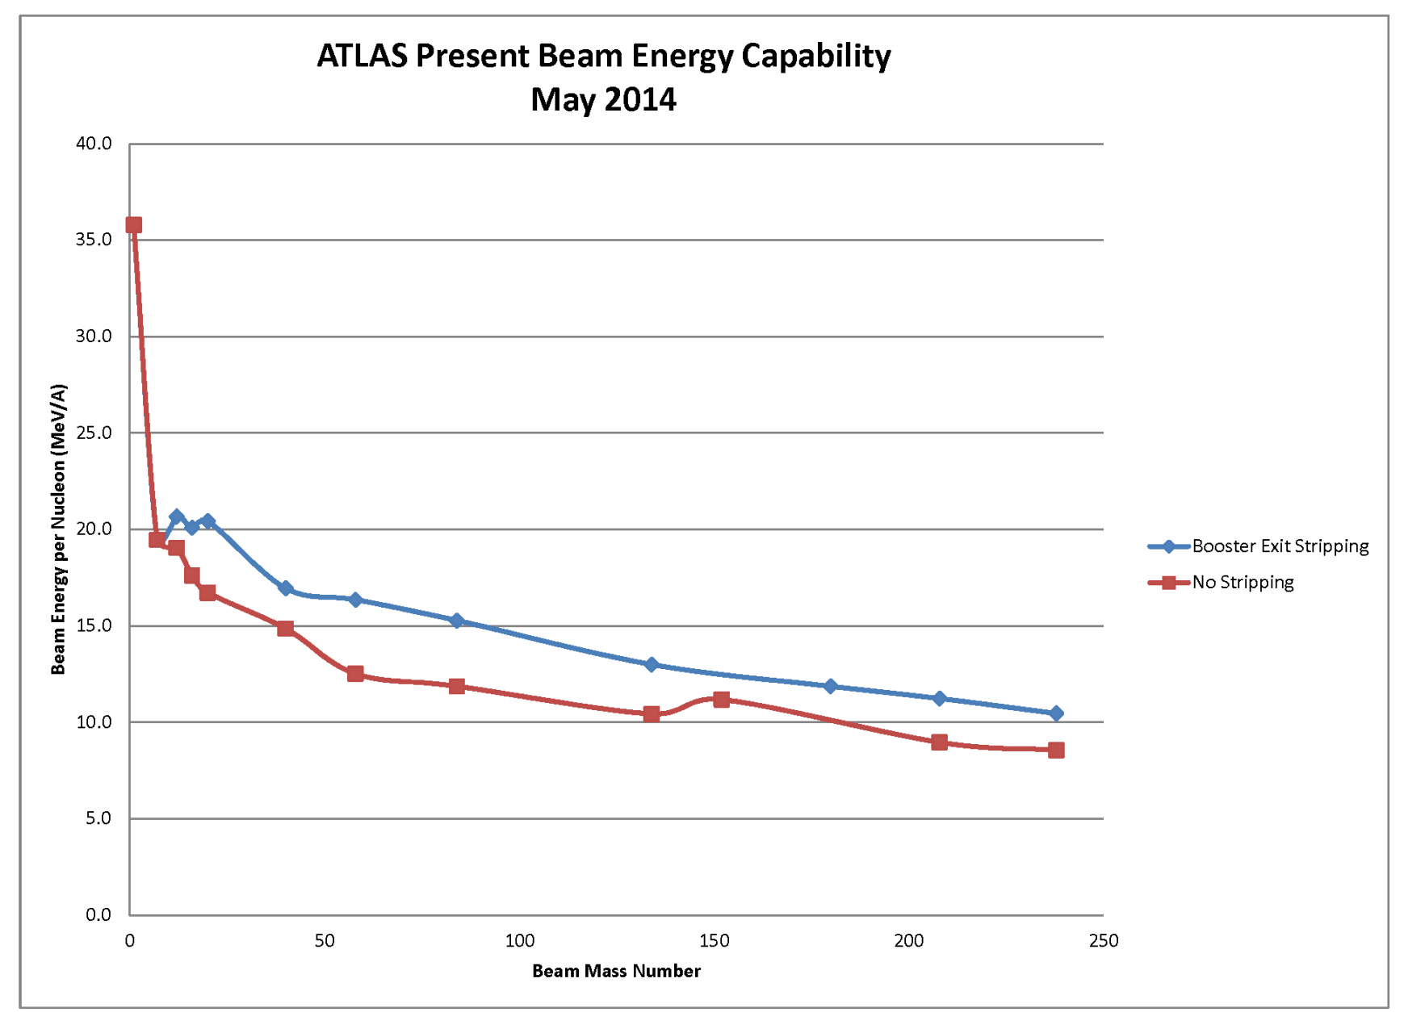
Available Beam Energy
*
* ATLAS Operations Envelope limits all beams to energy < 23 MeV/A

Slide 16
Summary
ATLAS has now returned to full technical operation
All major capabilities are now available
Some further improvements are ongoing
Major facility improvements underway or actively planned:
AGFA
EBIS (and move of RF test facility)
AIRIS
Tandem removal and changes to vault
Four new operators are in training
Limits operation to 5.33 days/week
Additional operating time should be possible in July.
Full staff restored by October 2014.

