Slide 1
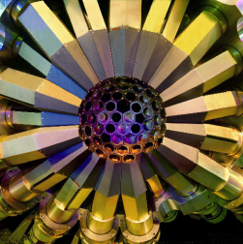
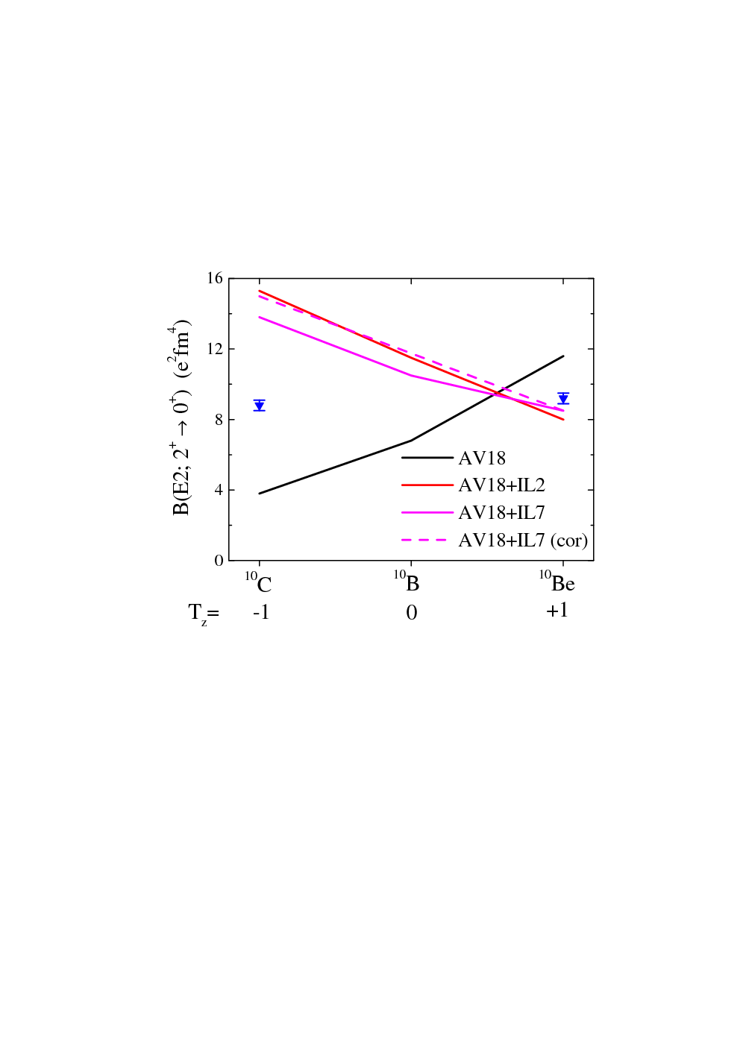
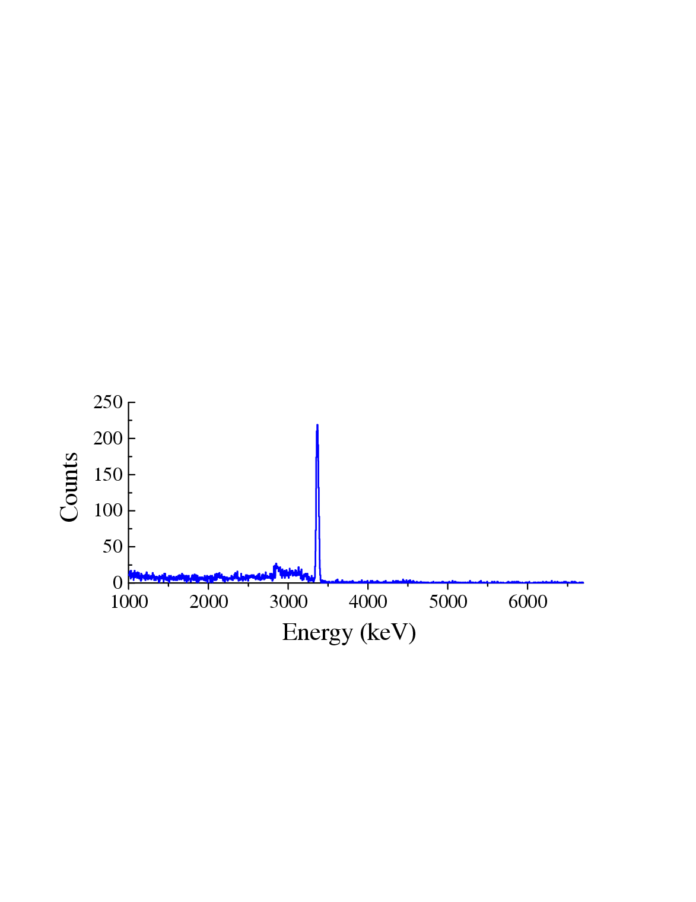
Precision Lifetime Measurements (DSAM)
to Test Ab-initio Calculations
Ion
Q2
Q3
Q4
chamber
ED1
ED2
MD1
PPAC

Slide 2
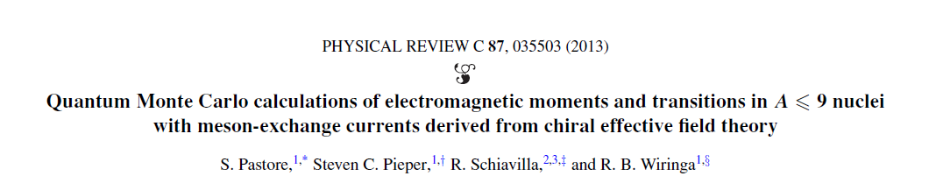
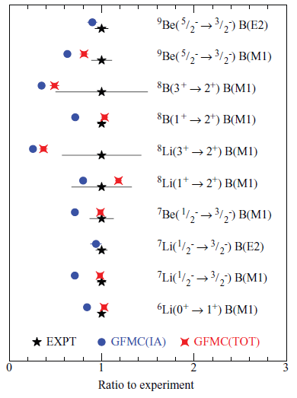
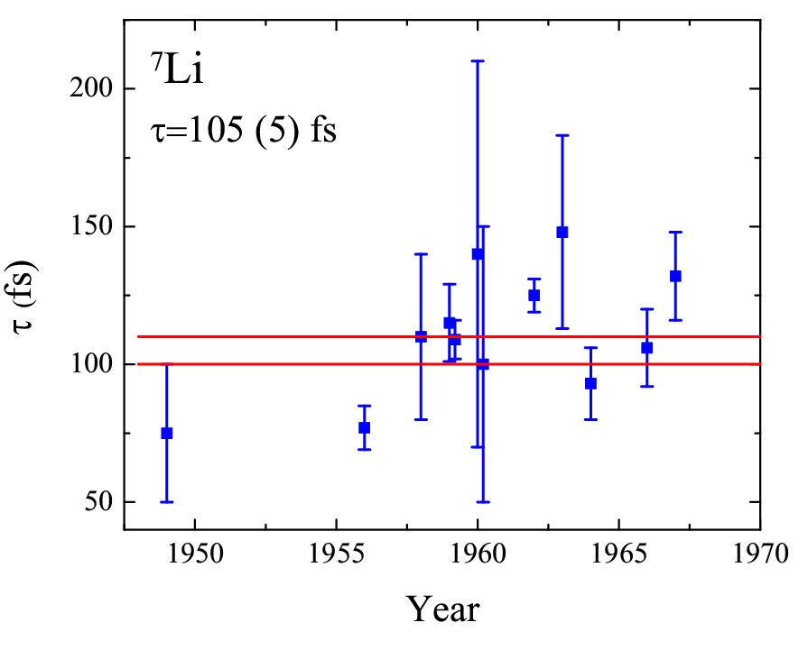
The Next Step : M1 strengths

Slide 3
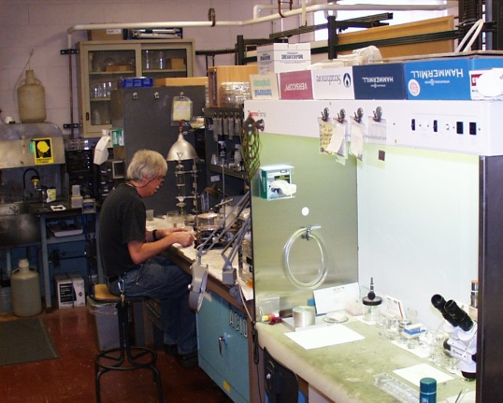
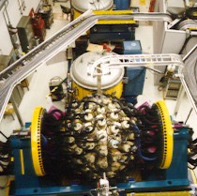
Requirements
Targets
Multiple and well-characterized :
needed to pin down systematic uncertainties
Exotic? Like tritium doped:
(t,p) reactions to push to more neutron-rich
Gammasphere+FMA
Recoil detection
Necessary to define recoil-velocity vector
High granularity, high efficiency γ-ray detection
large number of recoil-γ ray angles helps to reduce uncertainties

