Slide 1
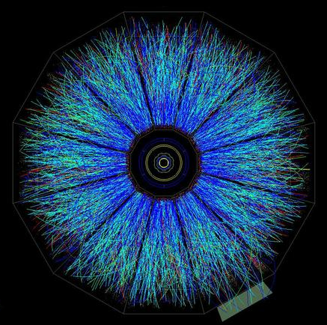
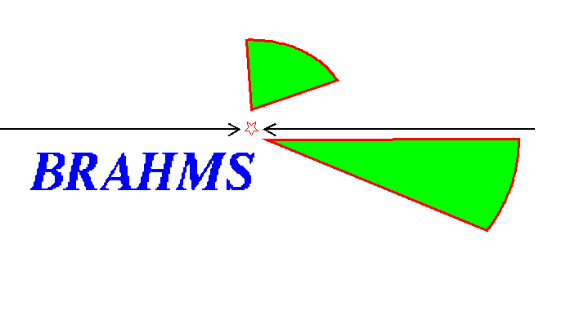


RHIC Measurements and EIC Extensions
M. Grosse Perdekamp, UIUC
STAR
Workshop on Nuclear Chromo-Dynamic Studies with a Future Electron Ion Collider
Argonne National Laboratory April 7^{h}–9th 2010
Final State
of a Au-Au
Collision at RHIC

Slide 2
RHIC: Why Study Nuclear Effects in Nucleon Structure?
General interest:
Extend Understanding
of QCD into the non-
perturbative regime.
Search for universal properties of nuclear
matter at low x and high
energies.
Heavy Ion Collisions:
Understand the initial state to obtain quantitative
description of the final state
in HI-collisions.
➔ Gain correct interpretation of experimental data.

Slide 3
Understand the Beginning to Know the End
A-A Collisions at RHIC and the Initial State
  Elliptic flow, J/ψ
  Studying the Initial State in d-A Collisions
    Hadron cross sections, hadron pair correlations
Outlook: EIC
observed final state
initial state
partonic
matter
hadronization
Au
Au
time

Slide 4
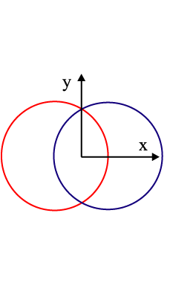
If Matter in A-A Governed by Hydrodynamics ➔ Azimuthal Anisotropy: Elliptic Flow v₂
nucleus, A
nucleus, A
Almond shape nuclear overlap region in coordinate space
Pressure
Anisotropy in momentum space
v₂: 2nd harmonic Fourier coefficient in dN/dφ with respect to the reaction plane

Slide 5
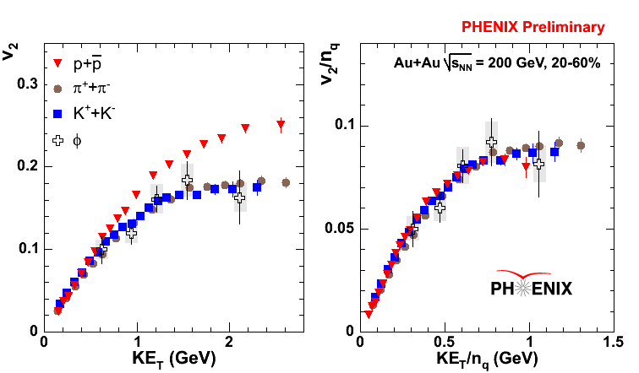
Elliptic Flow v₂: Among Key Evidence for Formation of Partonic Matter at RHIC
baryons
mesons
Early thermalization
Strongly interacting
Quark dofs, v₂/n_{q} scales
Does the quantitative
interpretation depend of
v₂ depend on the initial state ?

Slide 6
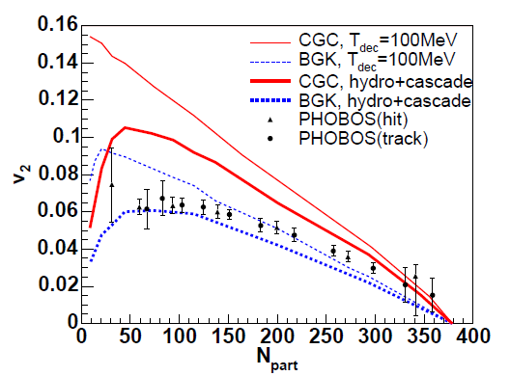
Elliptic Flow v₂ : Choice of Initial State has Significant Impact on Hydro Calculations
PHOBOS v₂ vs Hydro Calculations
Color Glass Condensate
Brodsky-Gunion-Kuhn Model
Phys.Rev.Lett.39:1120
➔
Knowledge of the initial
state is important for the
quantitative interpretation
of experimental results in
heavy ion collisions!
T. Hirano, U. Heinz, D. Kharzeev,
R. Lacey, Y. Nara
Phys.Lett.B636:299-304,2006
Notes:
The lines on the figure are model calculation
purple line is electron v2 assume coalescence of thermal charm quark and u quark
black line is AMPT result which assume larger cross section
blue band is electron v2 assume resonance state of D & B
Those model is consistent with the result
indicate quark level thermalization & strong coupling

Slide 7
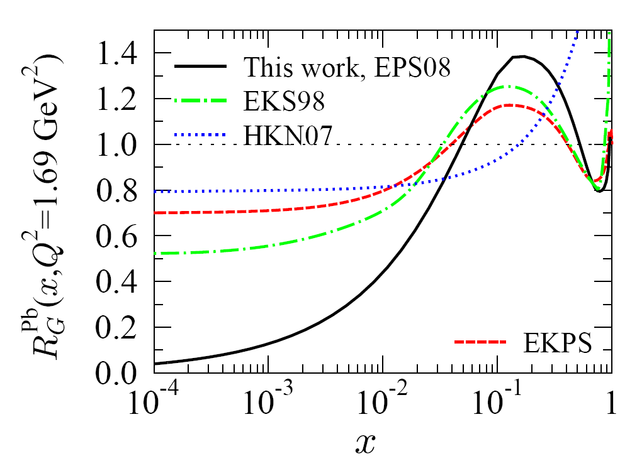
J/ψ Production: Some Relevant Cold Nuclear Matter Effects in the Initial State
(I) Shadowing from fits to DIS
or from coherence models
(II) Absorption (or dissociation)
of into two D mesons by
nucleus or co-movers
R_{G}^{Pb}
(III) Gluon saturation from non-linear
gluon interactions for the high
gluon densities at small x.
K. Eskola H. Paukkumen, C. Salgado
JHEP 0807:102,2008
➔ DGLAP LO analysis of nuclear pdfs
low x
high x
G^{Pb}(x,Q²)=R_{G}^{Pb}(x,Q²) G_{p}(x,Q²)

Slide 8
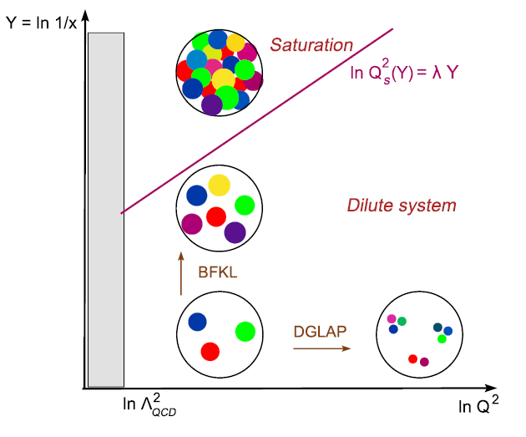
III) cont’d →The Color Glass Condensate
see for example, F. Gelis, E. Iancu, J. Jalilian-
Marian, R. Venugopalan, arXiv:1002.0333
CGC: an effective field theory:
Small-x gluons are described as the
color fields radiated by fast color
sources at higher rapidity. This EFT
describes the saturated gluons (slow
partons) as a Color Glass Condensate.
The EFT provides a gauge invariant,
universal distribution, W(ρ):
W(ρ) ~ probability to find a
configuration ρ of color sources
in a nucleus.
The evolution of W(ρ) is described by
the JIMWLK equation.
gluon density saturates for
large densities at small x :
Non-linear evolution eqn.
diffusion
g emission
g-g merging
g-g merging large if
saturation scale
Q_{S}, nuclear enhancement ~ A^{1/3}

Slide 9
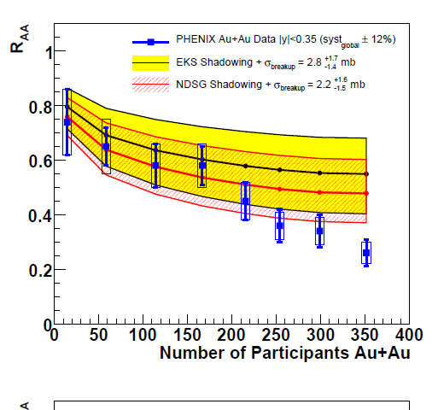
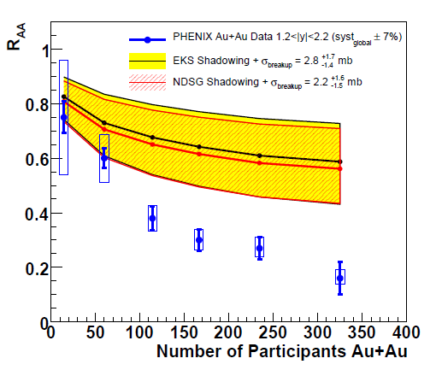
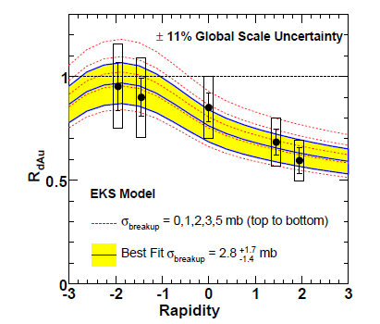
J/ψ : Most of the Suppression in A-A is from Cold Nuclear Matter Effects found in d-A Collisions
EKS shadowing + dissociation:
use d-Au data to determine
break-up cross section
EKS shadowing + dissociation:
from d-Au vs Au-Au data
at forward-rapidity
EKS shadowing + dissociation:
from d-Au vs Au-Au data
at mid-rapidity
PRC 77,024912(2008)
& Erratum: arXiv:0903.4845

Slide 10
Nucleon Structure in Nuclei Using d-Au Collisions at RHIC
Motivation:
Characterize initial state in heavy ion collisions.
Probe gluon distributions at low x and high parton densities
(in nuclei).
Signatures of saturation include suppressions of cross sections in d-Au collisisions compared to pp at forward rapidity:
R_{dA}(p_{T}), R_{cp}(p_{T}), and suppression of di-hadron yields I_{dA}(p_{T})

Slide 11
Suppression of Cross Sections in Forward Direction:
Sufficient Evidence for Saturation Effects in the Gluon Field in the Initial State of d-Au Collisions at RHIC?

Slide 12

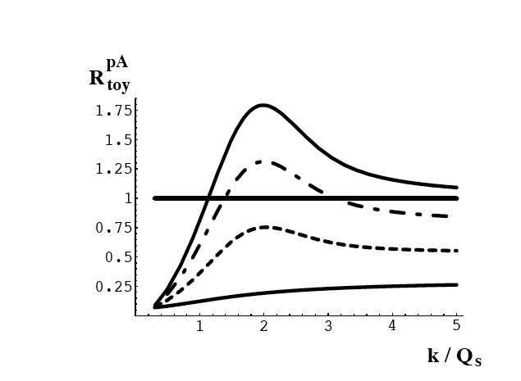
Quantification of Nuclear Modification for Hadron Spectra in d-Au Collisions
Nuclear
Modification
Factor:
R_{dA}
CGC-based expectations
Kharzeev, Kovchegov, and Tuchin, Phys.Rev.D68:094013,2003
rapidity, y
p_{T}

Slide 13
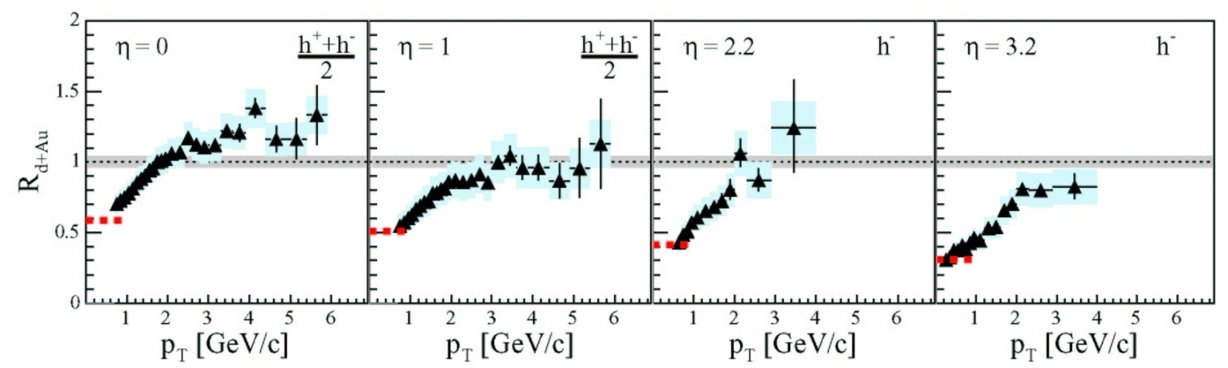
BRAHMS d+Au Cross Sections Decrease with
Increasing Rapidity and Centrality
BRAHMS, PRL 93, 242303
R_{dAu}
Hadron production is suppressed at large rapidity
consistent with saturation effects at low x in the
Au gluon densities → CGC

Slide 14

Similar Results from
STAR, PHENIX and PHOBOS
PRL 94, 082302
Suppression in the d direction and enhancement in the Au fragmentation region
d → x₁
Au → x₂
x₁ >> x₂ for forward particle, x_{g} = x₂ → 0

Slide 15
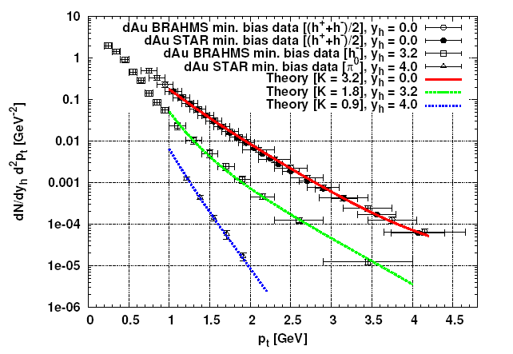
Theory vs Data ➔ CGC Inspired
Dumitriu, A. Hayashigaki,
J. Jalilian-Marian
Nucl. Phys. A770 57-70,2006
Not bad! However, large K factors, rapidity dependent.

Slide 16
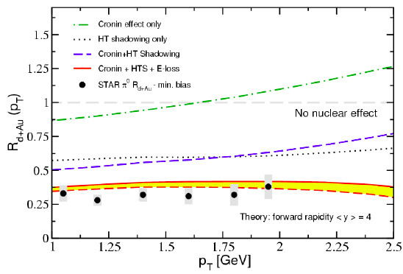
Theory vs Data ➔ Cronin + Shadowing + E-loss
I.Vitev, T. Goldman, M.B. Johnson,
JW. Qiu, Phys. Rev. D74 (2006)
Not bad either!
➔ R_{dA} results alone do not uniquely demonstrate gluon saturation. Additional data & different observables will be needed.

Slide 17
Rapidity Separated di-Hadron Correlations:
Physics idea + detector upgrades
First Results

Slide 18
Probing for Saturation Effects with
Hadron-Hadron Correlations in d+Au
Experimental signature:
Observe azimuthal correlation
between hadrons in opposing
hemisphere separated in rapidity
widening of correlation width of
d-Au compared to pp?
reduction in associated yield
of hadrons on the away site
p_{T} is balanced by many gluons
dilute parton system, deuteron
dense gluon
field , Au
Idea:
Presence of dense gluon field in the Au nucleus leads to multiple scattering and parton can distribute its energy to many scattering centers ➔ “Mono-jet signature”. D. Kharzeev, E. Levin, L. McLerran, Nucl.Phys.A748:627-640,2005

Slide 19
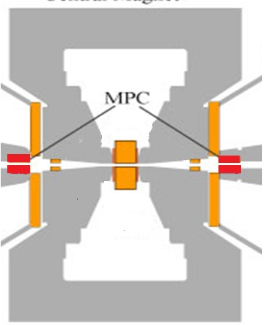
New Forward Calorimeters in PHENIX and STAR for the Measurement of di-Hadron Correlations
PHENIX central spectrometer magnet
Muon Piston Calorimeter (MPC)
d
π⁰ or clusters
Au
Backward direction (South) ←
Forward direction (North) →
π⁰ or h^{+/-}
Side View

Slide 20
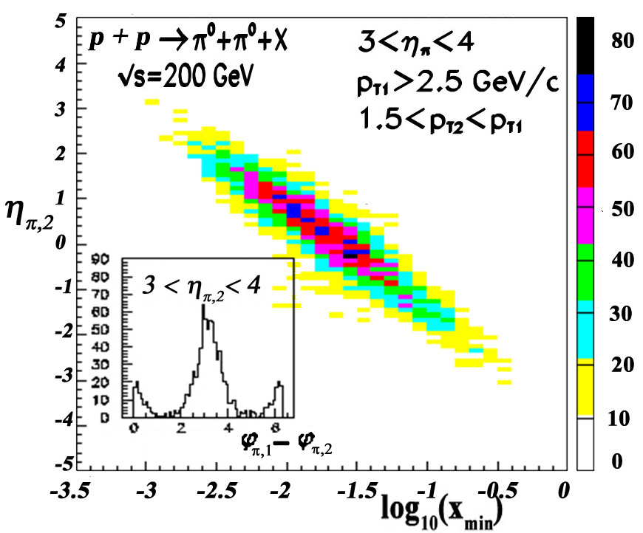
Probing Low x with Correlation Measurements for Neutral Pions
PYTHIA p+p study, STAR, L. Bland
Trigger forward π⁰
Forward-forward di-hadron
correlations reach down
to <x_{g} > ~ 10⁻³
With nuclear
enhancement x_{g} ~ 10⁻⁴
FMS
TPC
Barrel EMC
η^{asso} gives handle on x_{gluon}
FTPC

Slide 21
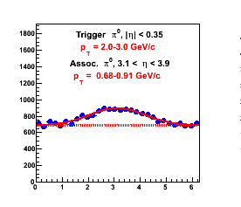
Correlation Function CY and I_{dA}
For example:
Trigger particle: π⁰ with |η| < 0.35
Associate particle: π⁰ with 3.1 < η < 3.9
Peripheral d-Au Correlation Function
Δφ

Slide 22
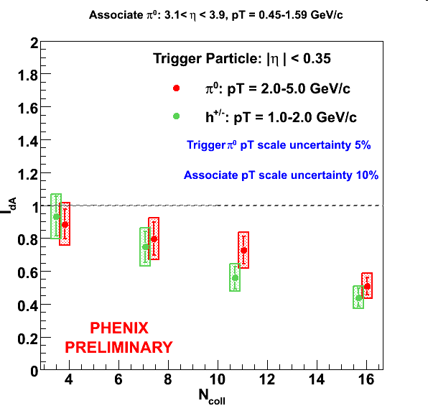
Forward/Central I_{dA} vs N_{coll}
Associate π⁰: 3.1 < η < 3.9, 0.45 < p_{T} < 1.6 GeV/c
Increasing suppression of I_{dA} reaches a factor 2 for central events
Model calculations are needed to distinguish between different models
  Saturation
  Shadowing
  Others ?

Slide 23
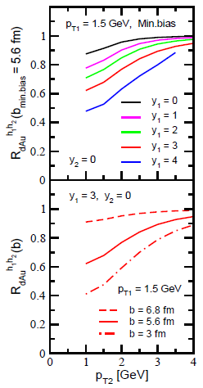
Alternative Explanation of Rapidity-Separated
di-Hadron correlations in d+Au
Complete (coherent + multiple elastic scattering) treatment of multiple parton scattering gives suppression of pairs with respect to singles for mid-rapidity tag!
However, small for forward trigger particle!
J. Qiu, I. Vitev, Phys.Lett.B632:507-511,2006

Slide 24
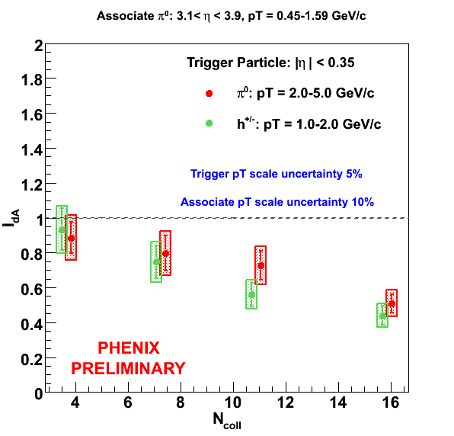
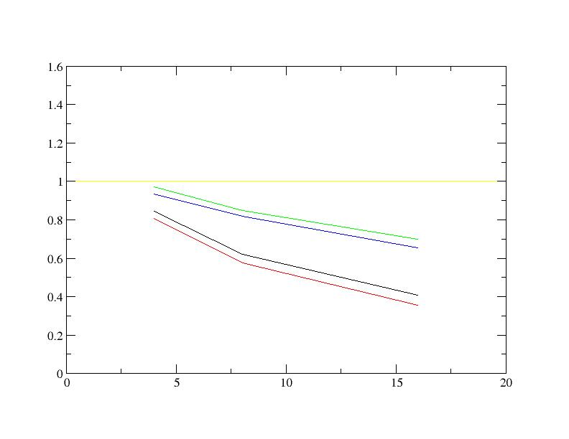
Private Comunication from Ivan Vitev after QM 2009
Extend analysis to
forward-forward
correlations to reach
lower x ➔ STAR !

Slide 25
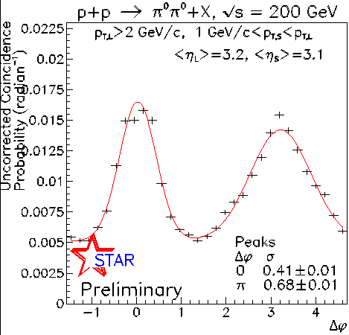
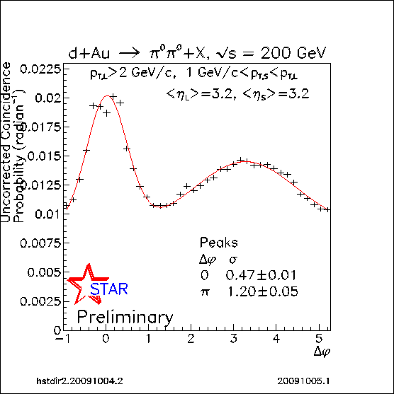
STAR Run8 FMS :
π⁰ Forward - Forward Correlations
pp data
(rad)
dAu data
(rad)
Strong azimuthal broadening from pp to
dAu for away side, while near side remains unchanged.
σ(dAu)-σ (pp)=0.52±0.05

Slide 26
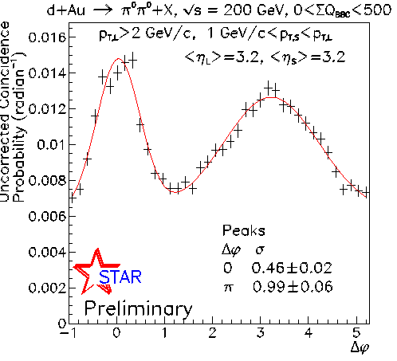
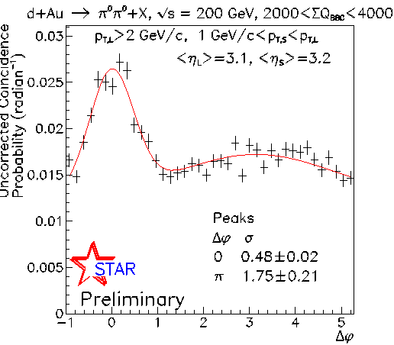
Centrality Dependence
dAu all data
dAu peripheral
Azimuthal decorrelations show significant dependence on centrality!
dAu central

Slide 27
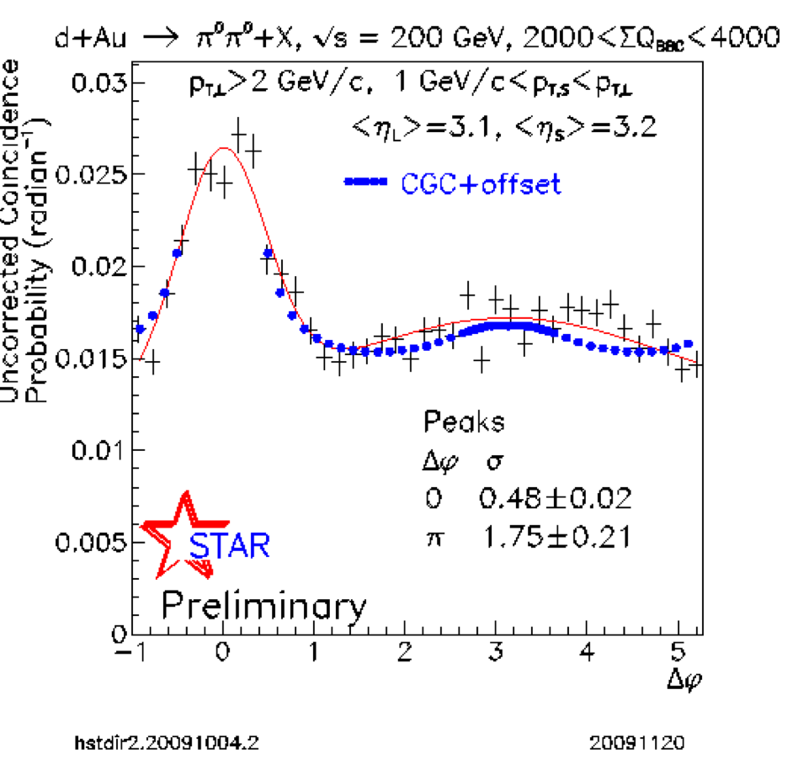
Comparison to CGC prediction
CGC prediction
for b=0 (central)
by Cyrille Marquet
Nucl.Phys.A796:41-60,2007
dAu Central
Strong suppression of away
side peak in central dAu is
consistent with CGC prediction

Slide 28
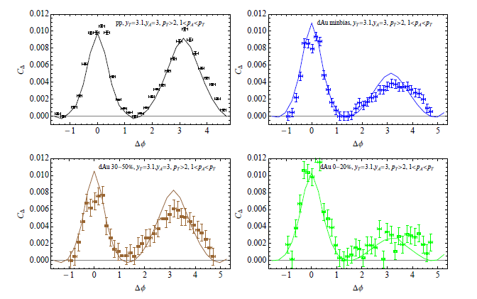
CGC Calculations K. Tuchin arXiv:09125479
dAu
pp
dAu-peripheral
dAu-central

Slide 29
EIC: 4 Key Measurements in e+A Physics
• Momentum distribution of gluons in nuclei?
Extract via scaling violation in F₂
Direct Measurement: F_{L} ~ xG(x,Q2)
Inelastic vector meson production
Diffractive vector meson production
• Space-time distribution of gluons in nuclei?
Exclusive final states
Deep Virtual Compton Scattering
F₂, F_{L} for various impact parameters
• Role of colour-neutral (Pomeron) excitations?
Diffractive cross-section
Diffractive structure functions and vector meson productions
Abundance and distribution of rapidity gaps
• Interaction of fast probes with gluonic medium?
Hadronization, Fragmentation
Energy loss
CGC EFT: will it be possible to carry out a global analysis
of RHIC d+A, LHC p+A and EIC e+A to extract
W(ρ) and thus demonstrate universality of W(ρ) ?

Slide 30
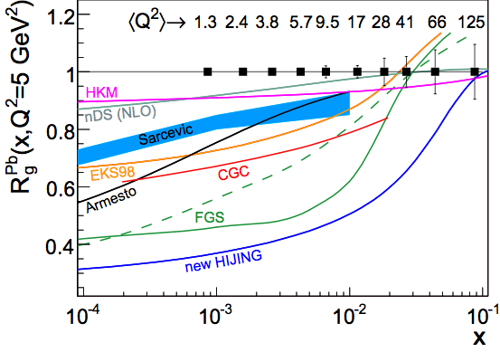
Gluon Distribution from F_{L} at the EIC
e+A whitepaper (2007)
Precise extraction
of G_{A}(x,Q²)
will be able to dis-
criminate between
different models
eRHIC: 10 GeV + 100 GeV/n - estimate for 10 fb⁻¹

Slide 31
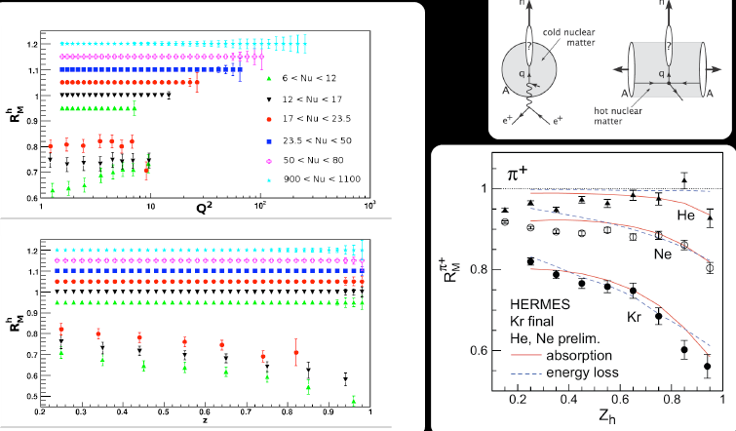
Interaction of Fast Probes with Gluonic Medium

Slide 32
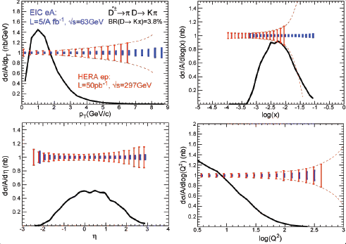
Charm Measurements at the EIC
EIC: allows multi-differential measurements of heavy flavour
Extends energy range of SLAC, EMC, HERA, and JLAB
allowing for the study of wide range of formation lengths

Slide 33
Conclusions
First results from azimuthal angle correlations for rapidity separated di-hadrons with Forward EMCs in STAR & PHENIX
  Suppression and broadening of di-hadron correlations observed in STAR and PHENIX
  CGC calculations in good agreement with forward-
  forward correlations observed in STAR !
EIC will enable precision measurements of G_{A}(x,Q²),
diffractive processes and interaction of fast probes with
possible gluonic medium with good discriminatory power
between different theoretical possibilities.

Slide 34
Backup Slides

Slide 35
Outlook – Run 8 Analysis
CY, widths, I_{dA} and R_{dA} with Forward Calorimeters 3.1 < |η| < 3.9 + High Statistics from 2008 d+Au Run. Update earlier muon arm measurement.
 | South MPC | South Muon Arm | Central Arm | North Muon Arm | North MPC
Particle Detection | π⁰ | h^{+/-} | Identified hadrons | h^{+/-} | π⁰
η_{min} η_{max} | -3.7 -3.1 | -2.0 -1.4 | -0.35 +0.35 | 1.4 2.0 | 3.1 3.9
Phys.Rev.Lett. 96 (2006) 222301
Phys.Rev.Lett. 96 (2006) 222301
Backward/Central
Forward/Central
Forward/Backward
Forward/Forward

Slide 36
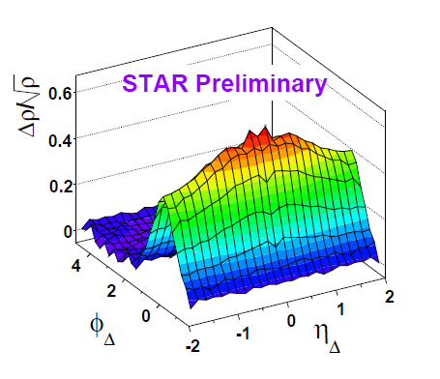
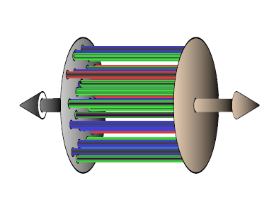
Near Side Long Range Rapidity Correlations
may be Explained through Initial State Flux Tubes
Near side di-hadron correlations
observed in STAR
Possible explanation:
Color flux tubes in the initial state as
predicted in the CGC
Causality requires that correlations
are created very early !
Recent review: J. L. Nagle
Nucl.Phys.A830:147C-154C,2009

Slide 37
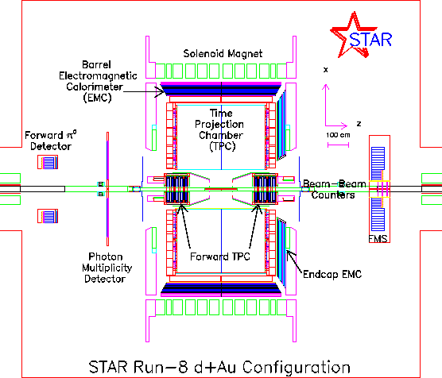
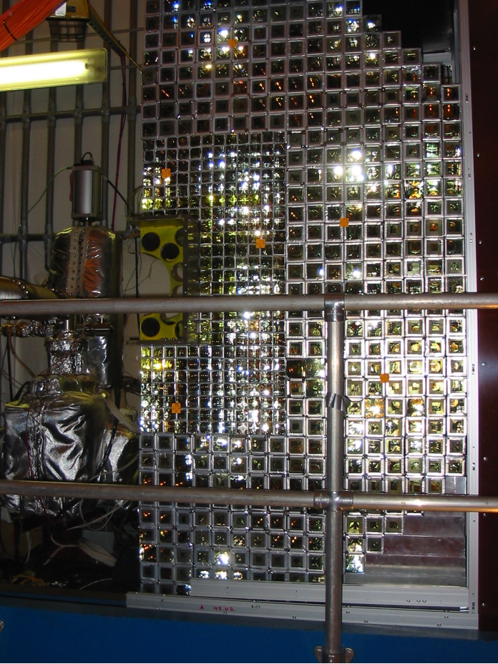
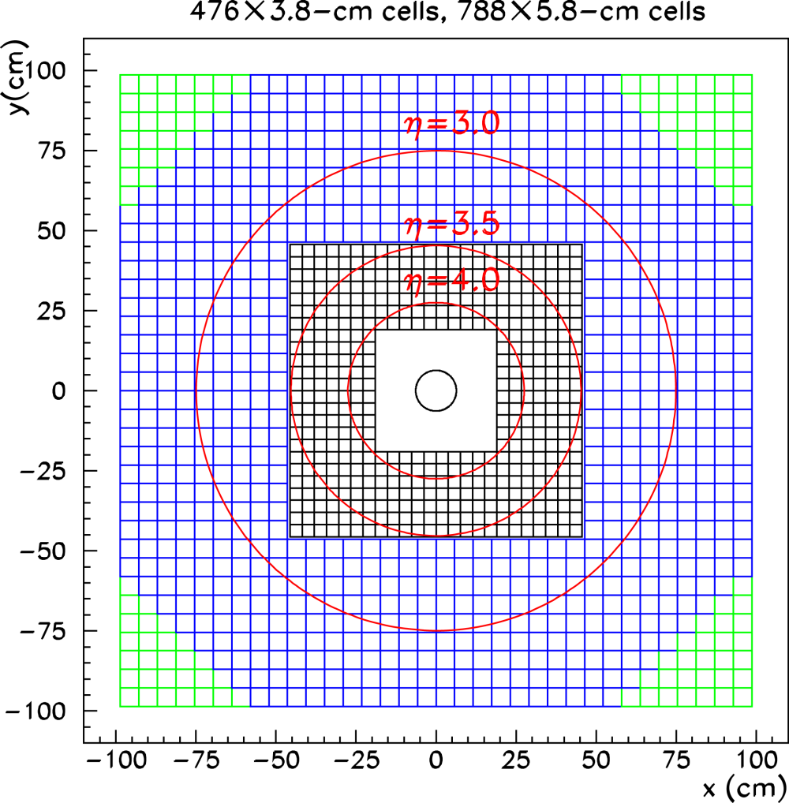
The STAR FMS Upgrade and Configuration for Run 2008
STAR
see A. Ogawa
H2, Sunday 11:57
BEMC: -1.0 < η < 1.0
TPC: -1.0 < η < 1.0
FMS: 2.5 < η < 4.1
Forward Meson Spectrometer (FMS)
Pb-glass EM calorimeter
~x50 more acceptance

Slide 38
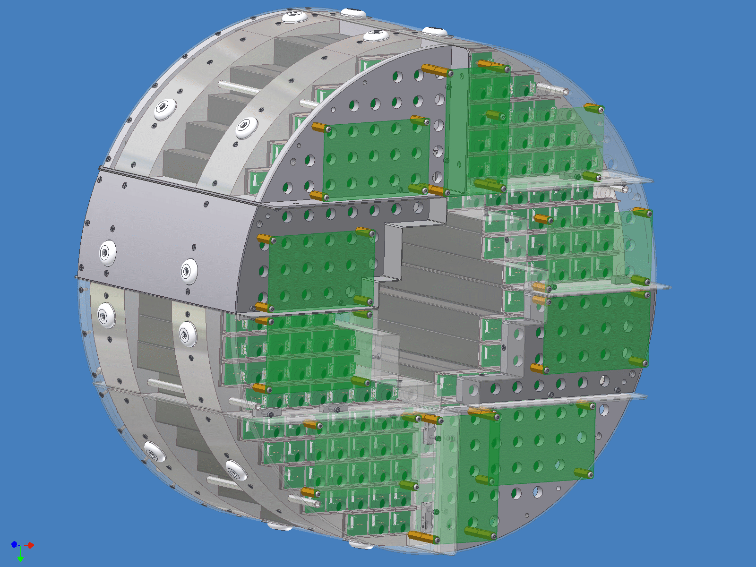
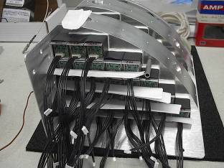
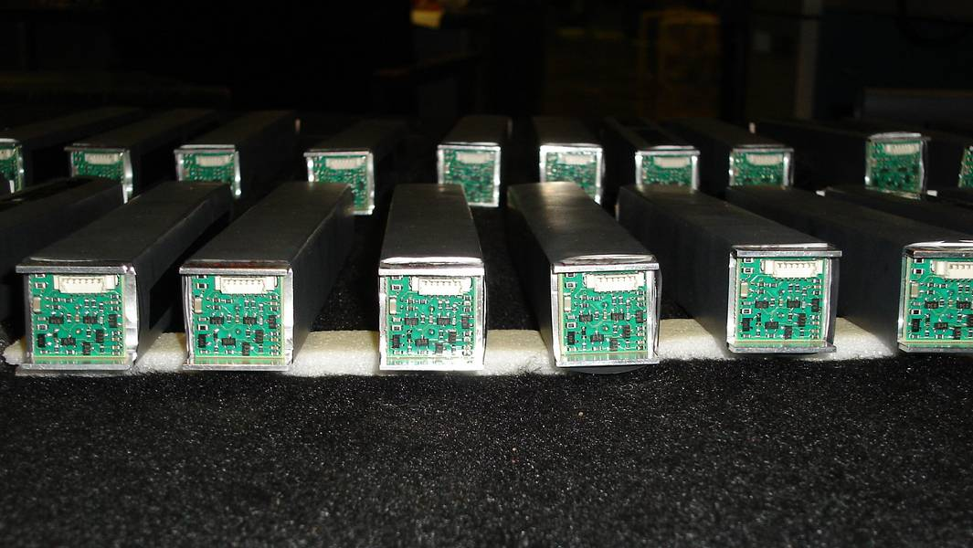
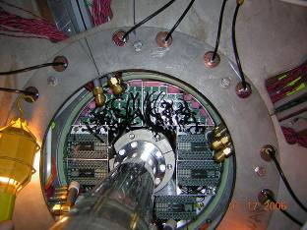
PHENIX Muon Piston Calorimeter
Technology → ALICE(PHOS)
PbWO₄
avalanche photo diode readout
Acceptance:
3.1 < η < 3.9, 0 < φ < 2π
-3.7 < η < -3.1, 0 < φ < 2π
Both detectors were installed for 2008 d-Au run.
Assembly at UIUC
PbWO4 + APD + Preamp
MPC integrated in the
piston of the muon
spectrometer magnet.

Slide 39
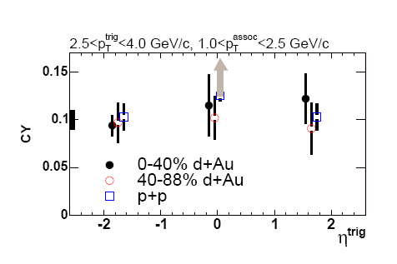
I_{dAu} from the PHENIX Muon Arms
p_{T}ª, h^{+/-}
Observations at PHENIX using the 2003 d-Au sample:
  Left: I_{dA} for hadrons 1.4 < |η| < 2.0 , PHENIX muon arms.
  correlated with h^{+/-} in |η| < 0.35, central arms.
  Right: Comparison of conditional yields with different trigger particle pseudo-rapidities and different collision centralities
  ➔ No significant suppression or widening seen within large uncertainties !
p_{T}^{t}, hadron
0-40% centrality
40-88% centrality
I_{dA}
Trigger p_{T} range
I_{dA}
p_{T}aassociated
Phys.Rev.Lett. 96 (2006) 222301

Slide 40
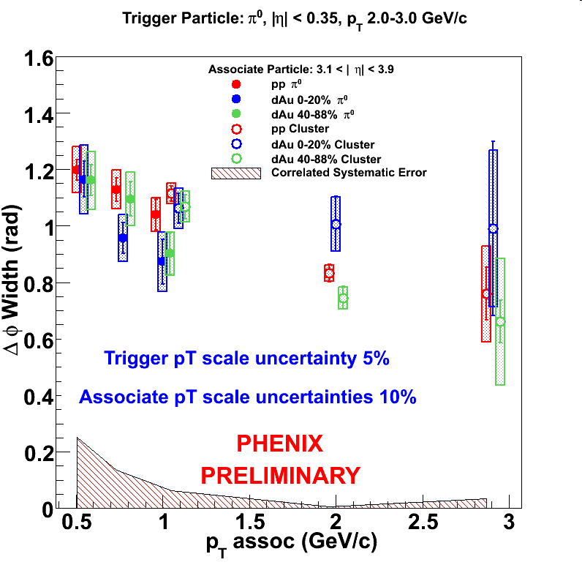
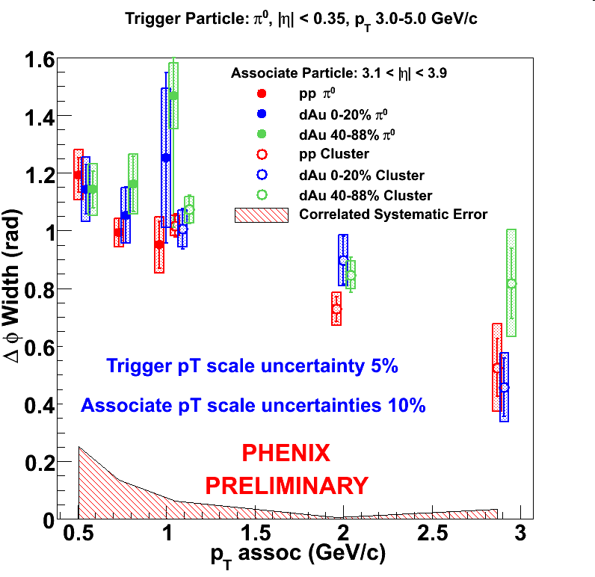
Forward/Central Correlation Widths
Trigger π⁰: |η| < 0.35, 2.0 < p_{T} < 3.0 GeV/c
Associate particle: 3.1 < |η| < 3.9
Trigger π⁰: |η| < 0.35, 3.0 < p_{T} < 5.0 GeV/c
Associate particle: 3.1 < |η| < 3.9
No significant changes in correlation width between pp and dAu within experimental uncertainties
dAu 0-20%
pp
dAu 40-88%
No significant broadening observed yet, still large uncertainties.

Slide 41
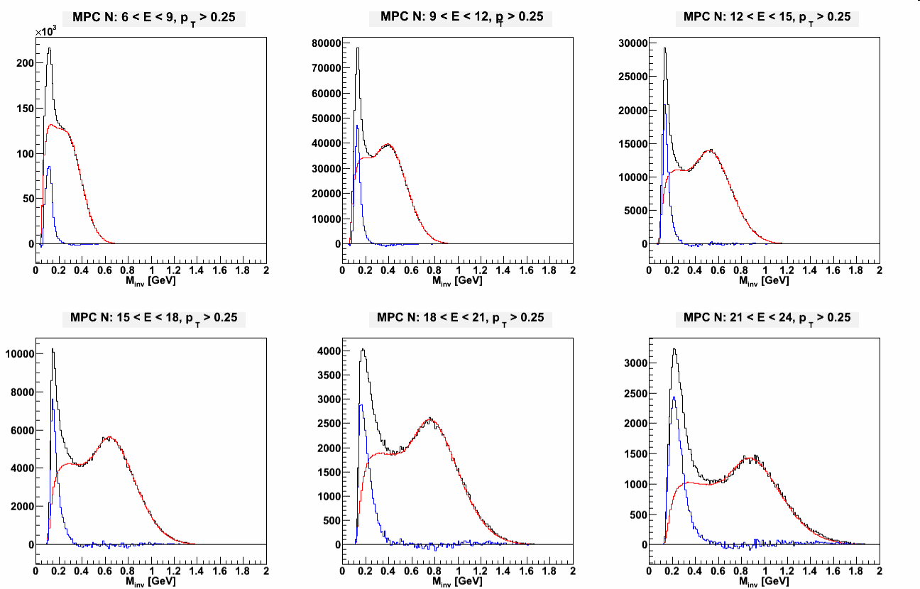
MPC Pion/Cluster Identification
The MPC can reliably detect pions (via π⁰→γ γ) up to E =17 GeV
To go to higher p_{T}, use single clusters in the calorimeter
  Use π⁰s for 7 GeV < E < 17 GeV
  Use clusters for 20 GeV < E < 50 GeV
Correlation measurements are performed using π⁰s, clusters
Use event mixing to identify pions:
foreground → photons from same event
background → photons from different events
South MPC
Foreground
12 < E < 15
N
Background
Yield
M_{inv} (GeV/c²)

Slide 42
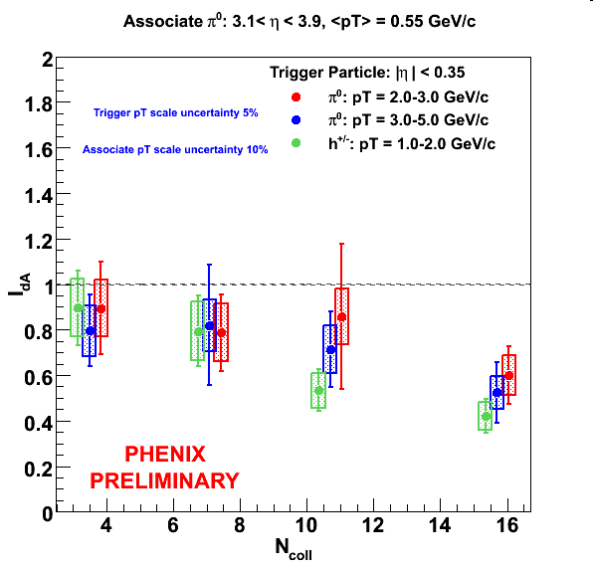
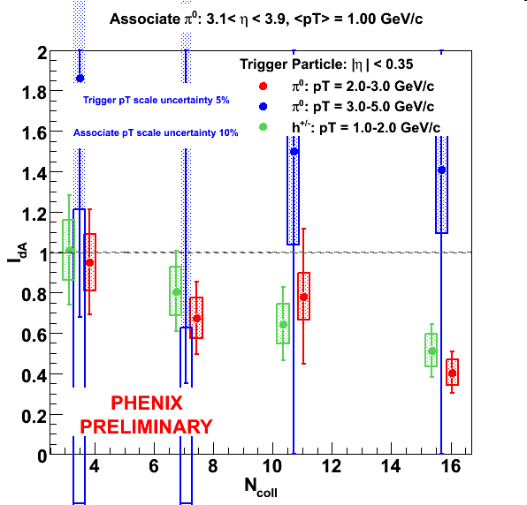
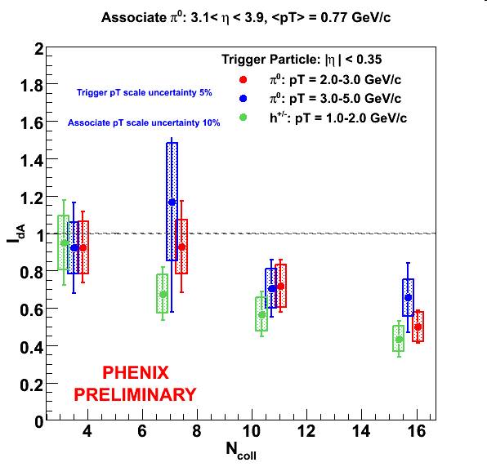
I_{dA} vs p_{T}ª
<p_{T}ª>=0.55 GeV/c
<p_{T}ª>=0.77 GeV/c
<p_{T}ª>=1.00 GeV/c

Slide 43
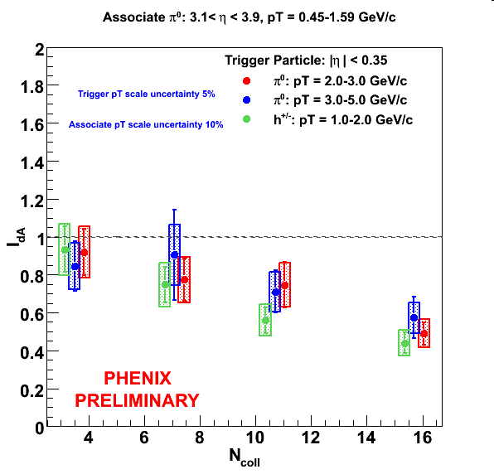
I_{dA} with 3 Trigger Particle Bins

Slide 44
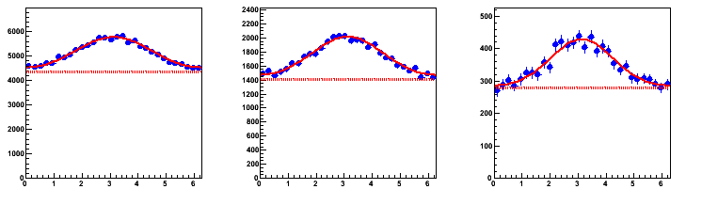
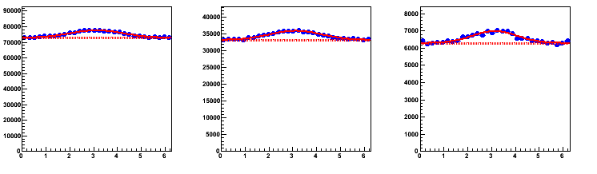
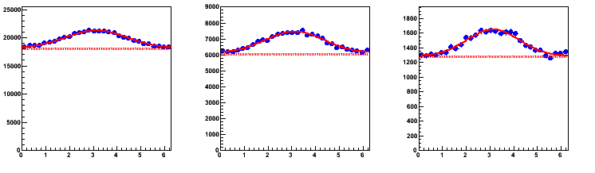
h^{+/-} (trigger,central)/π⁰ (associate,forward)
1.0 < p_{T}^{t} < 2.0 GeV/c for all plots
pp
<p_{T}ª>=0.55 GeV/c
<p_{T}ª>=0.77 GeV/c
<p_{T}ª>=1.00 GeV/c
Correlation Function
dAu 0-20%
dAu 60-88%
p_{T}^{t}, h^{+/-}
p_{T}ª, π⁰
Δφ

Slide 45



π⁰ (trigger,central)/π⁰ (associate,forward)
2.0 < p_{T}^{t} < 3.0 GeV/c for all plots
pp
<p_{T}ª>=0.55 GeV/c
<p_{T}ª>=0.77 GeV/c
<p_{T}ª>=1.00 GeV/c
Correlation Function
dAu 0-20%
dAu 60-88%
p_{T}^{t}, π⁰
p_{T}ª, π⁰
Δφ

Slide 46
π⁰ (trigger,central)/π⁰ (associate,forward)
3.0 < p_{T}^{t} < 5.0 GeV/c
for all plots
pp
<p_{T}ª>=0.55 GeV/c
<p_{T}ª>=0.77 GeV/c
<p_{T}ª>=1.00 GeV/c
Correlation Function
dAu 0-20%
dAu 60-88%
p_{T}^{t}, π⁰
Δφ
p_{T}ª, π⁰

Slide 47



π⁰ (trigger,central)/cluster (associate,forward)
3.0 < p_{T}^{t} < 5.0 GeV/c for all plots
pp
dAu 0-20%
dAu 60-88%
p_{T}^{t}, π⁰
p_{T}ª, cluster
Δφ

Slide 48
Clusters vs π⁰s
MPC crystals are ~ 2.2 cm, and the detector sits Δz=220 cm from z = 0
From previous page, Δr min for two photons is 3.5 cm
What is max pion energy we can detect?
  For α=0, E_{γ1,max} = E_{γ2,max}
  E_{γ,max} = p_{T,γ}/ sin(Δϕ/2) = m_{π}Δz/Δr_{min}
  E_{π,max} = 2m_{π}Δz/Δr_{min} = 17 GeV
Able to identify pions up to 17 GeV for α = 0
Beyond this we need better cluster splitting
  As of now, single clusters above this energy are likely to be π⁰s, direct γs, or background
Use high energy clusters as well for correlations, R_{cp}, R_{dA}
γ kinematics, π₀ decay
p_{γ} = E_{γ}
Δϕ/2
p_{Tγ} = m_{π}/2

Slide 49
MPC Pion Selection
Cuts
  Cluster Cuts
    Cluster ecore > 1.0 (redundant w/ pion assym and energy cuts)
  Pi0 pair
    E > 6 GeV
    Asym < 0.6
    Separation cuts to match fg/bg mass distribution
    Max(dispx, dispy) < 2.5
Use mixed events to extract yields
  Normalize from 0.25-0.4 presently

Slide 50
MPC/CA Cuts
MPC pi0 ID
  Mass window of 0.1-0.2 GeV + previously shown cuts
  7 – 17 GeV energy range
  Max(dispx,dispy) <= 2.5
Charged Hadron ID Track Quality == 31 or 63
  n₀ <0 Rich cut
  p_{T} < 4.7 GeV
  pc3 sdz and sdphi matching < 3
  -70 < zed < 70
EMC pi0
  Alpha < 0.8
  PbGl min E = 0.1, PbSc min E = 0.2
  Chi2 cut of 3, prob cut of 0.02
  Sector matching
  Mass window 0.1-0.18
  Trigger bit check

Slide 51

x₁ and x₂ in Central Arm – MPC correlations
Central Arm
3.1 < η < 3.9
-0.35 < η < 0.35
π⁰
π⁰
MPC
X₂-range: 0.006 < x < 0.1
Marco Stratman pQCD calculations for pp
x₁ > x₂

Slide 52


Elliptic Flow v₂: Strong Evidence for
Strongly Interacting Parton Matter at RHIC
Scaling flow para-
meters by quark
content n_{q} resolves
meson-baryon sepa-
ration of final state
hadrons
baryons
Indicates quark level
thermalization, strong
coupling and parton
degrees of freedom
mesons
Does the interpretation of
v₂ depend on the knowledge
of the initial state?

