Slide 1

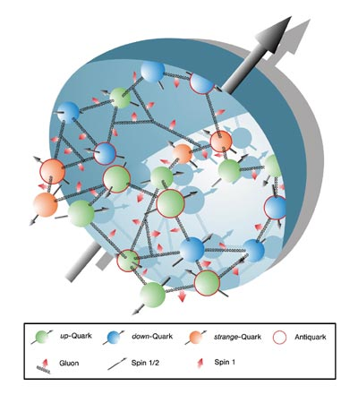
Nuclear Physics Symposium:
Exploring the Heart of Matter in honor of Roy Holt
Past: Nucleon spin physics at SLAC
  Björken sum rule
Present: Nucleon spin physics at JLab 6 GeV and 12 GeV
  Gerasimov-Drell-Hearn sum rule
  A₁^{n}, A₁^{p,} d₂^{n}, d₂^{p}
Future Nucleon spin physics at an EIC
Disclaimer:
This talk on nucleon spin structure is neither
complete nor comprehensive
Courtesy of CERN Courier

Slide 2
Past: Nucleon spin Physics at SLAC
After the Nuclear Physics at SLAC (NPAS) Program
    NE1-?-NE3-?-NE5-?-?-NE8-NE9-NE17-NE18
  Pegasys/MarkII: A program of internal target physics using the MARK II detector at the PEP storage ring.
    Negotiations failed
    PEPII: B-factory
  High Energy Polarized Beams and Target in End Station A
    Negotiations with SLC to be able to have some beam in End station A succeeded
    A trying time for SLAC, the competition from CERN was stiff some other physics needed to come out of the Lab
    Question: Where to do Spin Physics at DESY or SLAC?

Slide 3
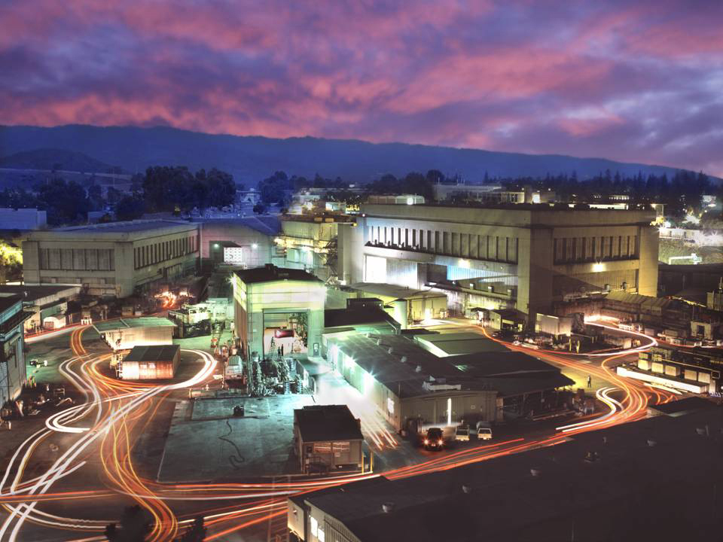
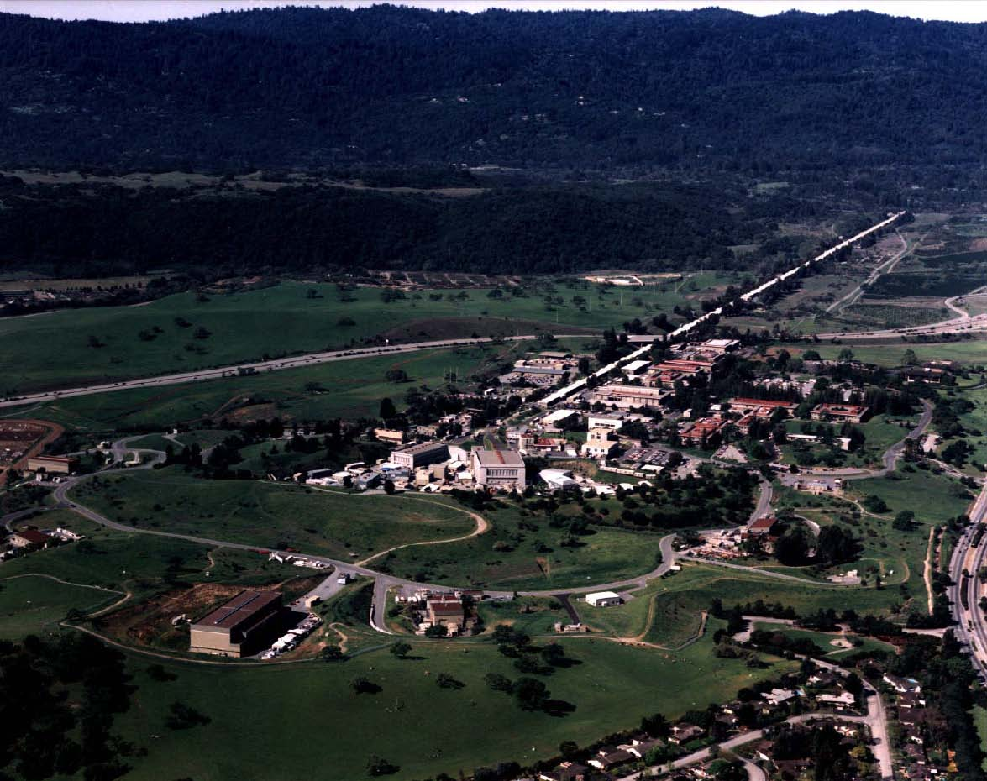
SLAC Fixed Polarized Target and Polarized Beam Experimental Program
End Station A

Slide 4
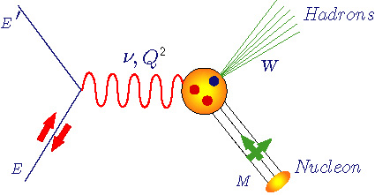

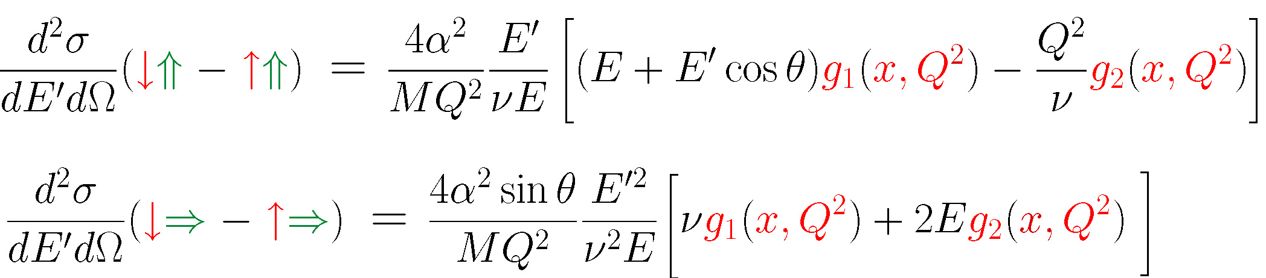
Spin Structure Functions in DIS
Unpolarized structure functions F₁(x,Q²) and F₂(x,Q²)
Polarized structure functions
g₁(x,Q²) and g₂(x,Q²)
U
Q² :Four-momentum transfer
x : Bjorken variable
: Energy transfer
M : Nucleon mass
W : Final state hadrons mass
L
T

Slide 5
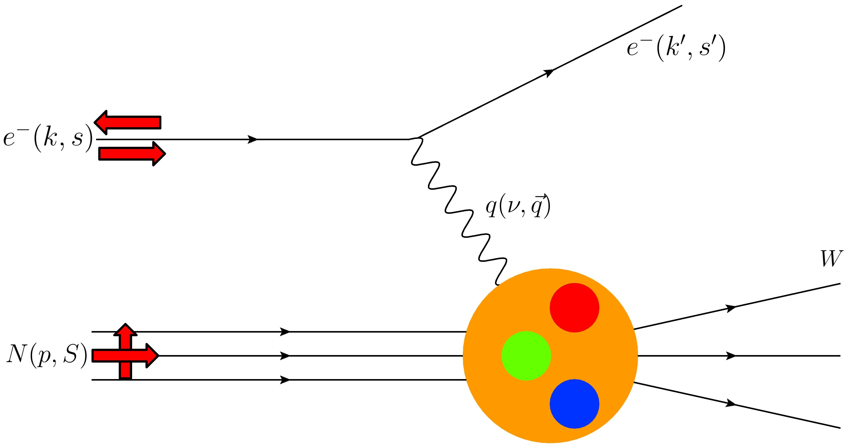
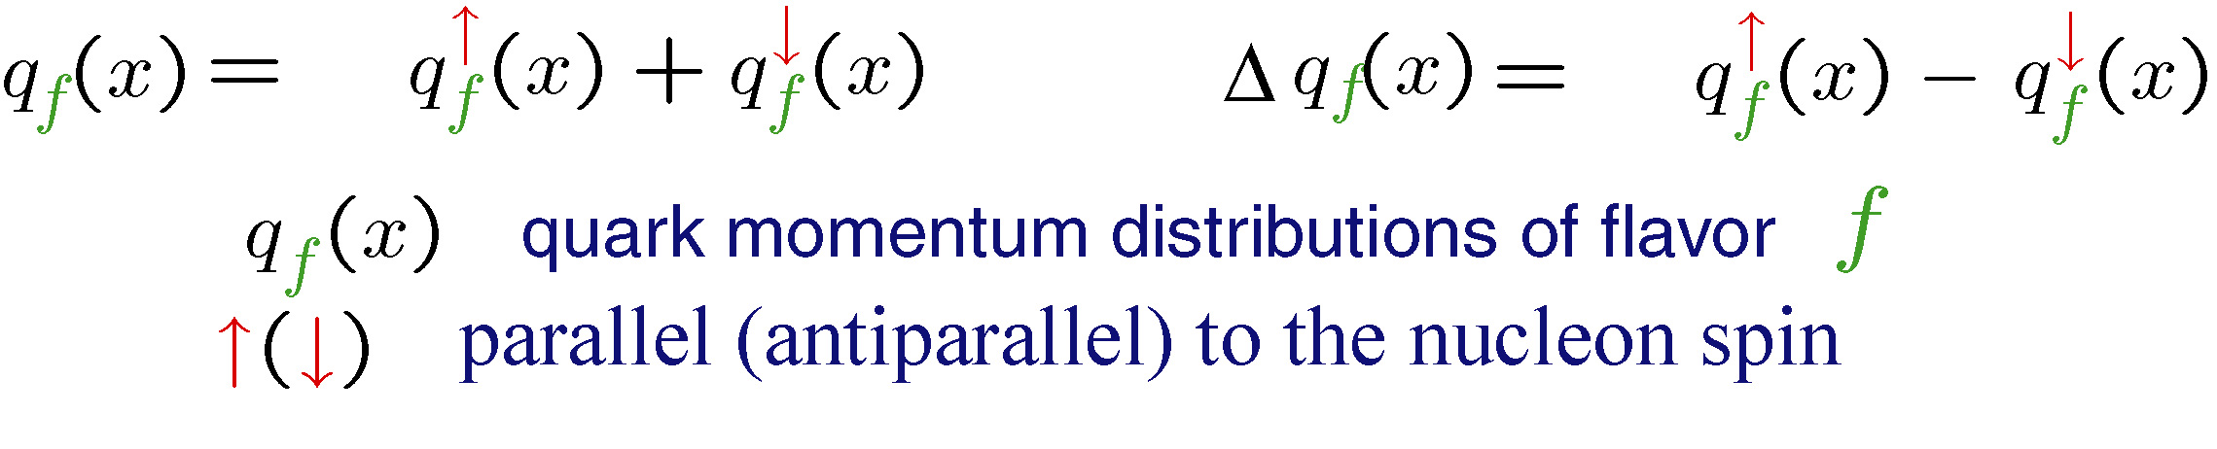
In the Feynman Quark-Parton Model

Slide 6
Moments of spin structure functions
Gerasimov-Drell-Hearn
Sum Rule
I_{GDH} (0)
Generalized
GDH Integral
I_{GDH} (Q² )
Bjorken
Sum Rule
Γ₁^{p-n}
Burkhardt-Cottingham
sum rule
Γ₂ (Q²) =0
Spin
Polarizabilities
γ₀(Q²),δ_{LT} (Q² )
Higher twists & color
forces/polarizabilities
d₂(Q²) , f₂ (Q²)
0
1
10
∞
Q²
pQCD
Lattice
QCD
MODELS
DSE
AdS/CFT

Slide 7
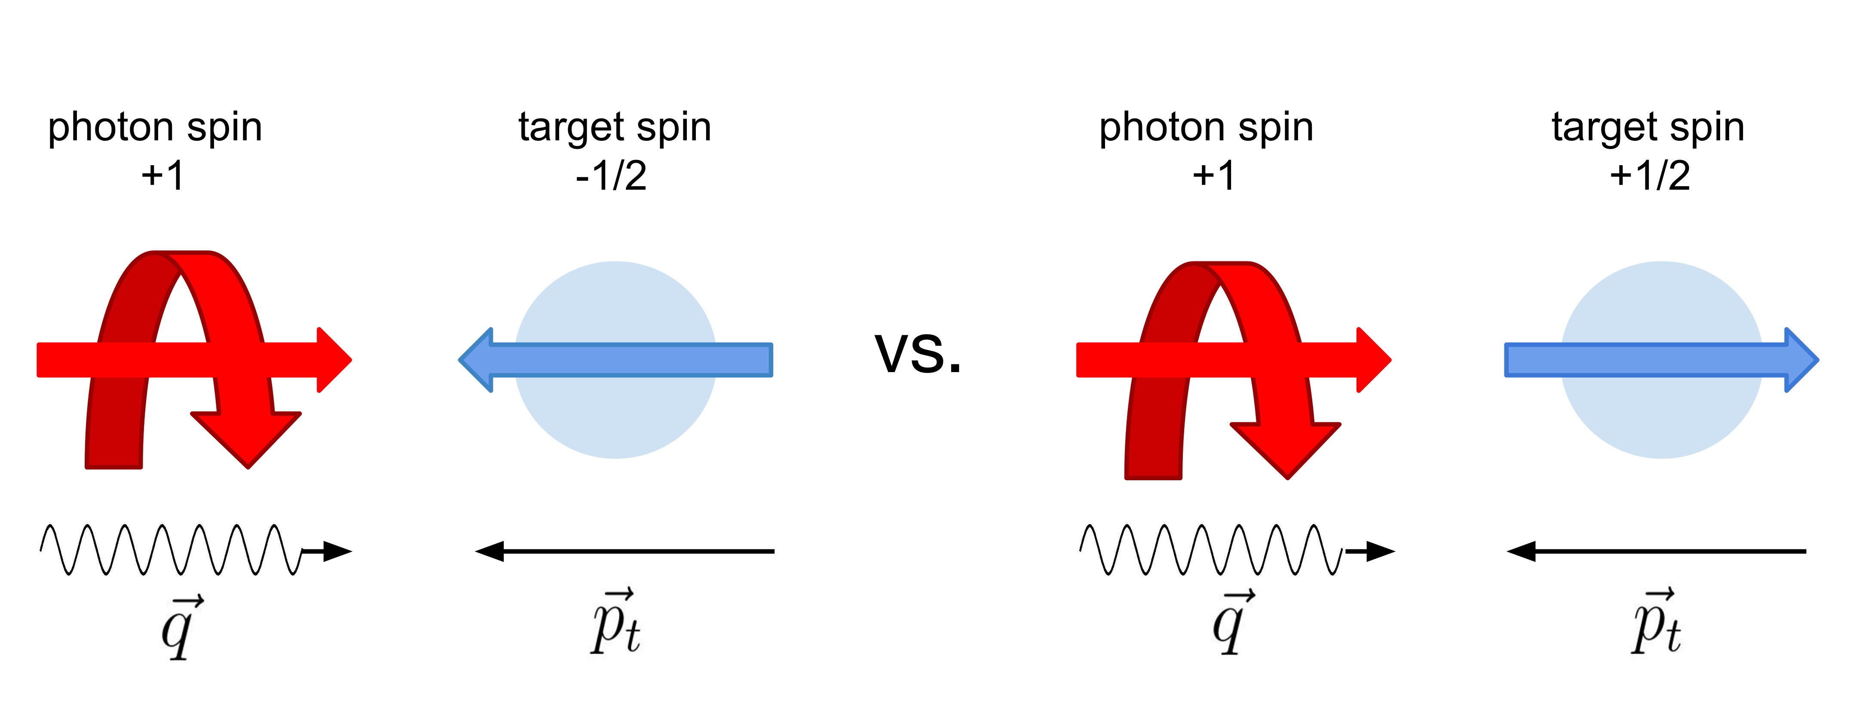
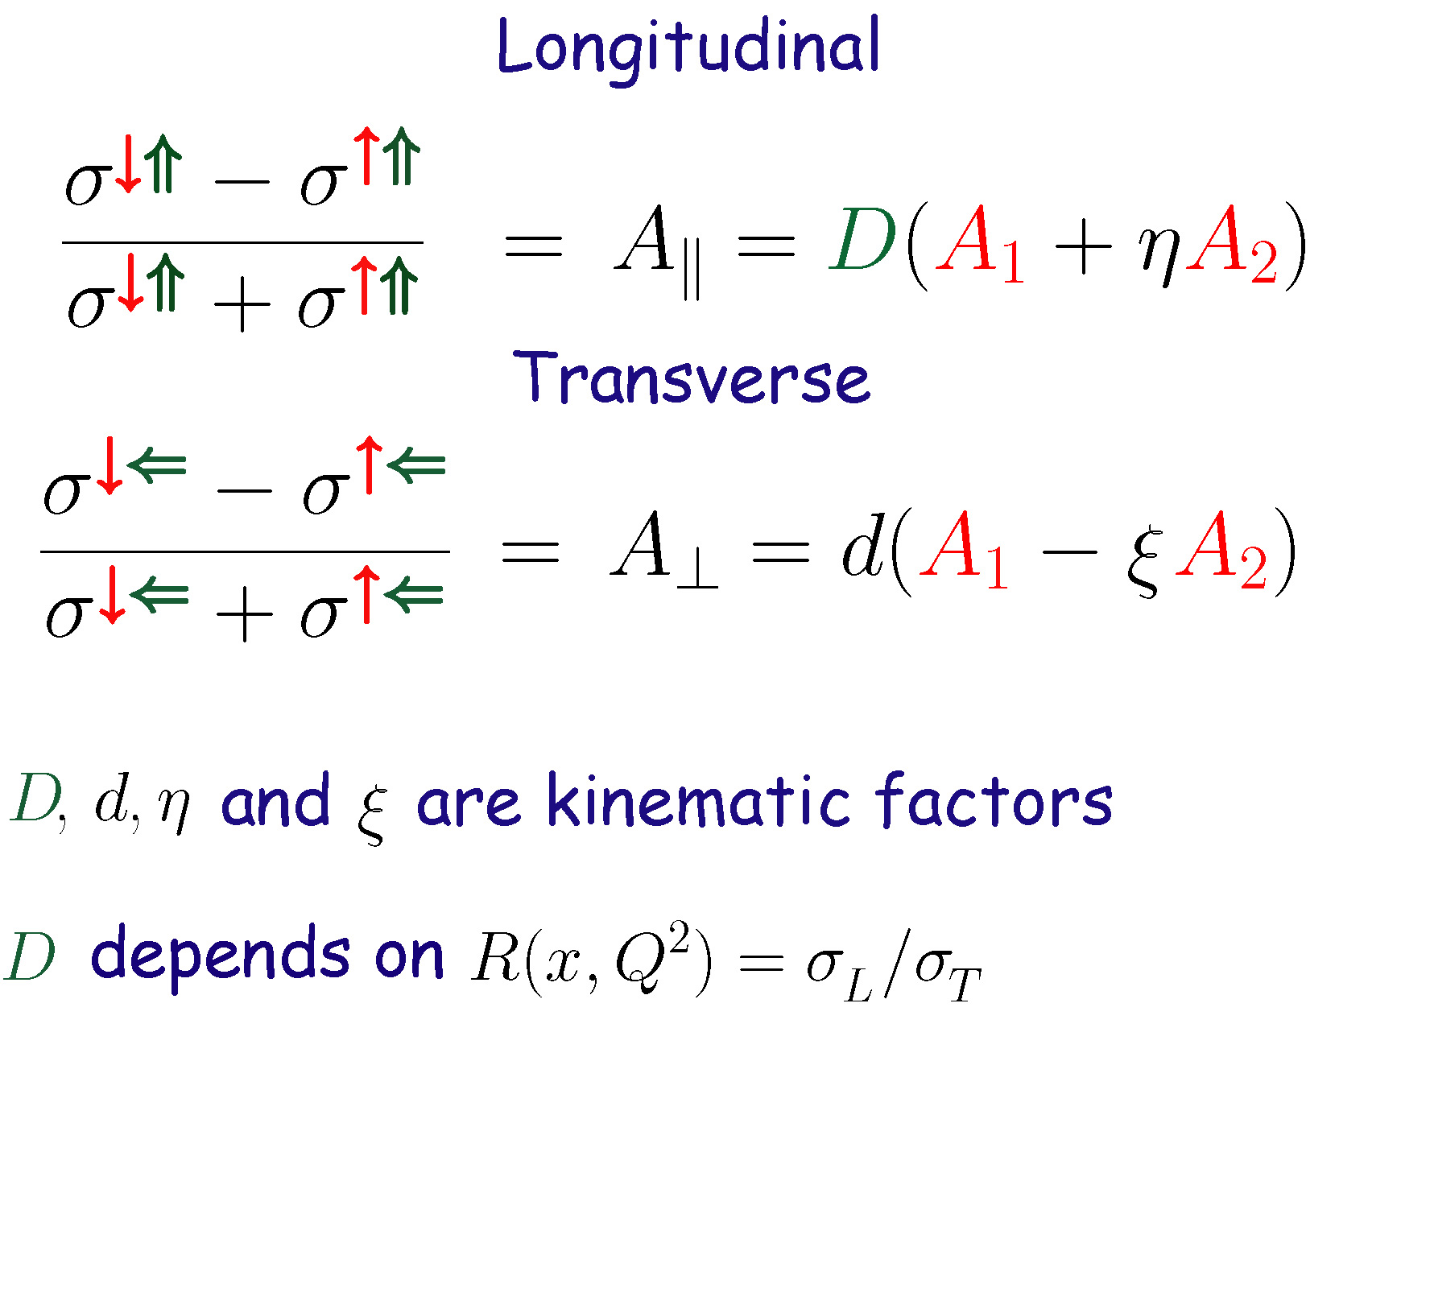
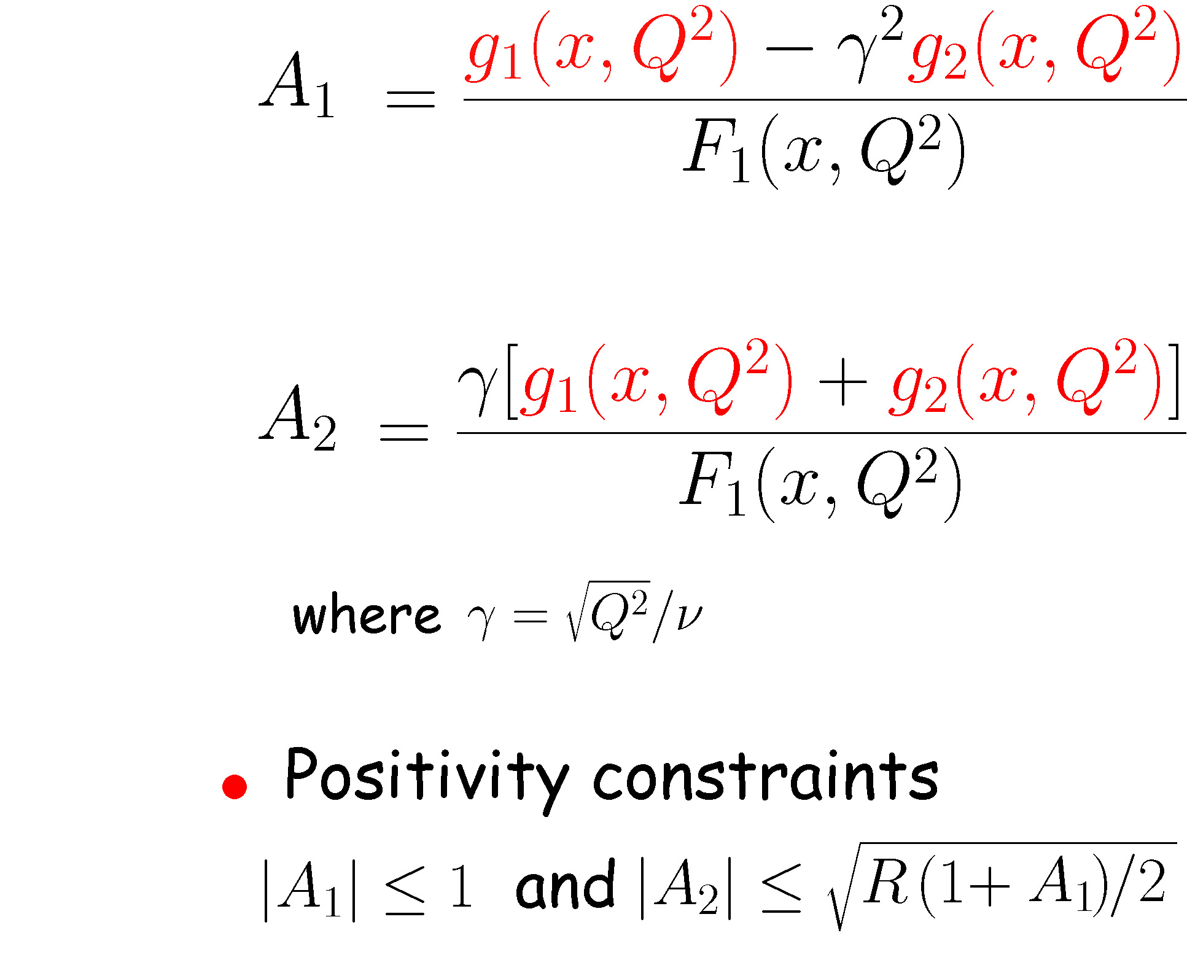
Virtual photon-nucleon asymmetry A₁

Slide 8
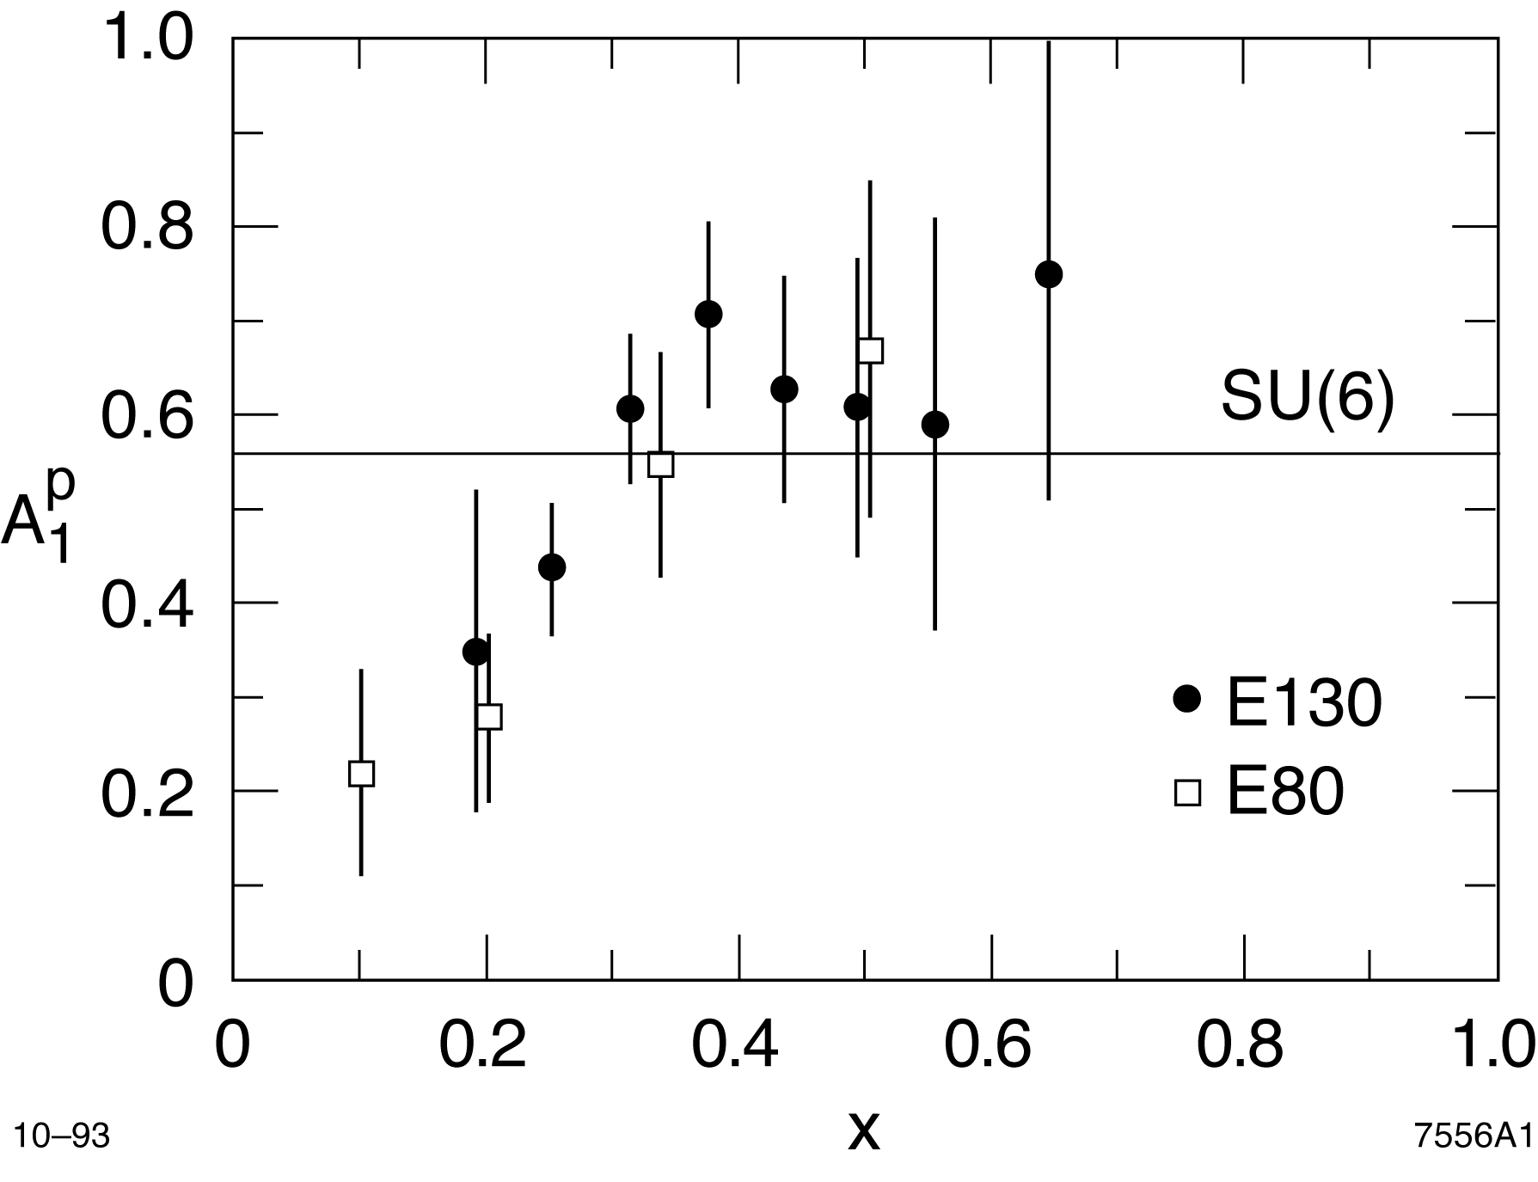
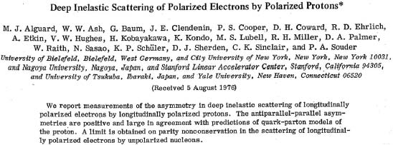
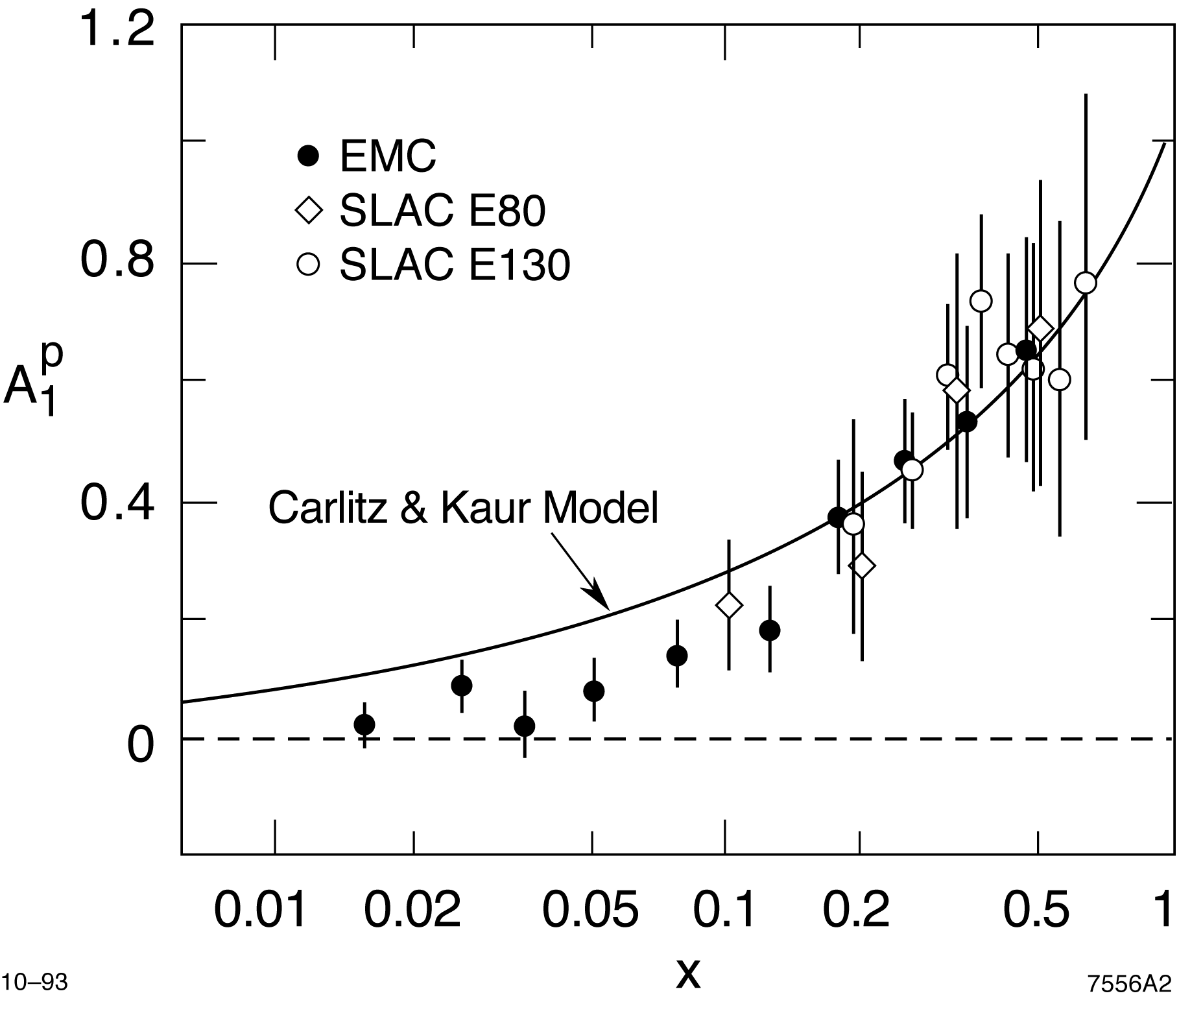
SLAC experiments with Polarized Beams and Polarized Targets in a nut shell
SLAC Pre-EMC experiment
  E80 and E130
EMC experiment
  Extended the range in x
  The net spin carried by the quarks is small
  Strange sea is highly polarized opposite
  to the nucleon spin

Slide 9
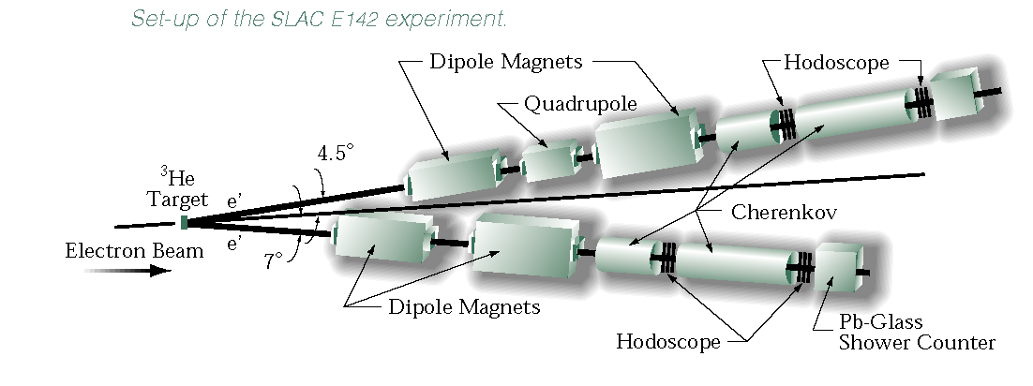
SLAC Post-EMC experiments
A race started for measuring the neutron E142 vs SMC
  Neutron spin structure using polarized ³He at SLAC
  E142 first DIS experiment at SLAC using a polarized ³He at 22 GeV
  E143 DIS experiment using NH₃ and ND₃ at 29 GeV

Slide 10
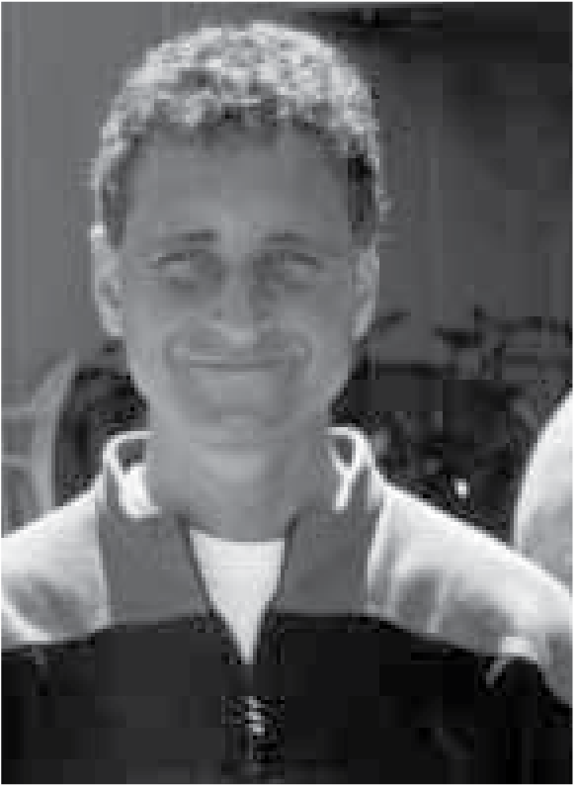
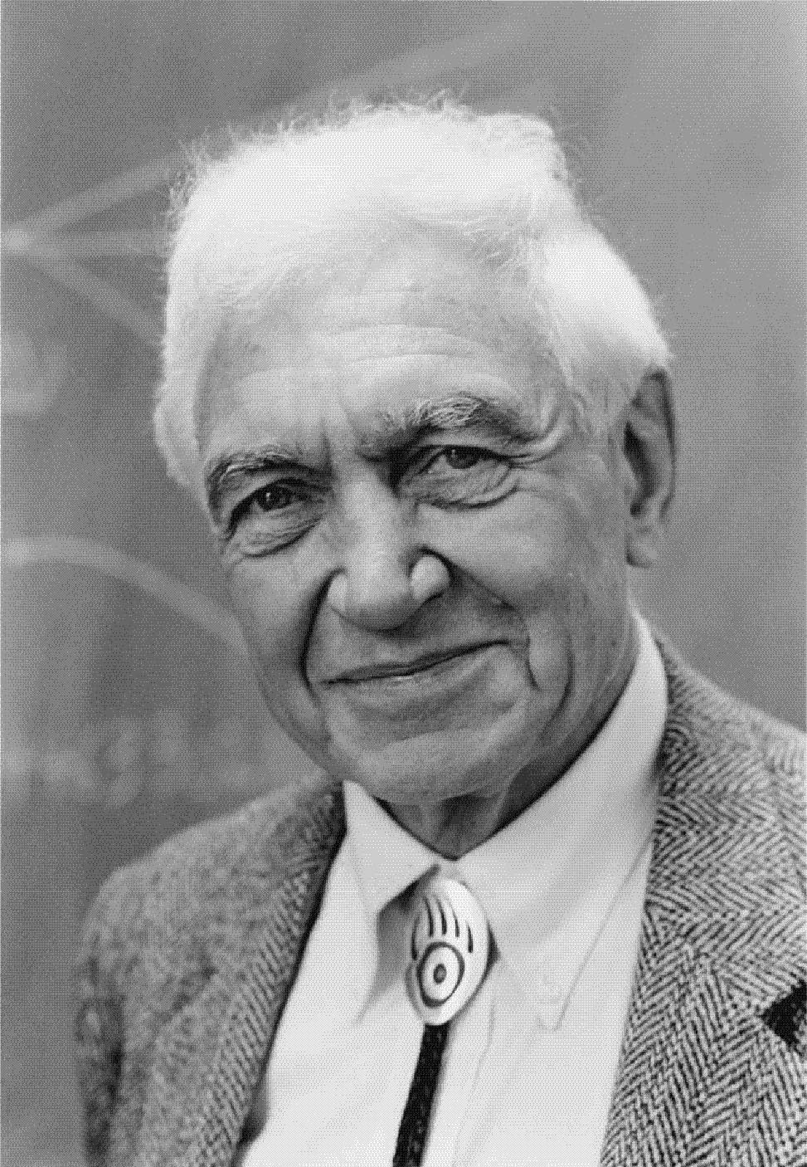
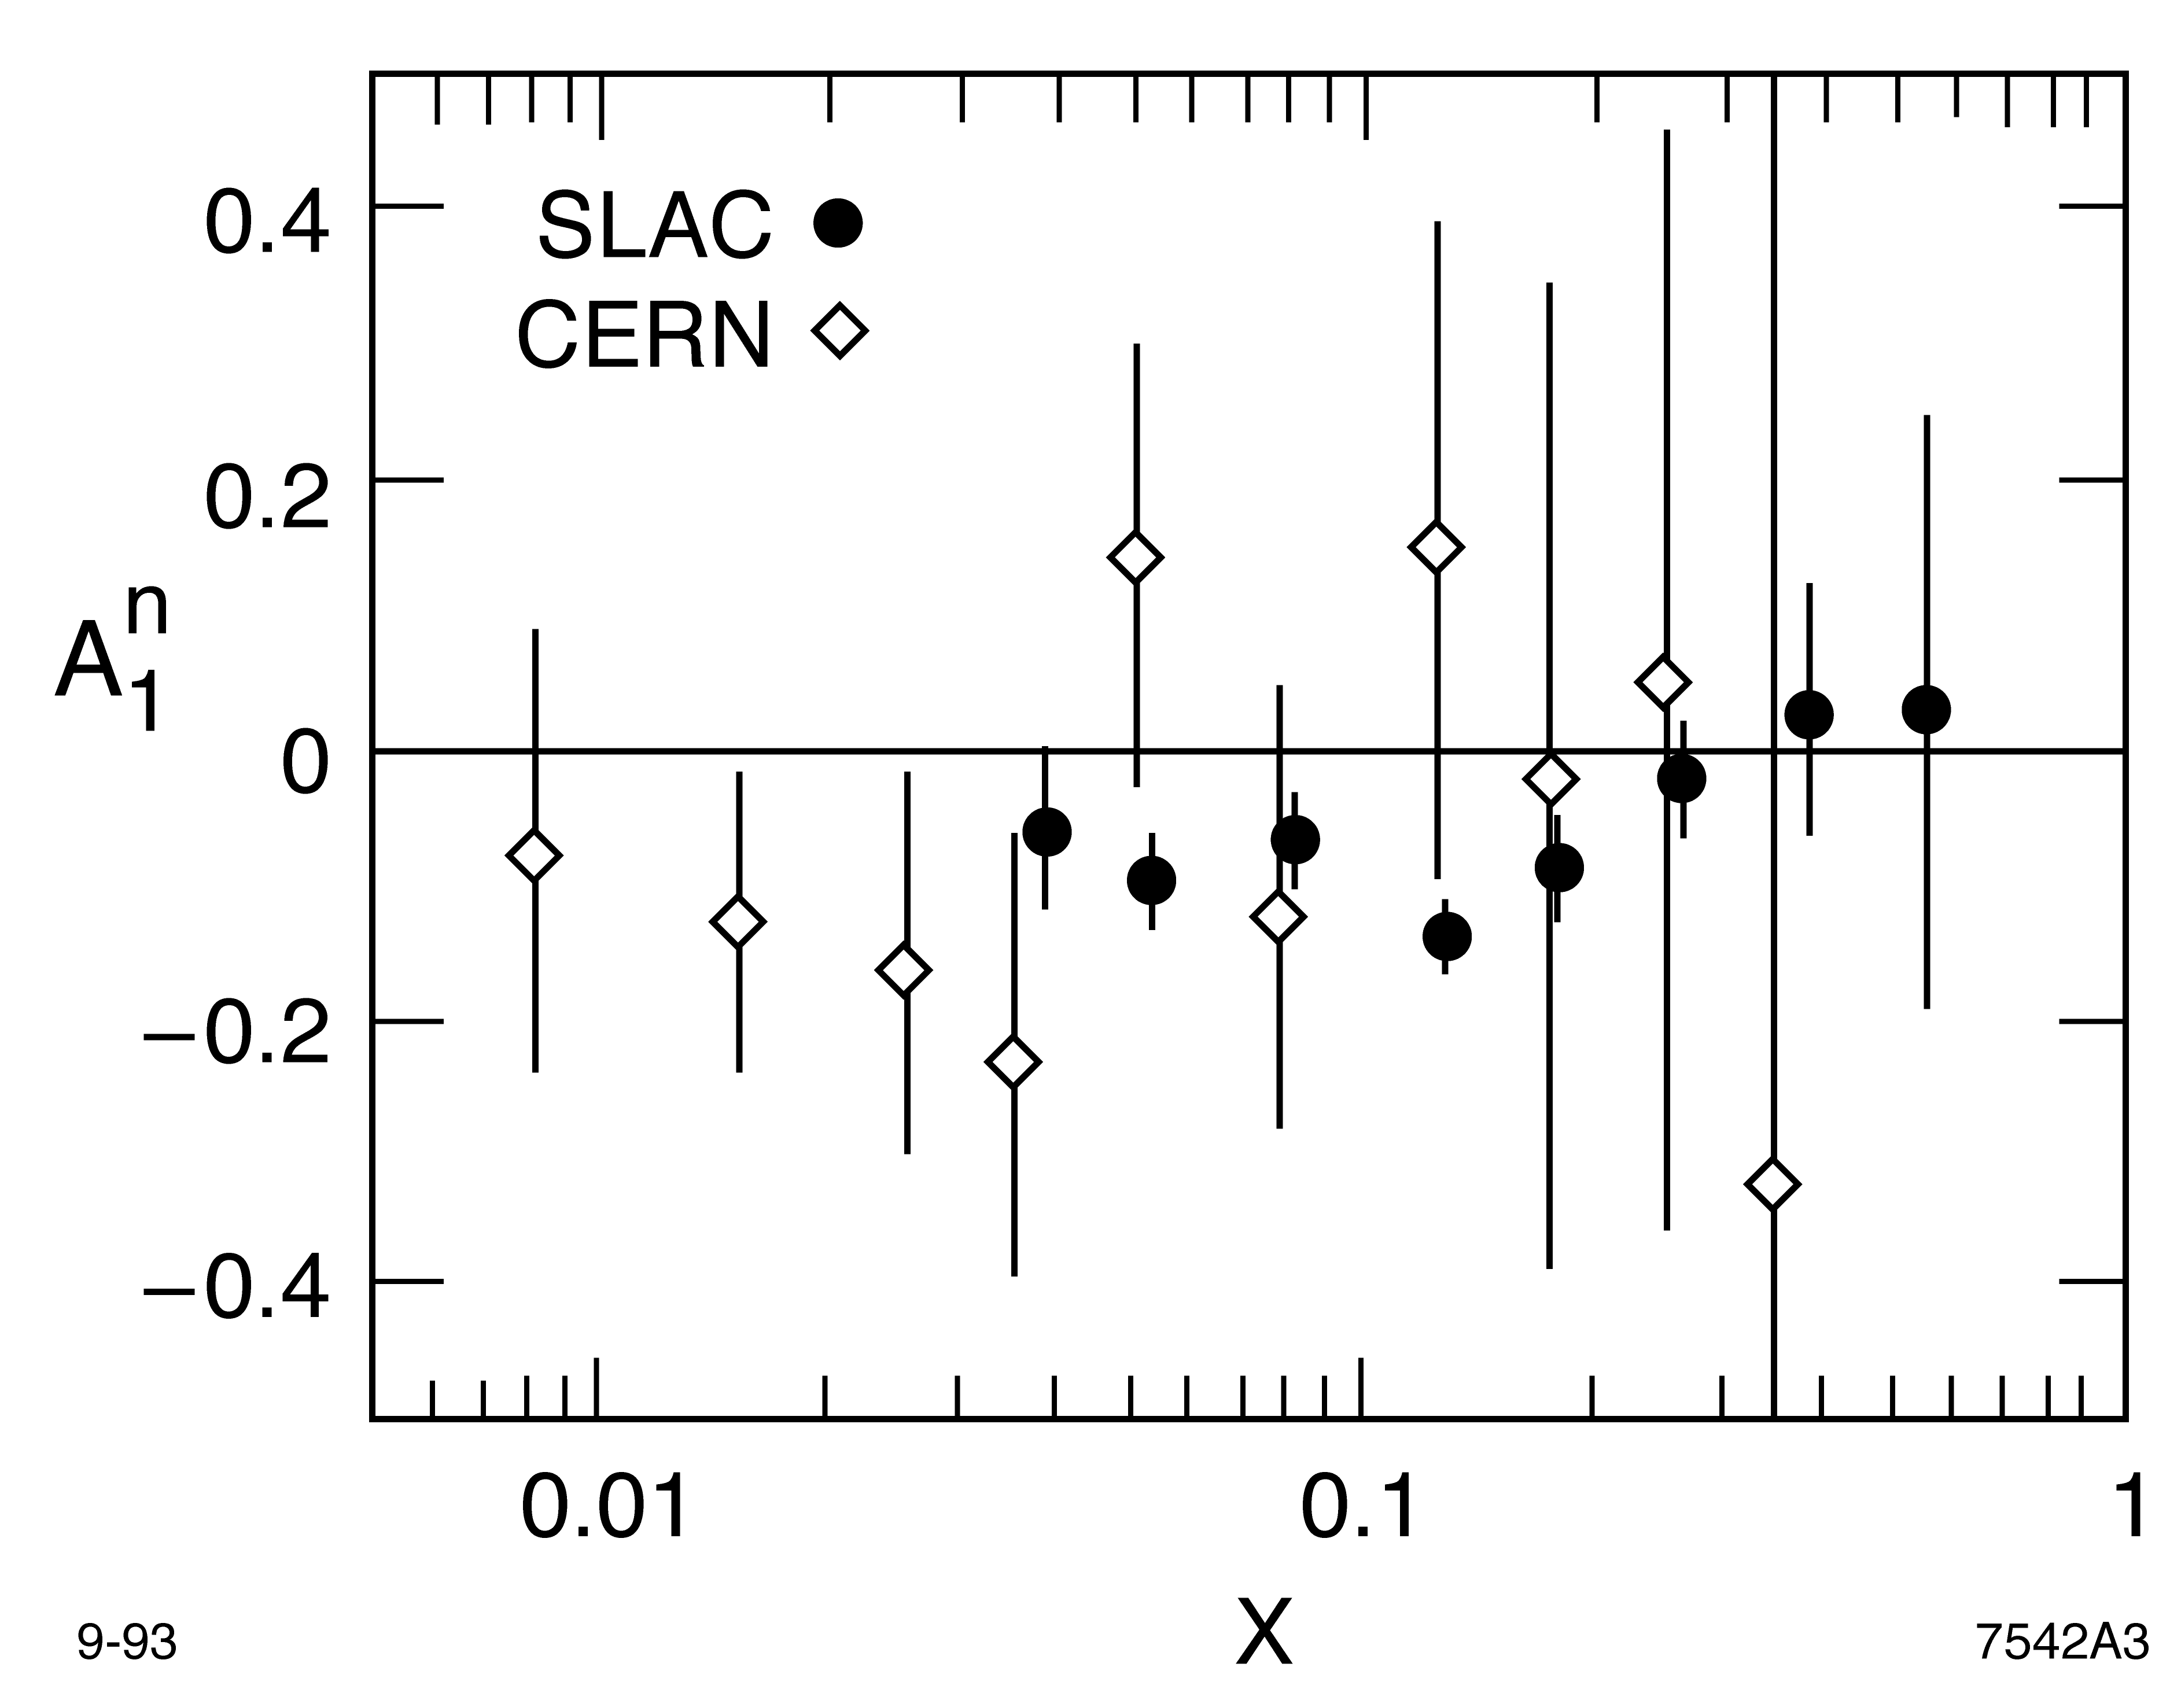
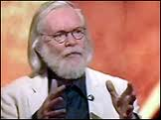

SLAC E142 – CERN SMC
    New opportunity with Stanford Linear Collider (SLC) 50 GeV beam: Accessing lower x to resolve the disagreement about the B.J. sum rule
  E154 DIS experiment using a polarized ³He at 50 GeV
  E155 DIS experiment using NH₃ and ND₃ at 50 GeV

Slide 11
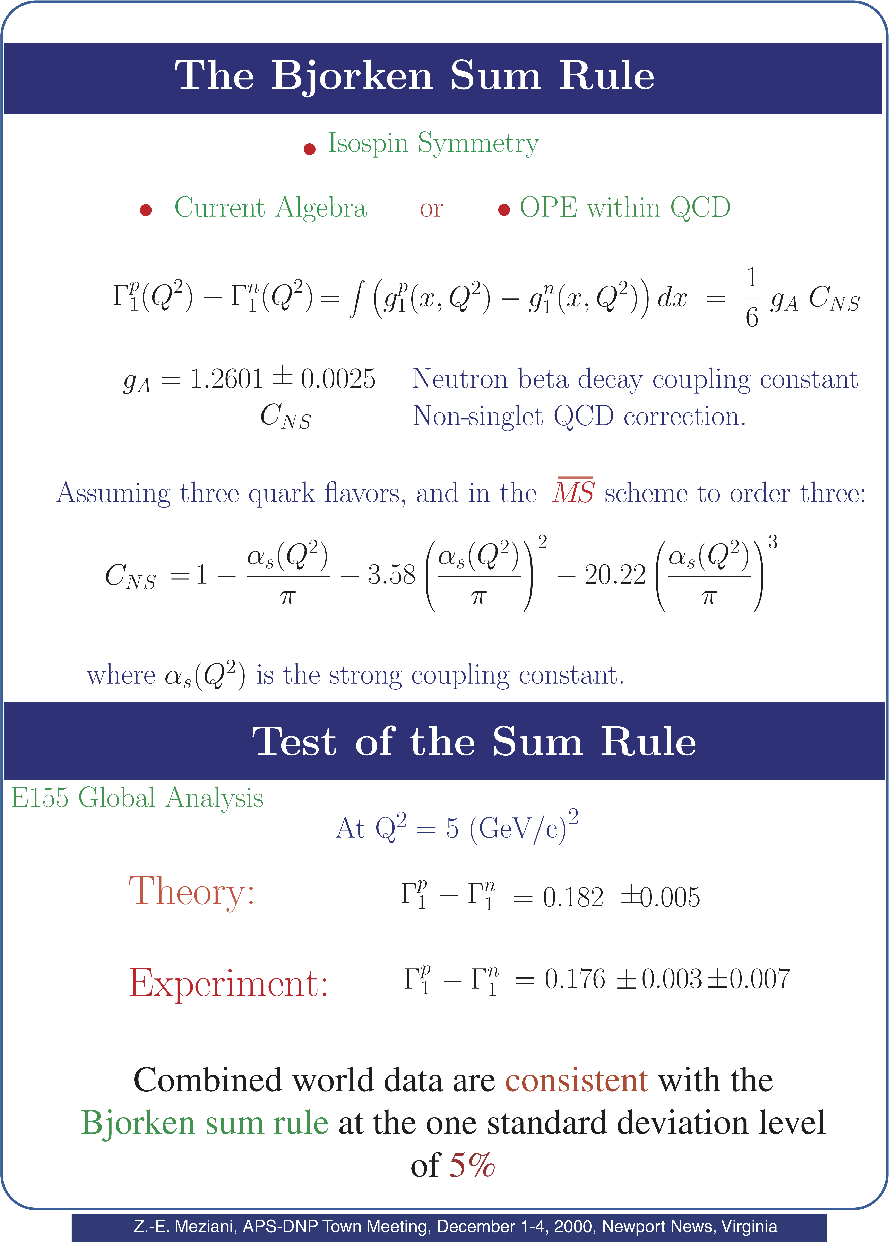
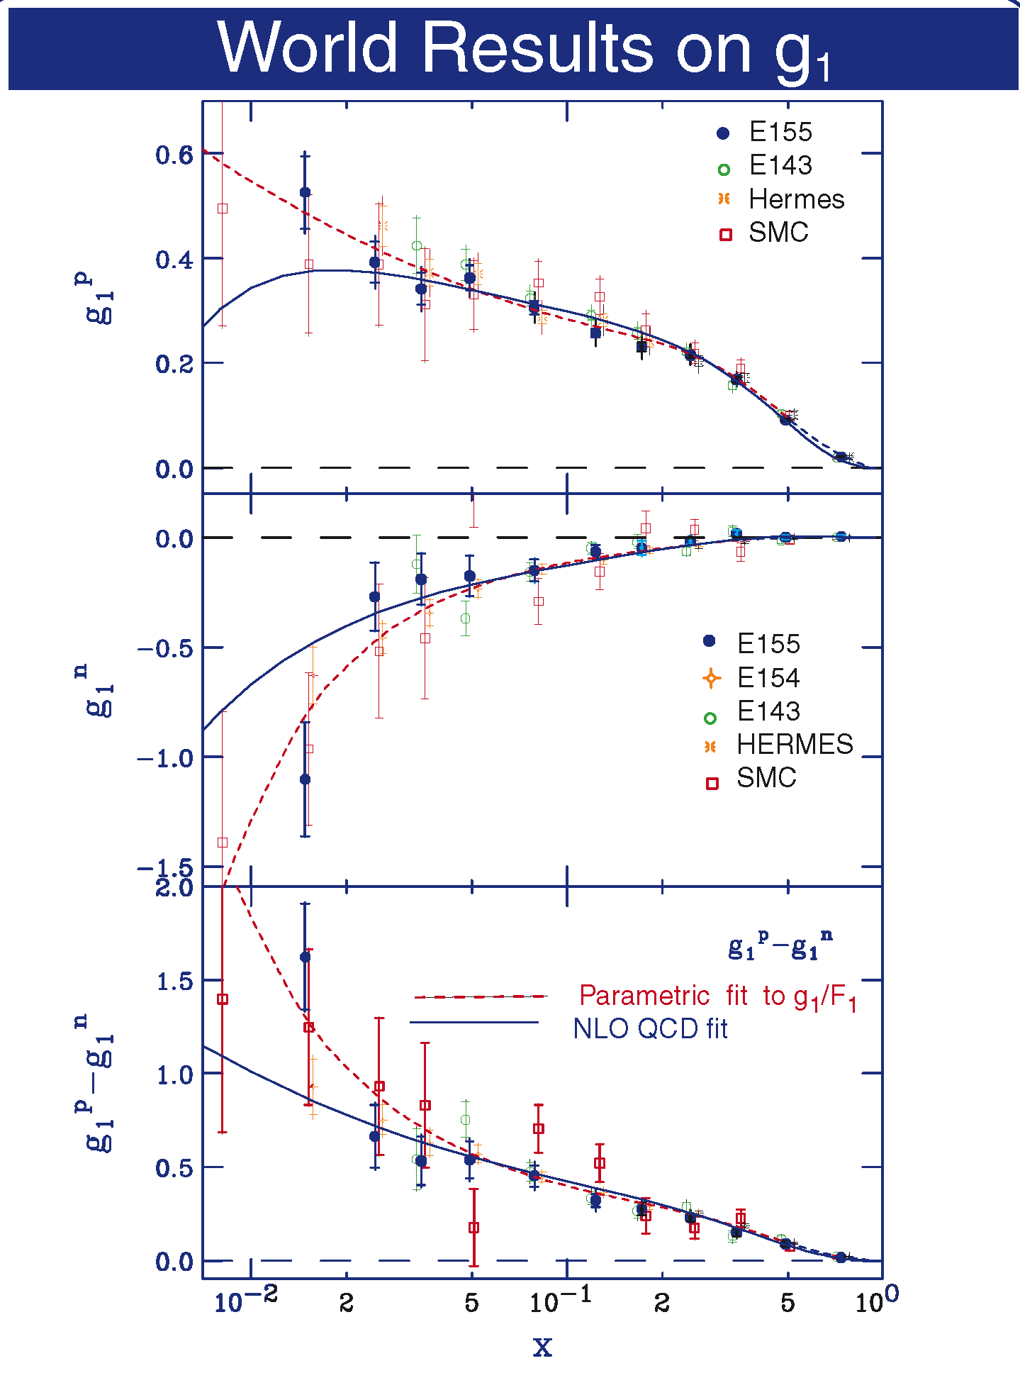

Slide 12
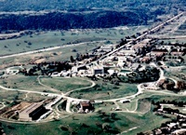
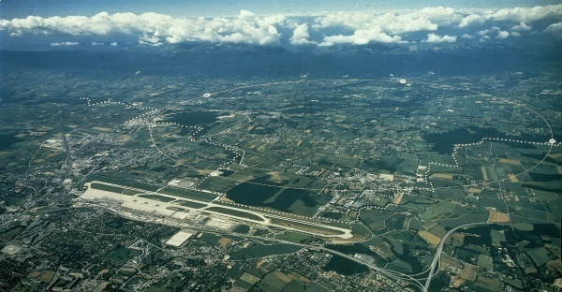
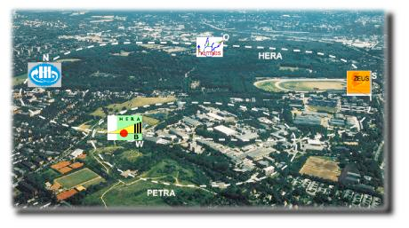
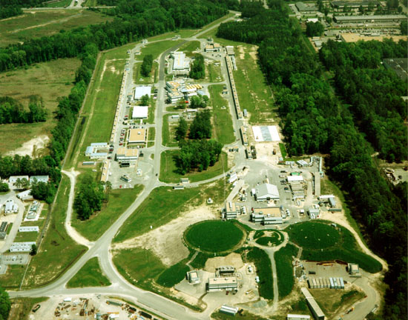
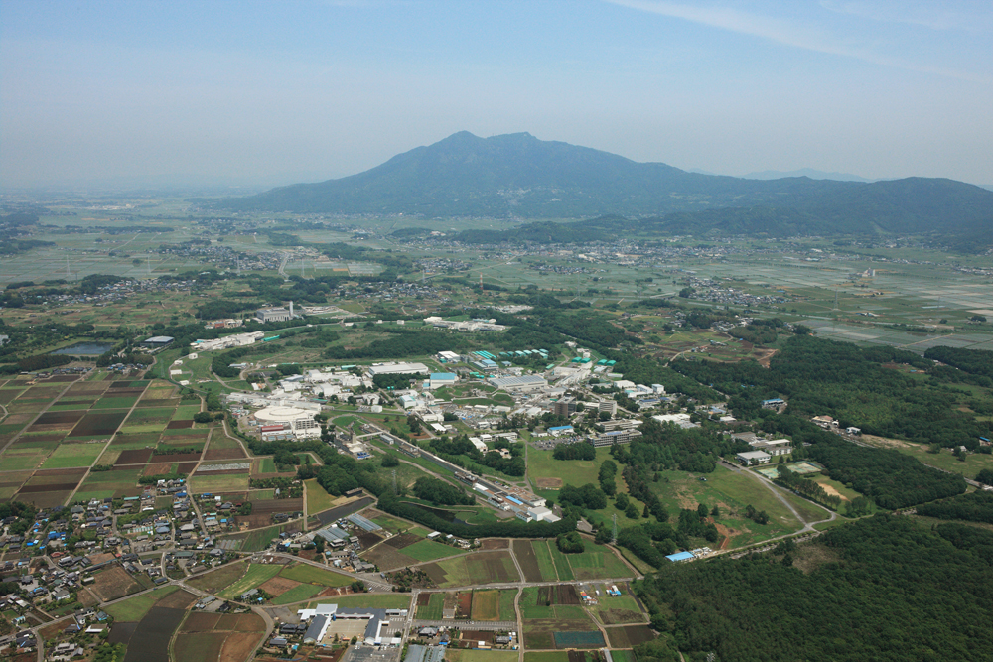
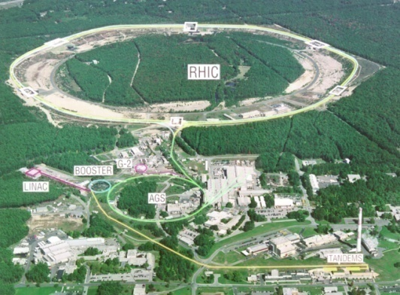
Impressive experimental progress in QCD spin physics in the last 25 years
Inclusive spin-dependent DIS
  CERN: EMC, SMC, COMPASS
  SLAC: E80, E142, E143, E154, E155
  DESY: HERMES
  JLab: Hall A, B and C
Semi-inclusive DIS
  SMC, COMPASS
  HERMES, JLab
Polarized pp collisions
  BNL: PHENIX & STAR
Polarized e+e- collisions
  KEK: Belle

Slide 13
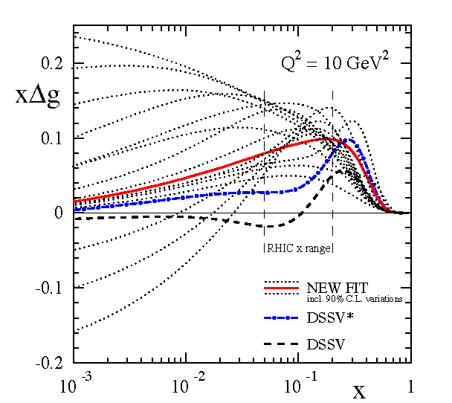
Quark and Gluon Helicity Distributions
Global analysis with RHIC data
DIS and pp data seem consistent
Error on is still large
Global DSSV analysis (de Florian, Sassot, Stratmann, Vogelsang 2008/2009)

Slide 14
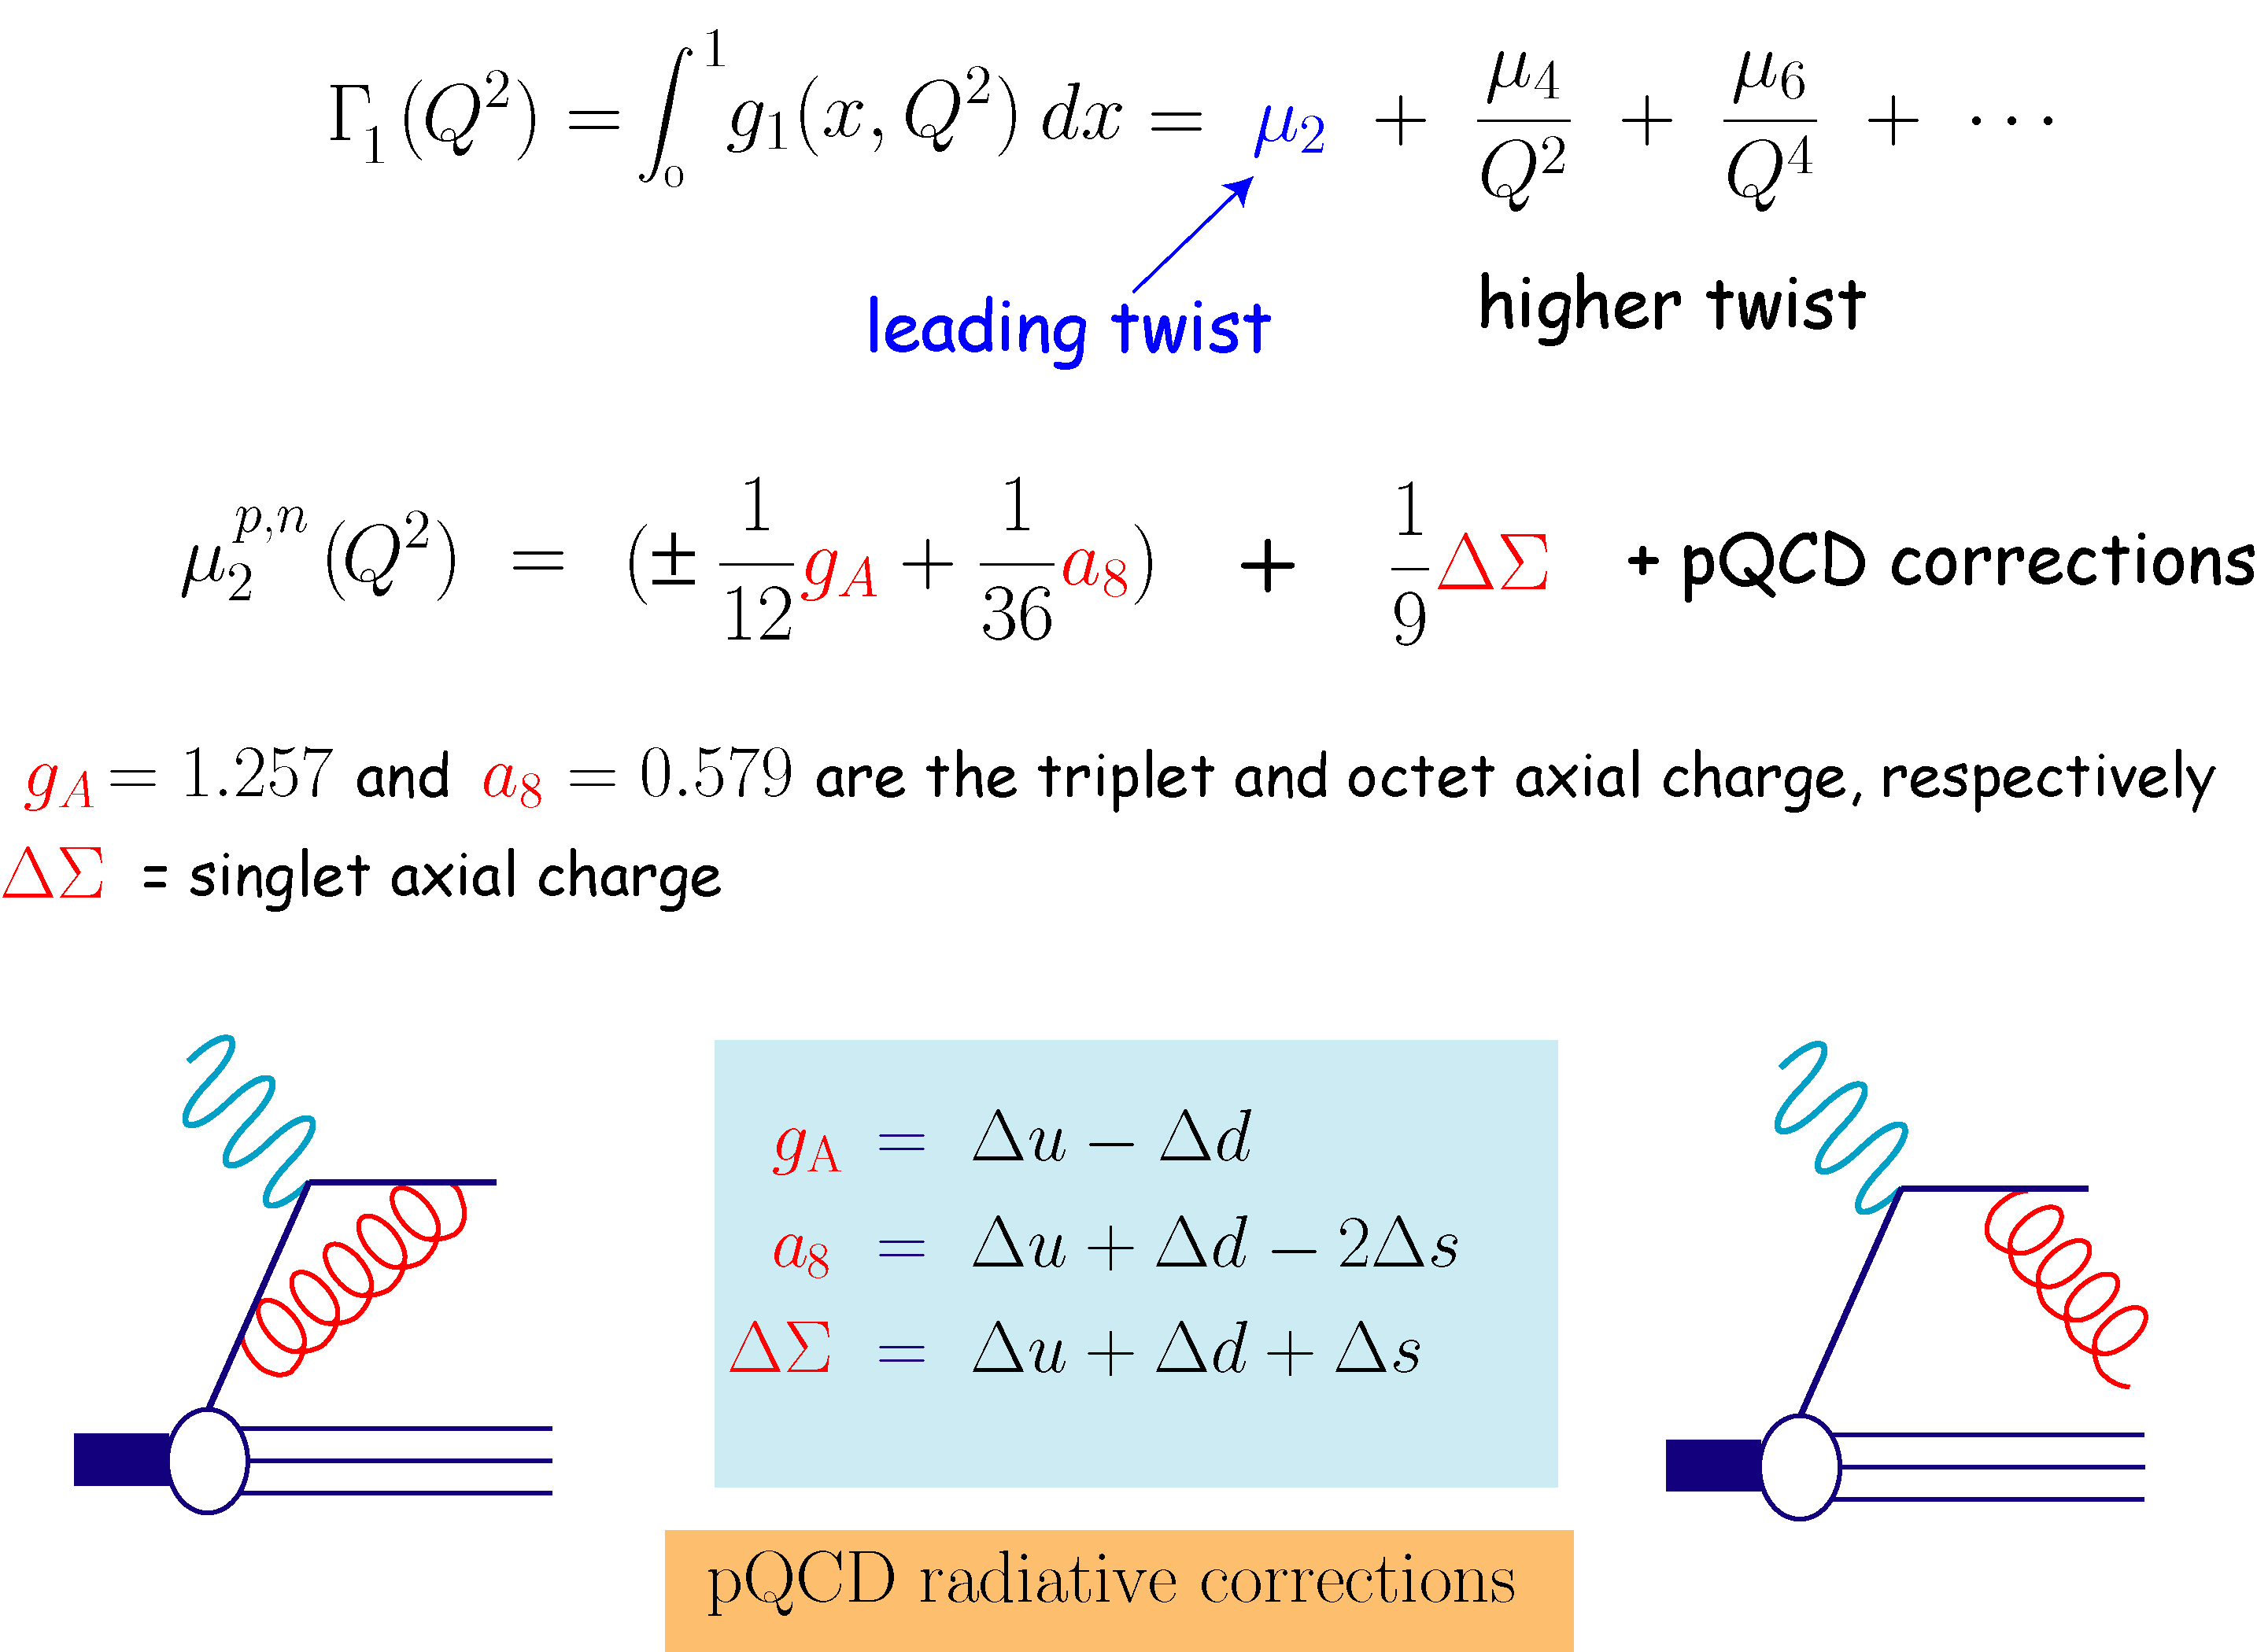
Moments of Structure Functions

Slide 15
Spin Physics at JLab
Started as early as winter 1994
  Generalized GDH experiment on the neutron approved E94-010 with A rating in Hall A.
    Q² evolution of the neutron sum from 1 GeV² to 0.1 GeV²
    Q² evolution of the Bjorken sum at lower Q² 1 GeV² to 0.1 GeV²
  Summer 1994 A₁^{n} experiment E94-101 conditionally approved no rating
  1997 back to the PAC approved with B
  back to PAC as E99-117 approved with B+
In the mean time Jaffe-Manohar and Ji write two different spin sum rules for the nucleon.
Jaffe-Manohar
Ji

Slide 16
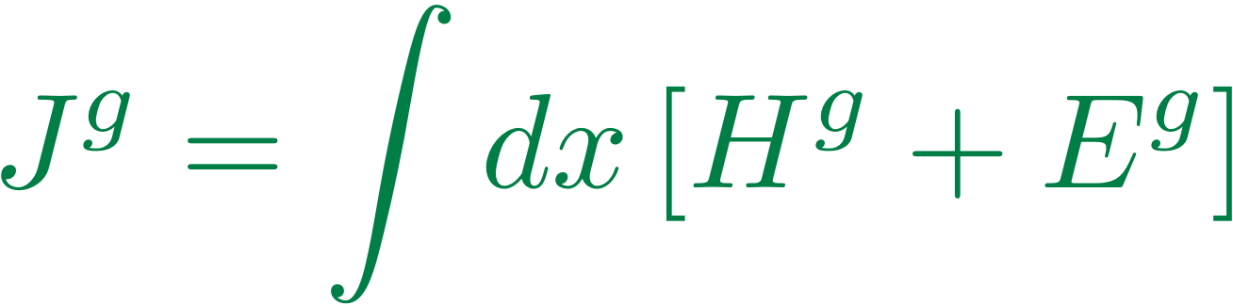
The Other View: Beyond 1-D description
Jaffe-
Manohar
(Change in OAM as quark leaves nucleon) M. Burkardt arXiv:1205.2916
Ji
DVCS, DVMP

Slide 17
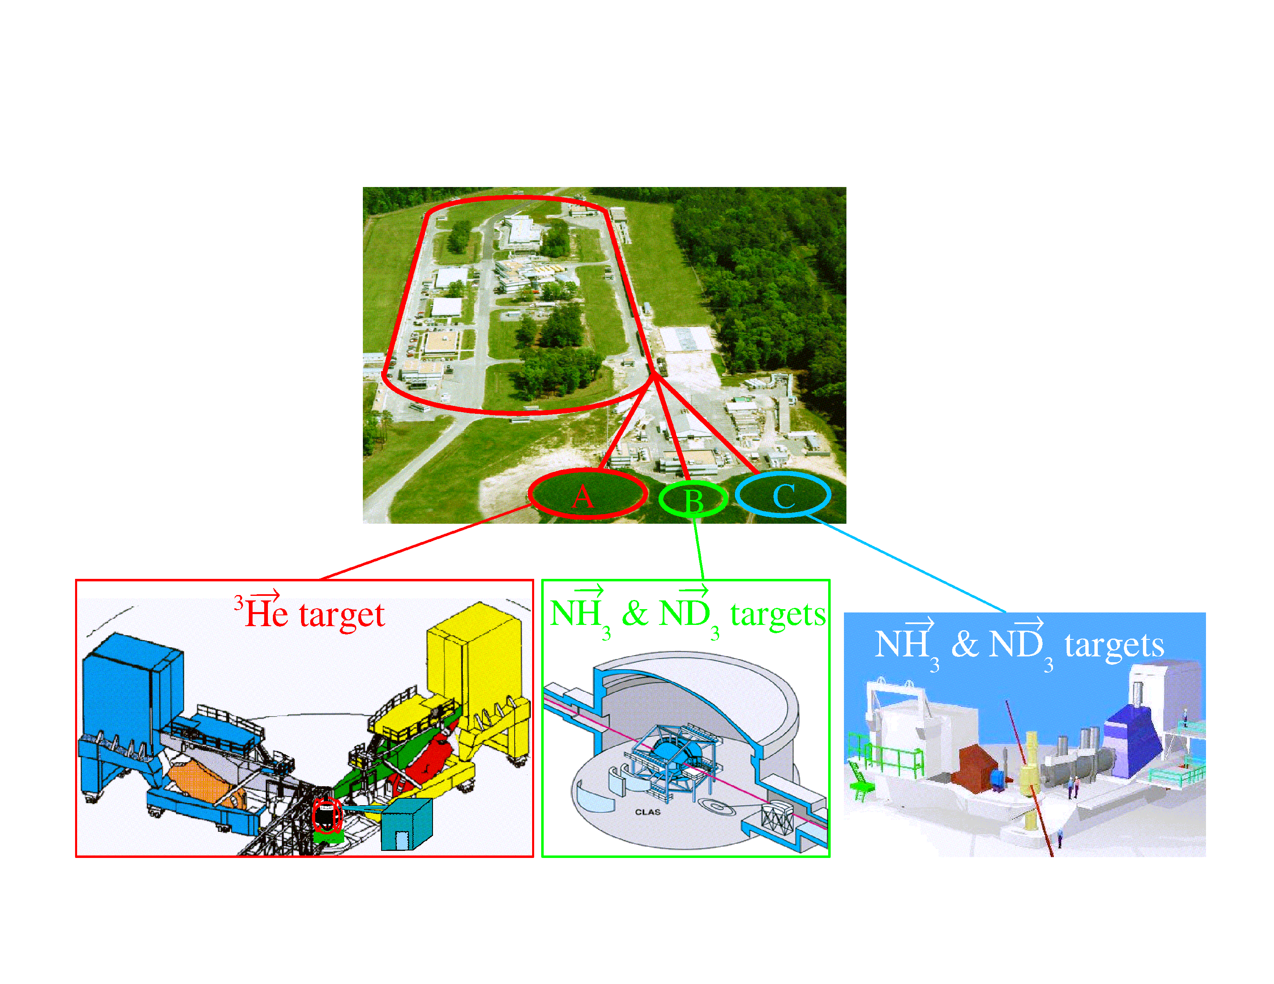
Jefferson Lab Polarized DIS experiments at 6 GeV
6 GeV pol. e beam
Pol=85%, 100μA
HallA: two HRS’ Hall B:CLAS Hall C: HMS+SOS
Luminosity~10³⁶ (cm⁻² s⁻¹ )
Luminosity up to 10³⁵ (cm⁻² s⁻¹ )

Slide 18
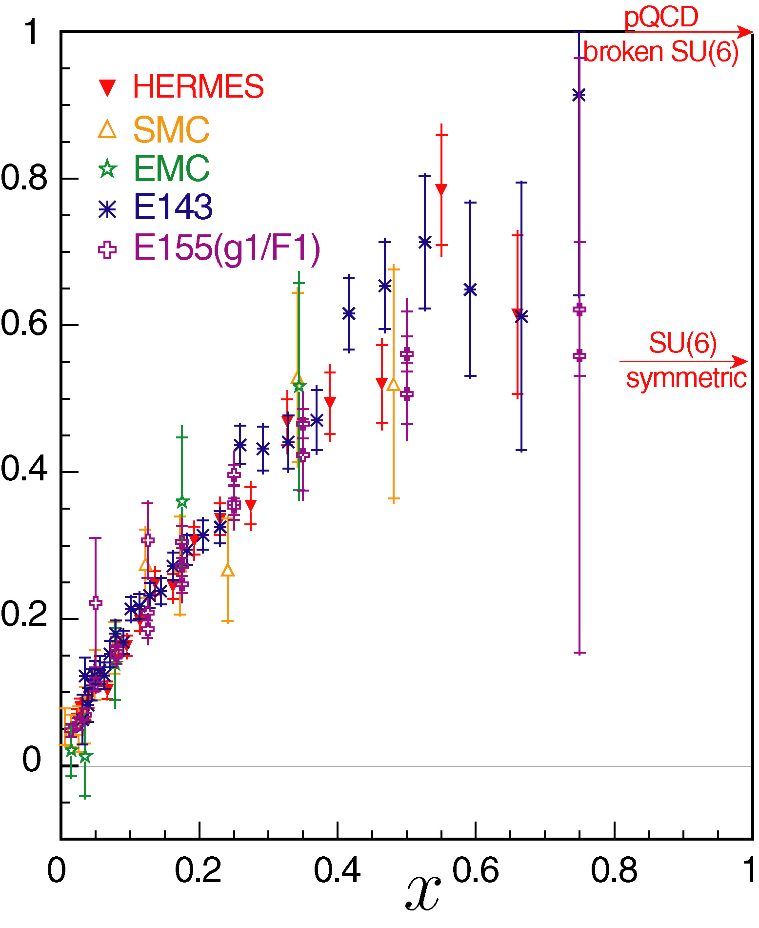
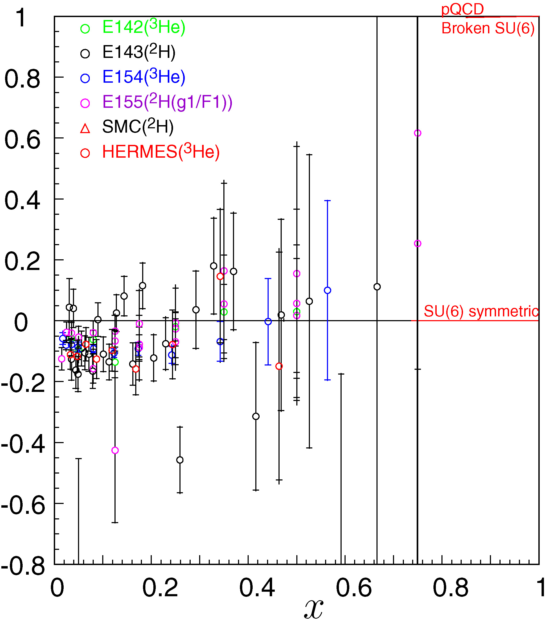
World data for A₁ & Physics Issues
Proton
Neutron

Slide 19
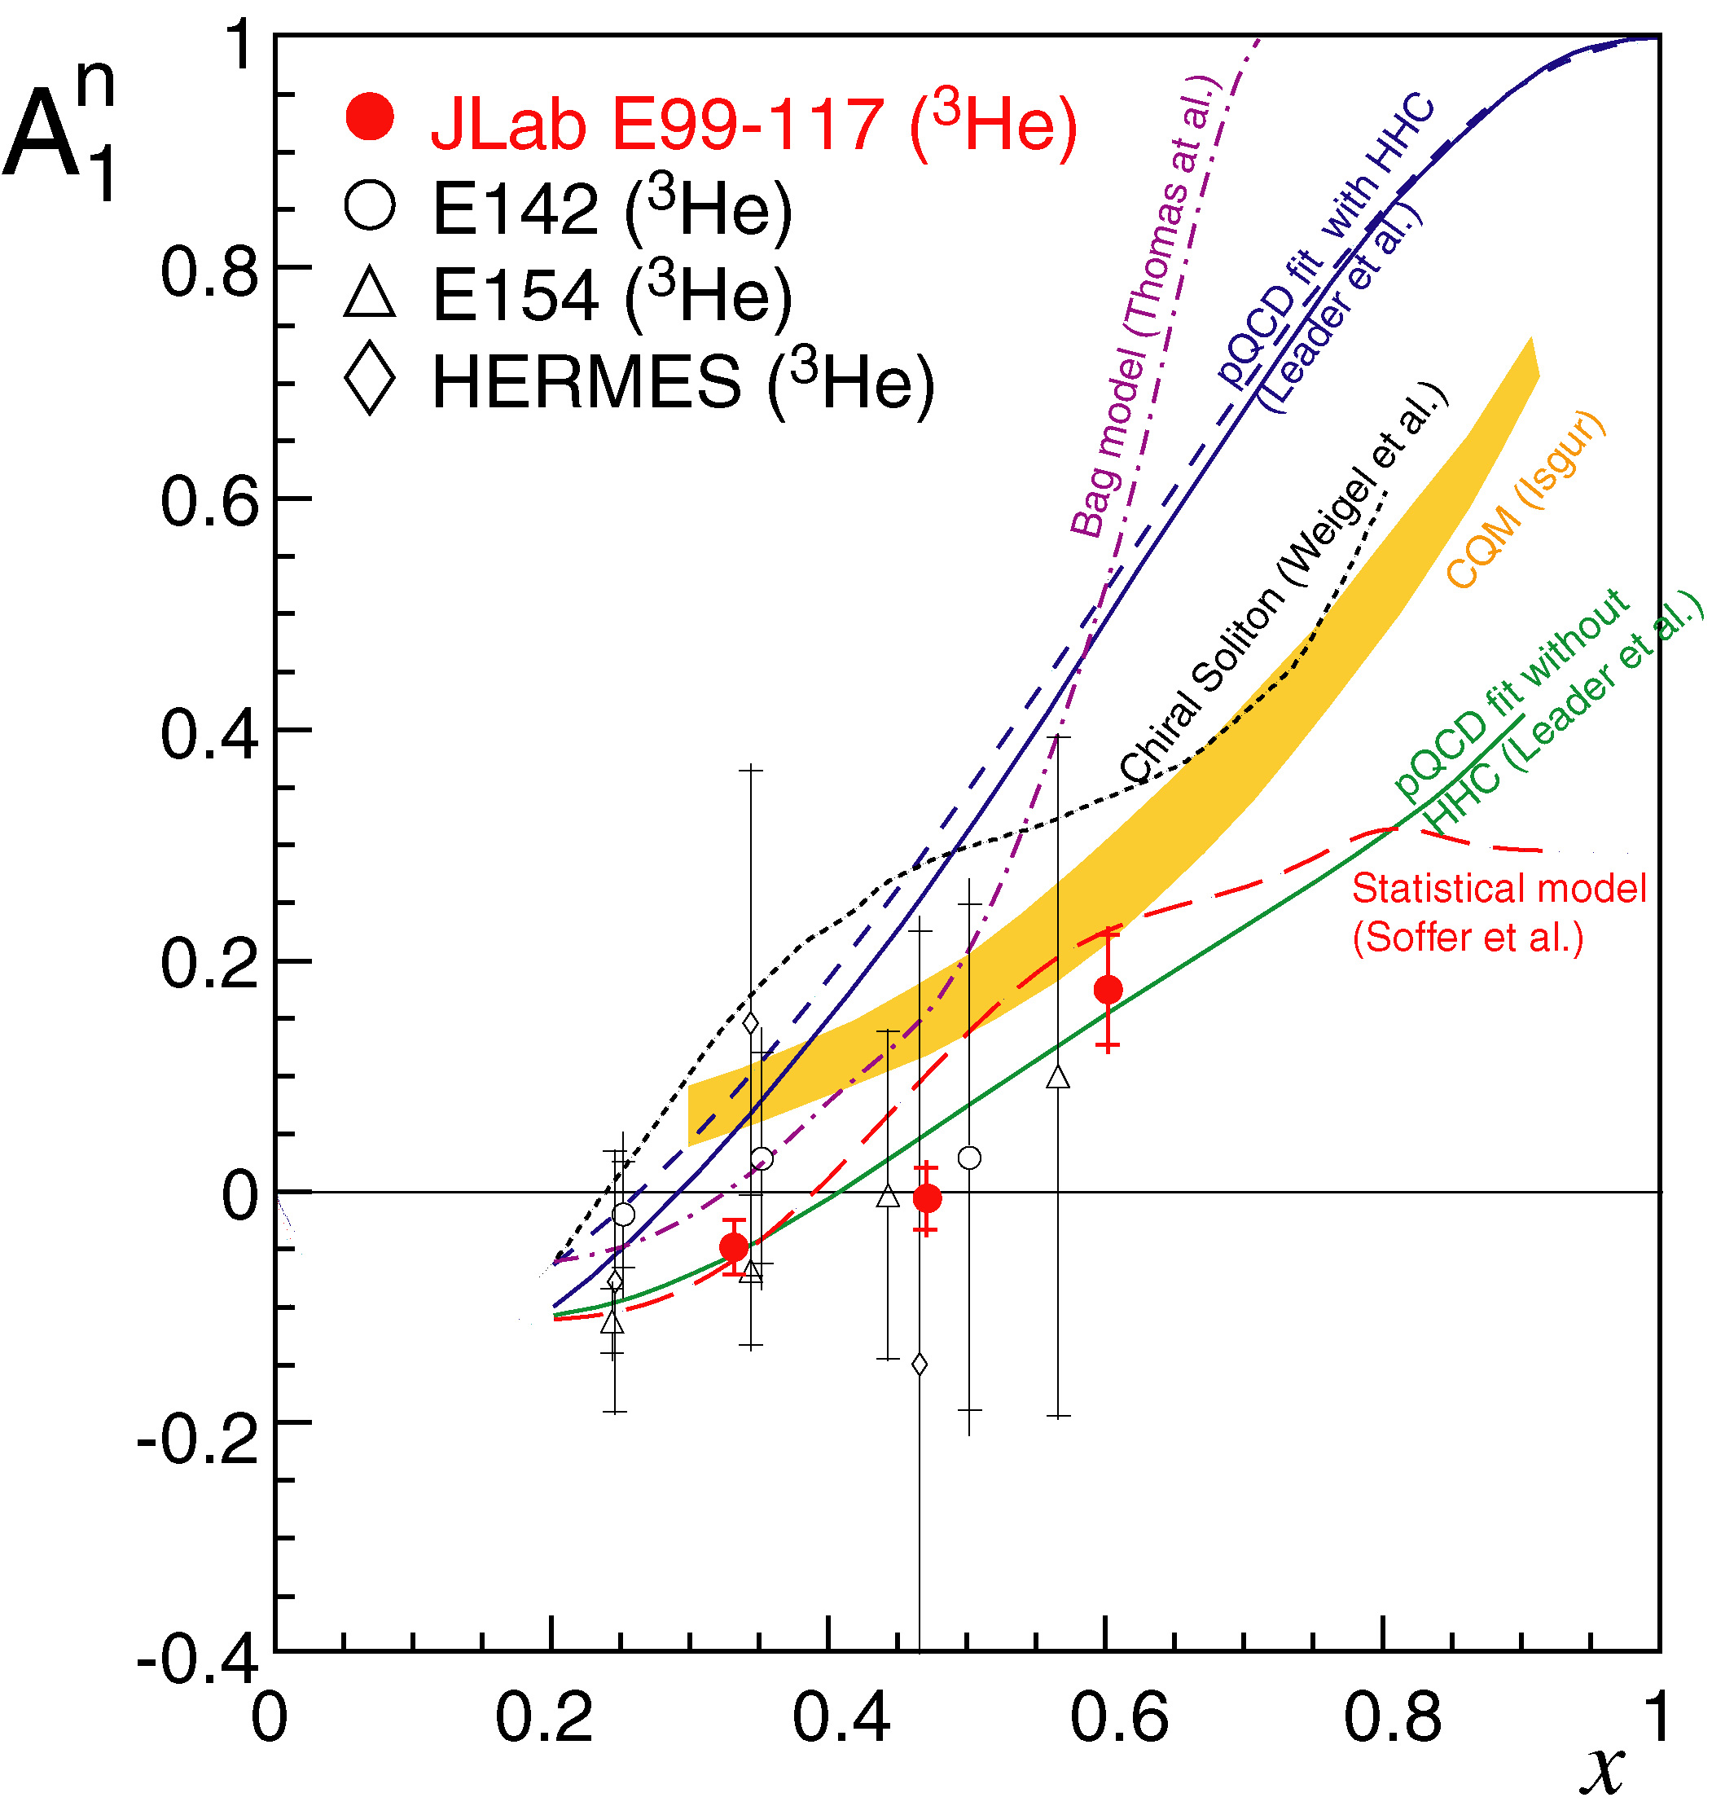
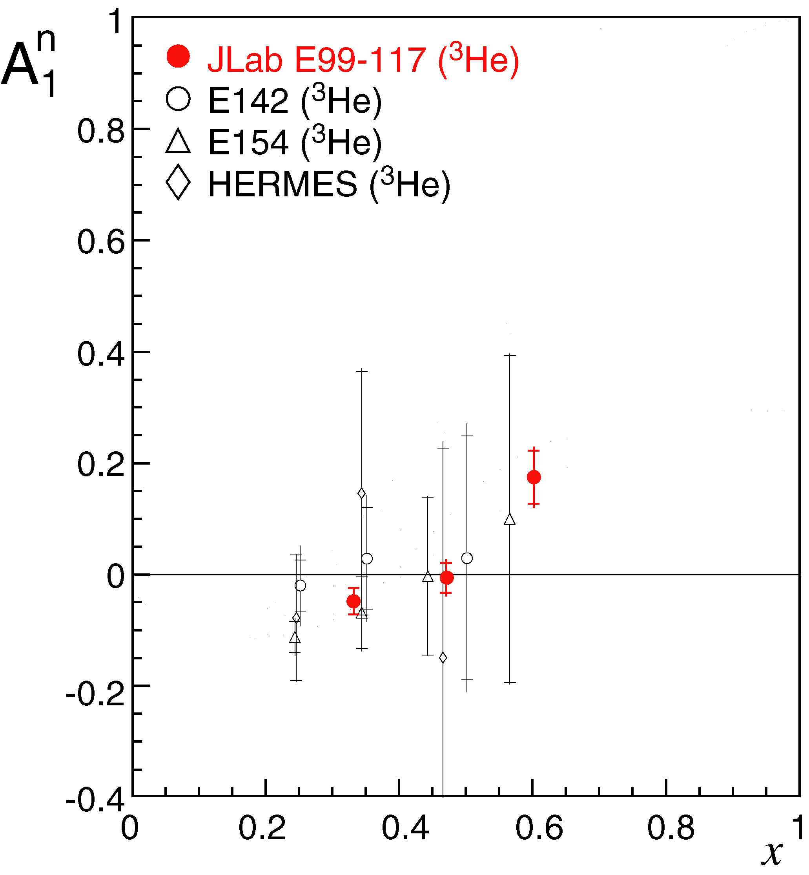
A₁^{n}
X. Zheng et al. PRL 92, 012004 ( 2004)
and PRC70, 065270 (2004)

Slide 20
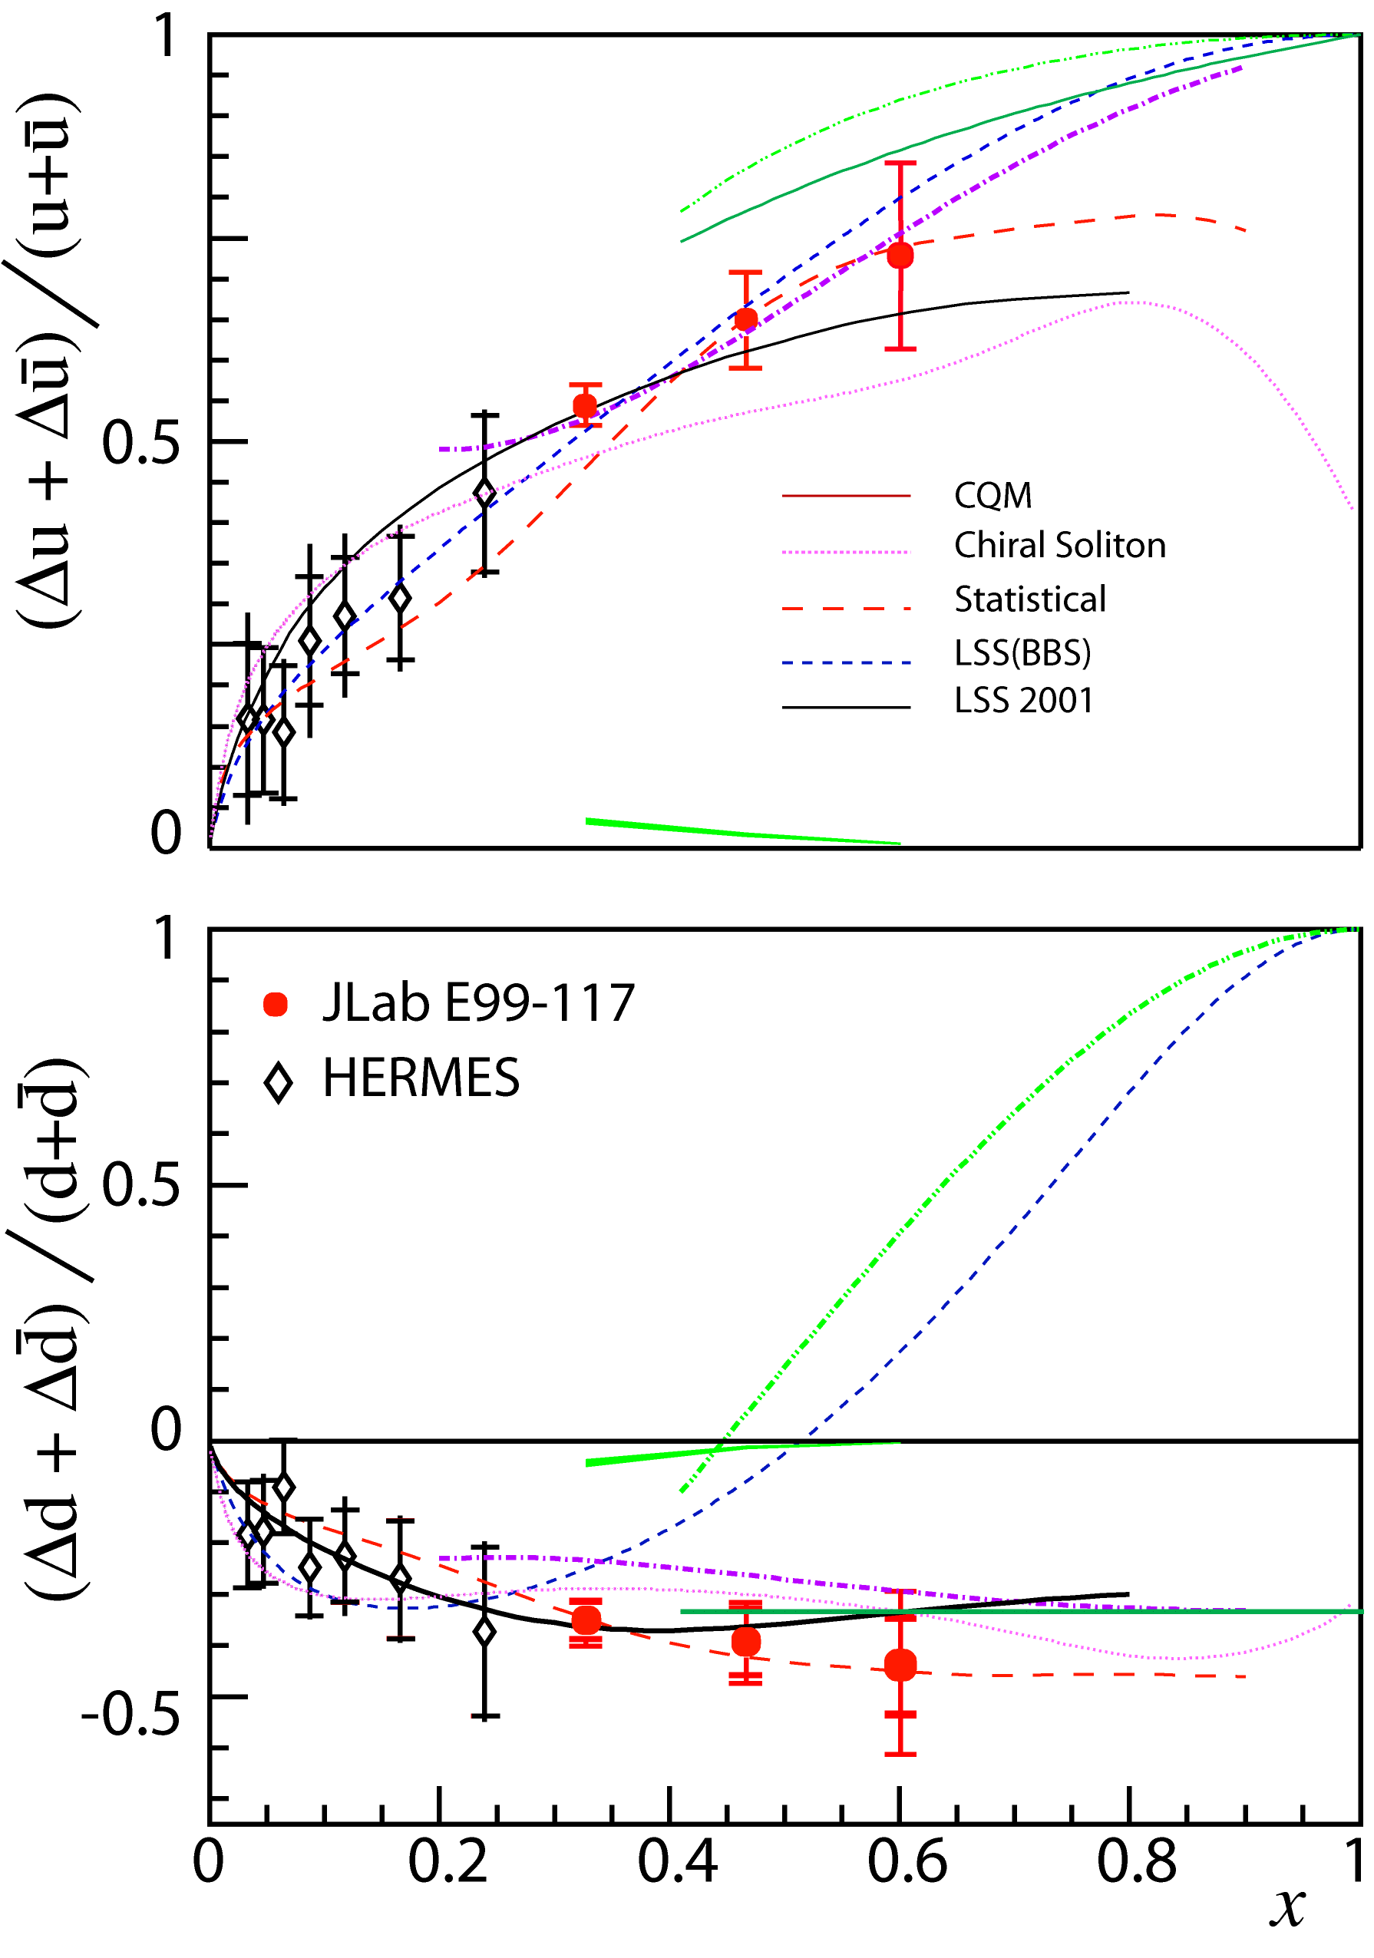
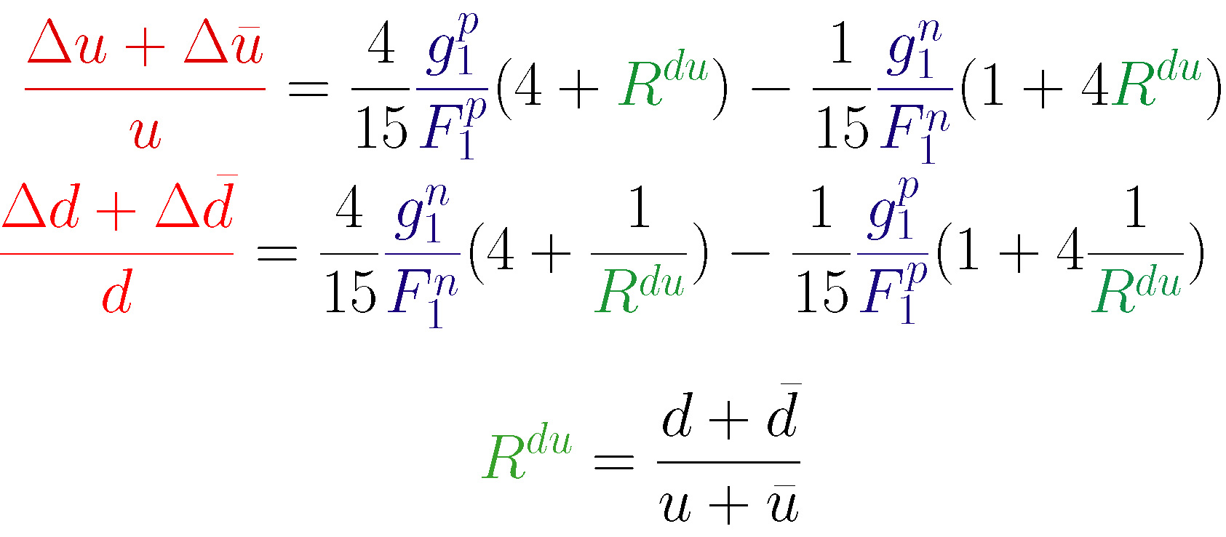
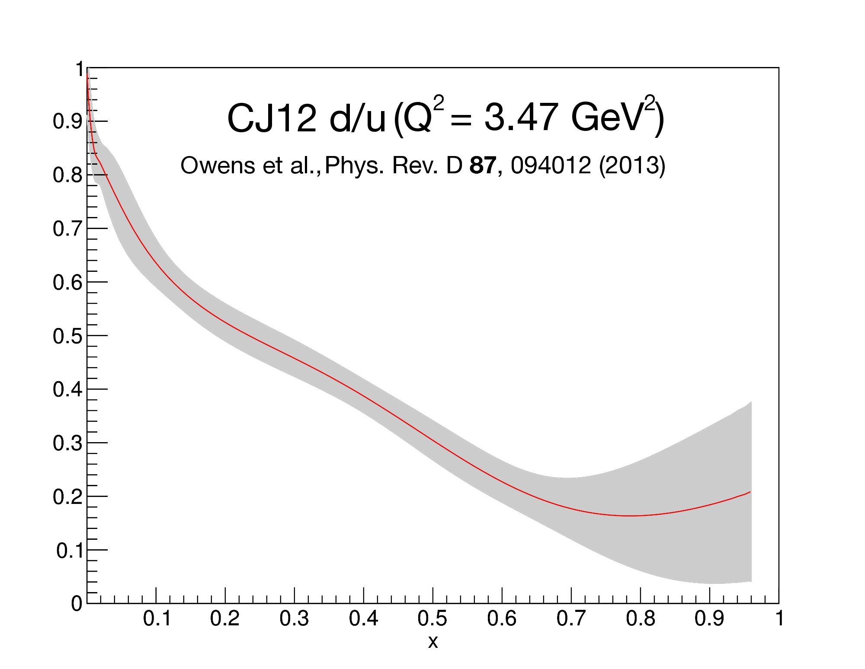
Flavor Decomposition of PDFs
Roy’s experiment ³He/³H should pin this down
X. Zheng et al. PRL 92, 012004 ( 2004)
and PRC70, 065270 (2004)

Slide 21
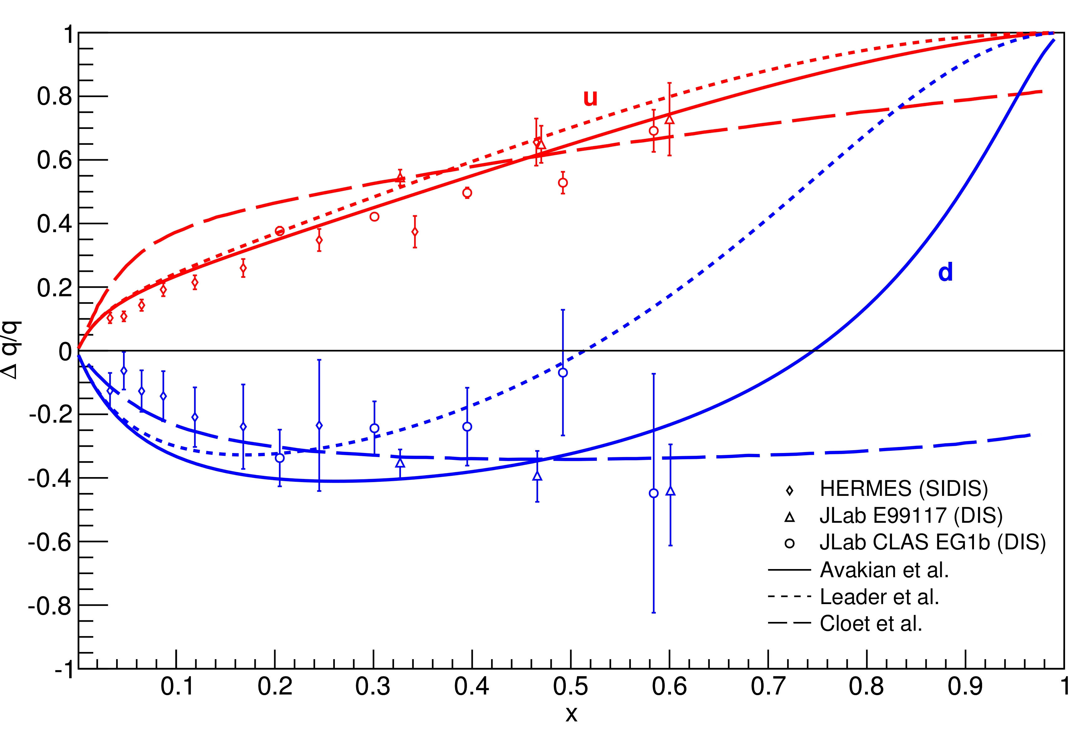


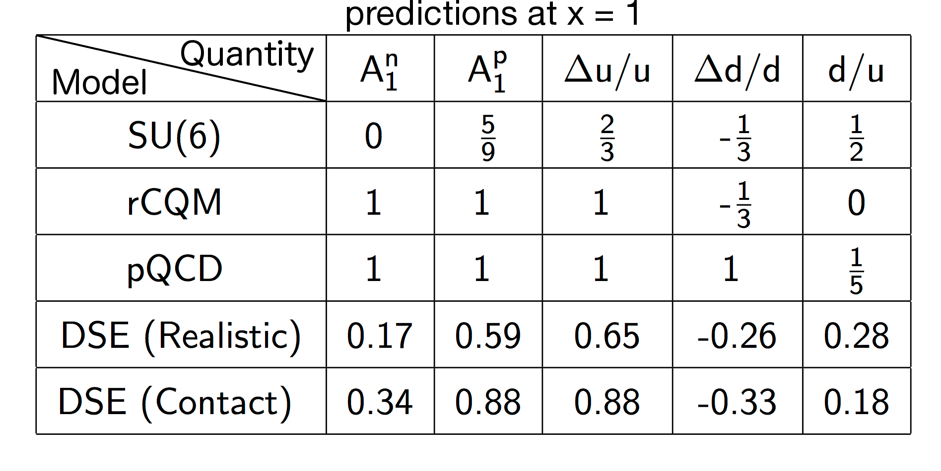
World data compared to theory
BBS
BBS+OAM
SU(6) F.E. Close, Nucl. Phys. B 80, 269 (1974)
rCQM: N. Isgur, Phys. Rev. D59, 034013 (1999)
pQCD: J. Farrar et al. Phys. Rev. Lett 35, 1416 (1975);
S. Brodsky et al., Nucl. Phys. B 441, 197 (1995)
DSE: C. Roberts et al., Phys. Lett. B727, 249 (2013)

Slide 22
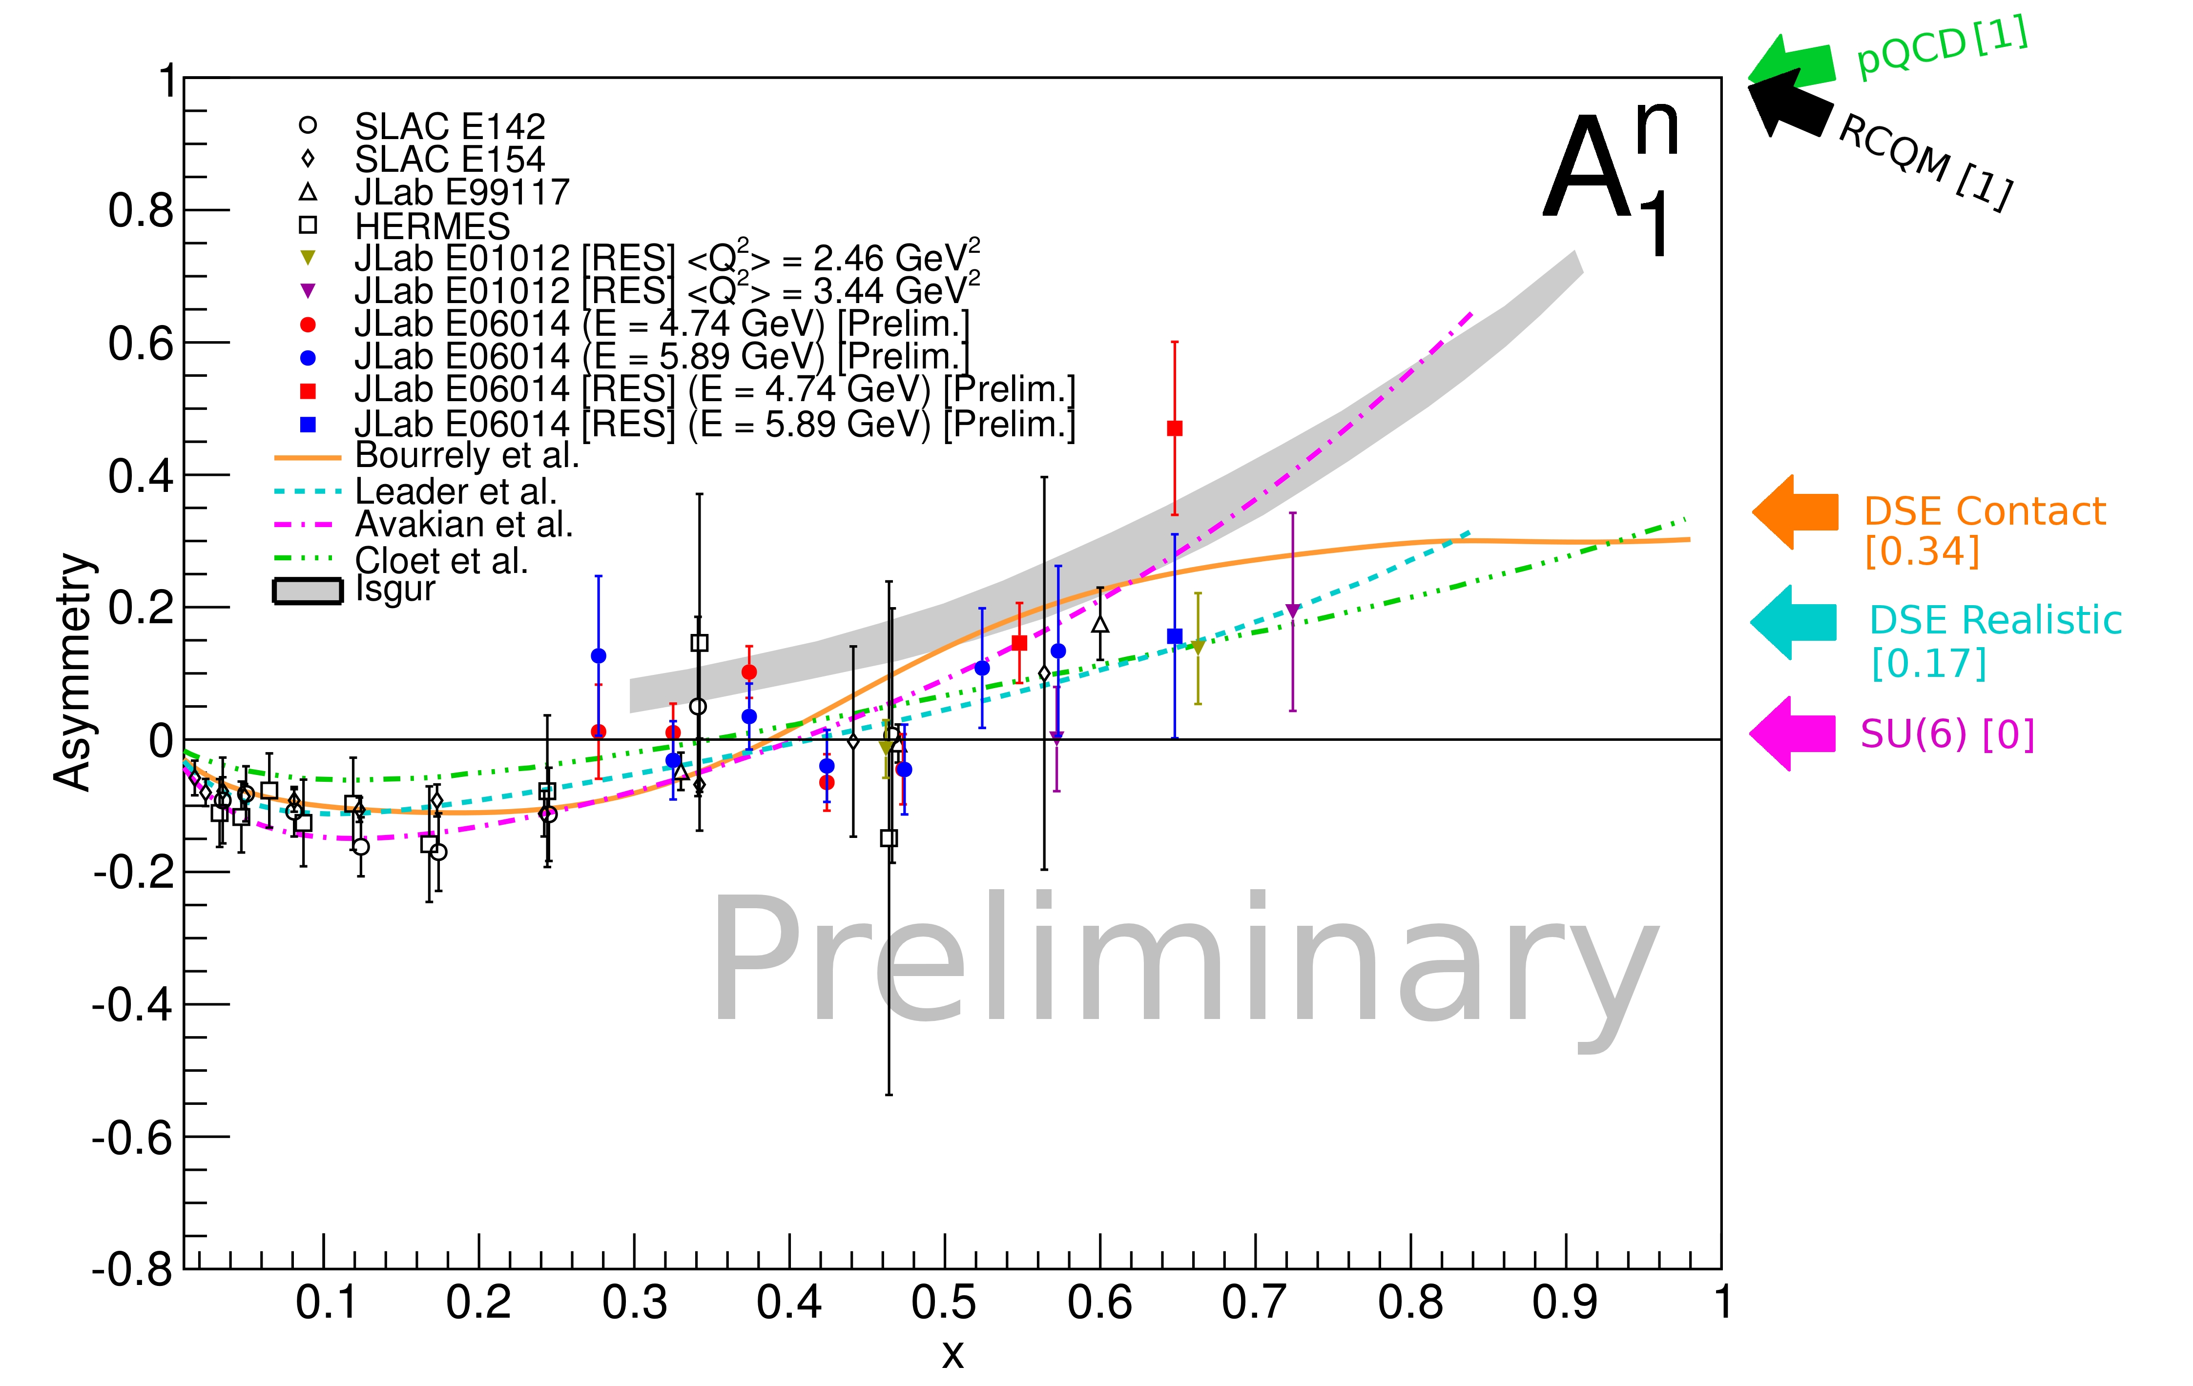
A₁^{n} extending to resonance region

Slide 23
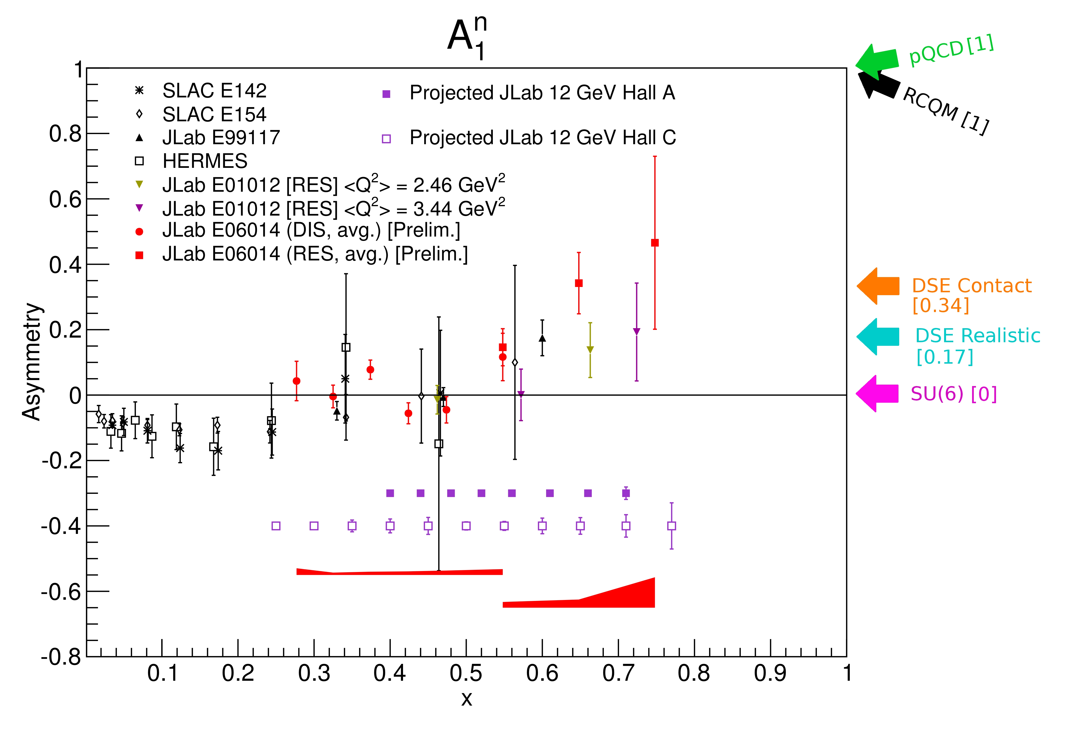
Projections for JLab 12 GeV upgrade
Use duality to extend the
x range of the measurement using the resonance region

Slide 24
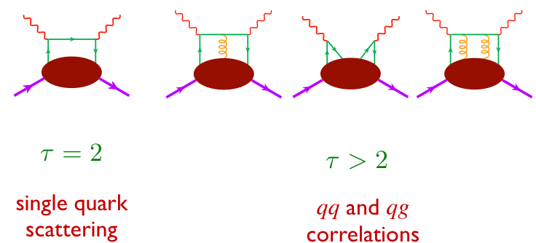
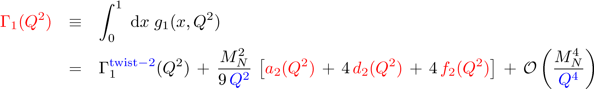
Moments of Structure Functions: Probing Color Forces

Slide 25
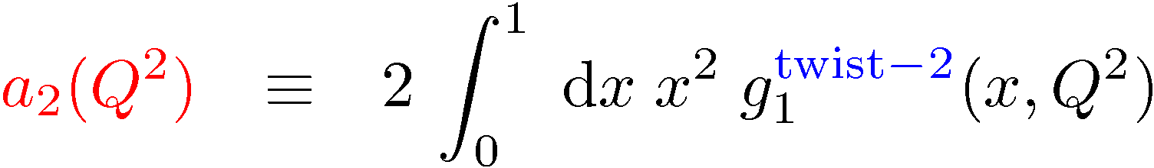
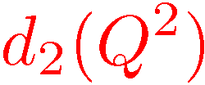
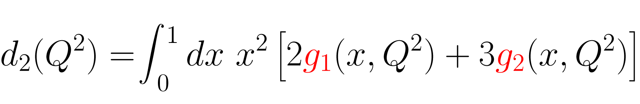
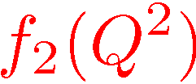
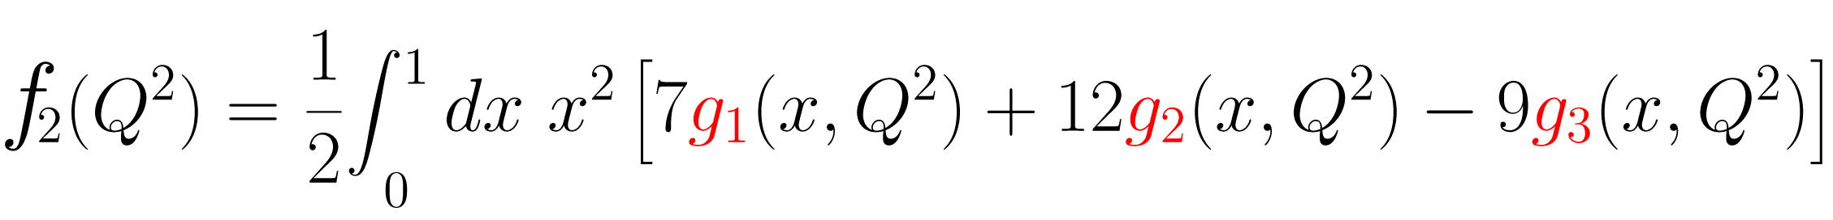
Moments of Structure Functions
target mass correction term
dynamical twist-3 matrix element
dynamical twist-4 matrix element

Slide 26
Lorentz Color Force (M. Burkardt)
M. Burkardt, Phys. Rev. D 88, 114502 (2013) and Nucl. Phys. A 735, 185 (2004).

Slide 27
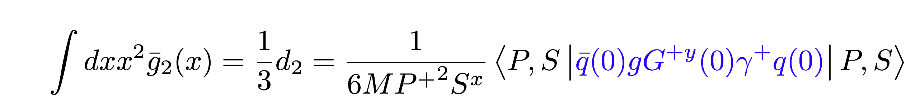
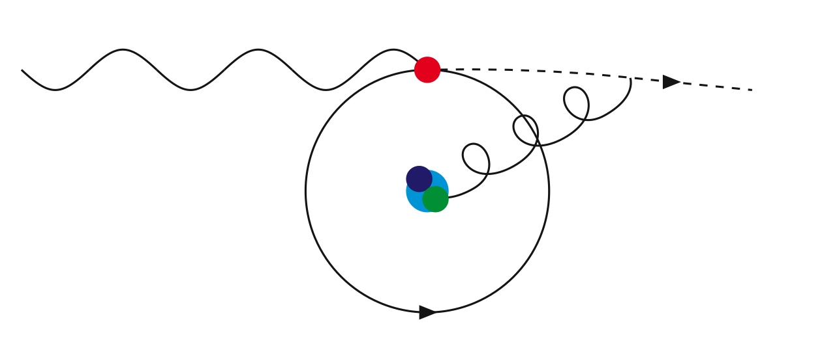

Average Color Lorentz Force (M. Burkardt)

Slide 28


The JLab E06-014 (d₂^{n}) Experiment
Polarized electron beam: E=4.74, 5.89 GeV, polarization ~ 71%
Polarized ³He target ~ 50%
HRS used for absolute cross section measurements at 45⁰
Bigbite used for asymmetries measurements at 45⁰

Slide 29



Spin Asymmetries of the Nucleon Experiment
(SANE)E07-003

Slide 30
³He g₂ structure function
M. Posik et al. Phys. Rev. Lett. 113, 022002 (2014)

Slide 31

d₂^{n} results compared to calculations
M. Posik et al. Phys. Rev. Lett. 113, 022002 (2014)

Slide 32

JLab 12 projection of d₂^{n} Planned in Hall C

Slide 33




Extraction of the twist-4 matrix element
Notes:
ADD THE VALUE OF DELTA SIGMA
ADD

Slide 34

Color forces in the neutron
The electric and magnetic average color forces in the neutron are about equal and opposite
A new measurement of the proton is needed to perform a flavor tagging of the force.
A lattice calculation of f₂ is still missing?!

Slide 35


What about Spin Physics at an EIC
The EIC – the decisive measurement (1st year of running):
(Wide Q², x including low x range at EIC)
w/EIC data
Before/after
No other machine in the world can achieve this!
Solution to the proton spin puzzle:
Precision measurement of ΔG – extends to smaller x regime
Orbital angular momentum – motion transverse to proton’s momentum

Slide 36



Spatial imaging of gluons
Need Form Factor of density operator:
Exchange of a colorless “object”
“Localized” probe
Control of exchanged momentum
Exclusive vector meson production:
Q
J/Ψ, Φ, …
Fourier transform of the t-dep
Spatial imaging of glue density
Resolution ~ 1/Q or 1/M_{Q}
t-dep

Slide 37

Spatial imaging of gluon density
Gluon imaging from simulation:
Images of gluons
from exclusive
J/ψ production
Only possible at the EIC: From the valence quark region
deep into the sea quark region

Slide 38
Summary
1-dimensional studies of the nucleon need to be completed.
3-dimensional mapping of the nucleon structure has just begun allowing for the determination of the orbital angular momentum of partons as well as the correlations between spin and confined motion.
Near-term studies: JLab 12 GeV upgrade, COMPASS Emphasis will be on quarks’ orbital angular momentum
Long-term studies: Future EIC emphasis will be on the glue

